Slide 1
Iowa State University Extension and Outreach: State Science and Technology Fair of Iowa
Future Ready Iowa Summit 2022

Slide 2


Alexa Groff
STEM Coordinator
SSTFI Director
Dr. Sara Nelson
State STEM Specialist
Interim Director NASA ISGC
ISU School of Education

Slide 3

Notes:
Iowa State University is focused on educating the next generation.
Iowa State University Extension and Outreach is very much a part of the university, but we have more of a singular focus – building a strong Iowa.
We do this by connecting with Iowans in every county, sharing the research-based education, support, and resources of Iowa State University to make their families, farms, and businesses stronger.
Because when you are strong, we all are strong.

Slide 4
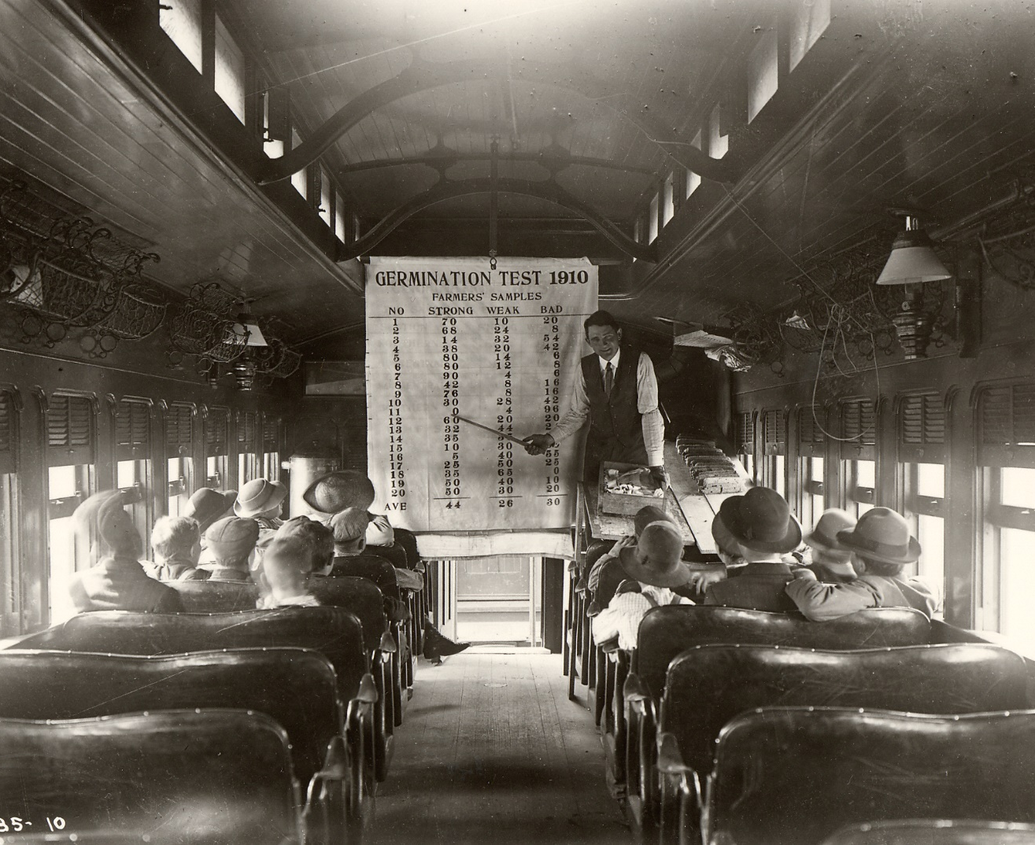
It’s Our
Land-Grant Mission
ISU Extension and Outreach takes the university’s research-based education to all Iowans
1862’s Morrill Act granted land to establish “people’s colleges”
ISU became the first statewide extension service in 1906
Professor Perry Holden’s “Seed Corn Gospel Train”
Notes:
Iowa State University Extension and Outreach takes the university’s education and research to Iowans out into the communities where they live and work. That’s the land-grant mission – sharing Iowa State’s knowledge beyond campus borders.
It all started in 1862, when President Abraham Lincoln signed the Morrill Act into law, offering the sale of acres of land to establish land-grant colleges to serve as “people’s colleges.”
Iowa pioneered the first statewide extension service in 1906, committing to actively transfer research and expertise to every corner of the state.
Pictured here is Professor Holden taking his corn short course on the road, via the “Seed Corn Gospel Train” – 50 stops, reaching about 30,000 Iowans.

Slide 5
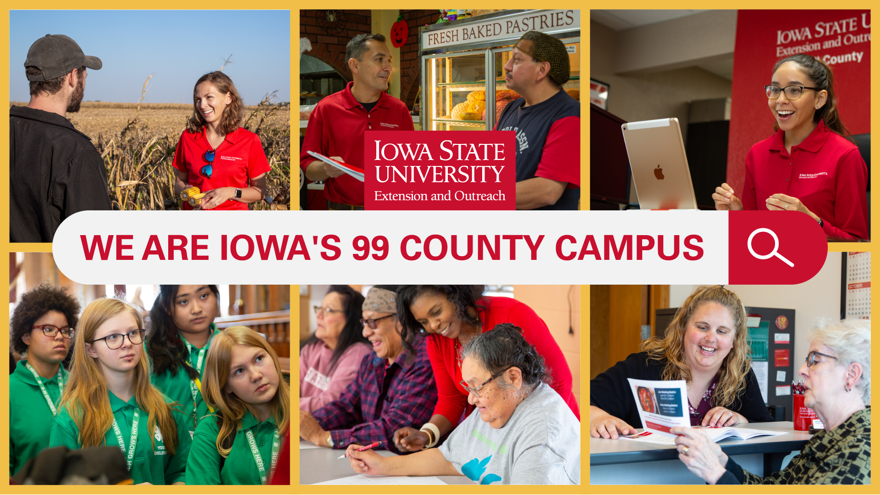
99-county campus video
Notes:
What do we do in these 99 counties? This video may help explain it a bit more.
LINK to video: https://youtu.be/JryNcG3TIoI
(note: click the graphic in presentation mode, and it will link to the video on YouTube)

Slide 6
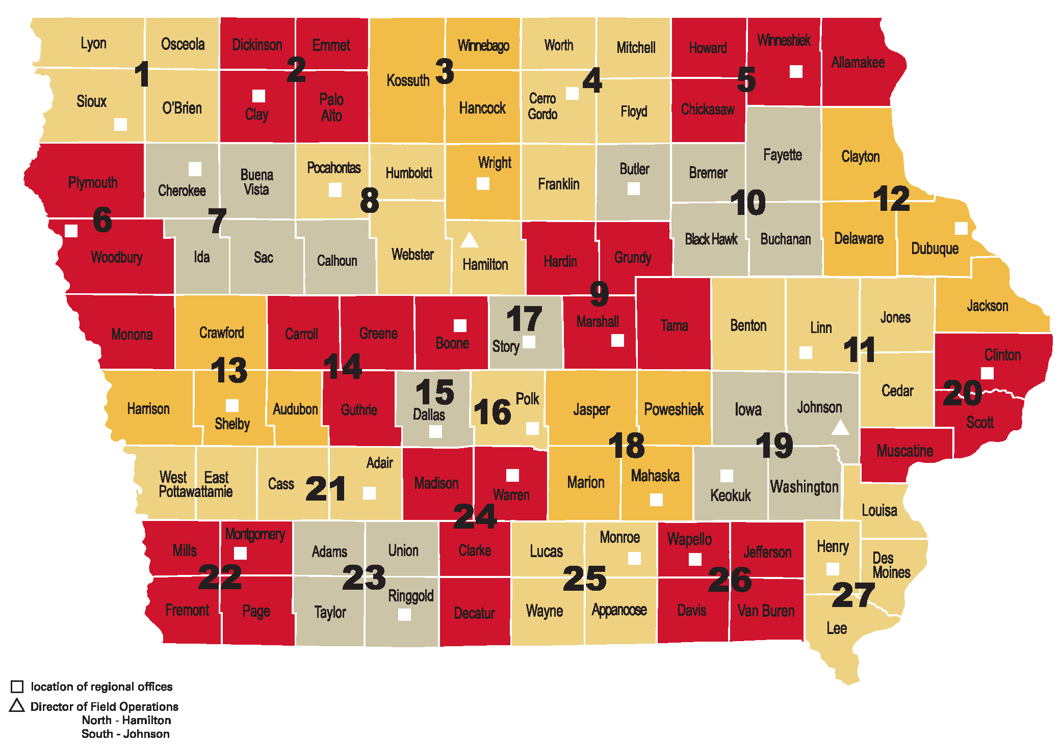
99 County Campus
1,200 faculty and staff
900 elected officials
100 county offices
Notes:
TODAY, you won’t see us on trains as much. We deliver that research-based education through offices located in each of our 99 counties – with TWO in Pottawatamie.
That’s 100 Extension and Outreach offices, comprising a community-based network to bring you and all Iowans access to Iowa State University research, education, support, and resources. This network is made possible
by partnerships with federal, state, and county governments.
Who makes it happen? It is our people. On our 99-county campus, you’ll find:
1,200 staff and faculty, located on campus in Ames as well as throughout the counties
900 elected county extension council members
100 county extension offices
Staff who are part of our statewide hotlines where Iowans find answers to physical and mental health, family, home, financial, legal, and other questions.

Slide 7
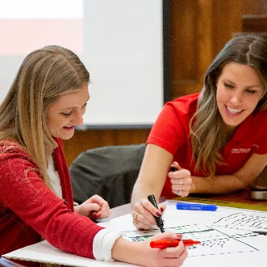
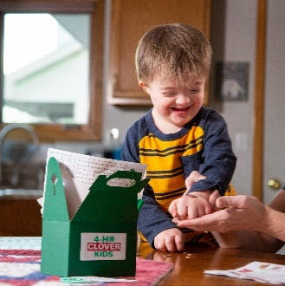
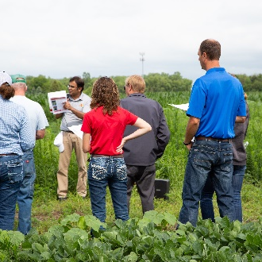
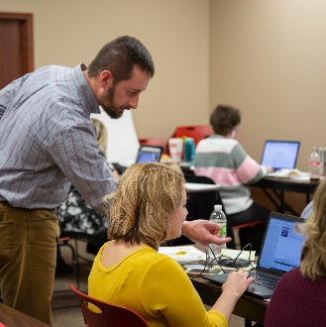
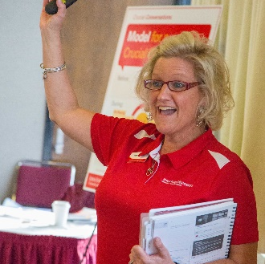
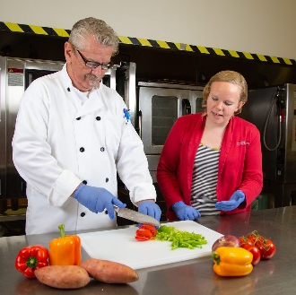
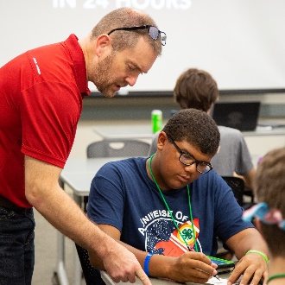
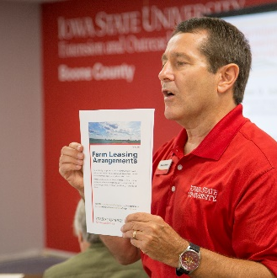
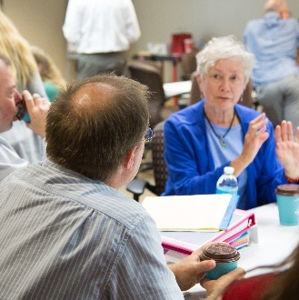
More Than 1 Million
People Benefit Each Year
One million contacts
Millions more access web resources
1 in 5 youth reached
8,000 volunteers
Hotlines for free, 24/7 confidential support and referrals
Notes:
We connect YOU with Iowa State University’s academic programs and scientists in many ways.
Each year more than a million people benefit from Extension and Outreach educational programs.
Millions more access our websites and online educational materials and courses
More than 100,000 youth participate in 4-H programs. That’s one in every five Iowa youth.
In addition, more than 8,000 Iowans volunteer with us, increasing our reach throughout the state.
Hotline support includes Iowa Concern and Iowa 2-1-1 – available 24/7
We focus on specific issues and provide educational programs that are relevant, needs-driven, and have the potential to make a significant difference to Iowans.

Slide 8
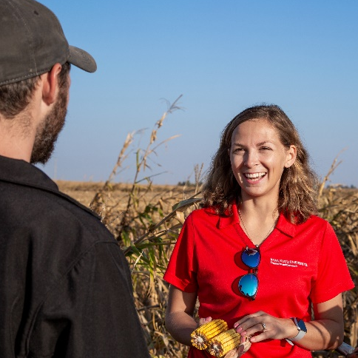
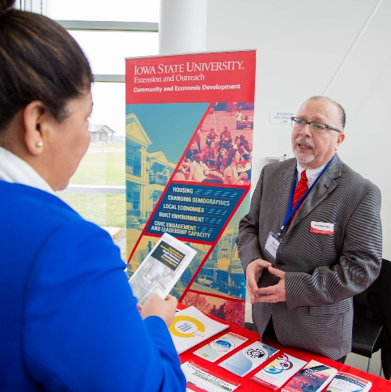
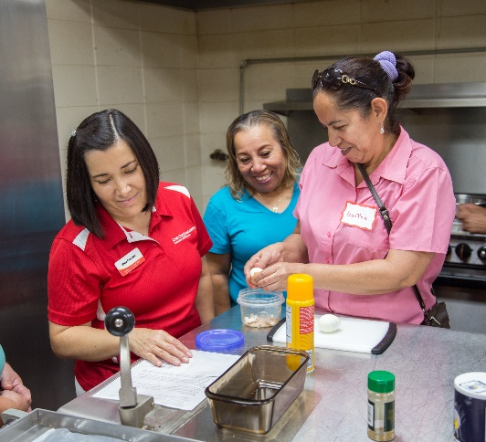
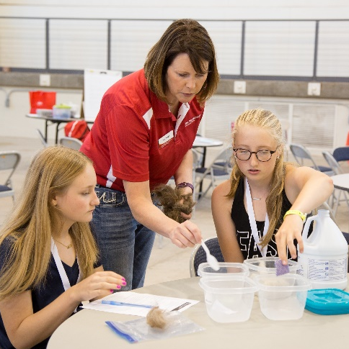
Four Program Areas
Agriculture and Natural Resources Improving water quality, producing crops and livestock sustainably, and strengthening rural economies.
Community & Economic Development
Bringing local people together to make their communities better places to live and work.
Human Sciences
Helping Iowans build strong, resilient families, and communities with education related to family, food, finance, and well-being.
4-H Youth Development
Preparing young people for college and careers, and to contribute to society.
Notes:
ISU Extension and Outreach provides research-based education and engages Iowans in solving today’s problems and preparing for a thriving future. Through our four program areas, we are building a strong Iowa.
Farmers, policy makers, regulators, and agribusiness professionals participate in Agriculture and Natural Resources learning opportunities. They gain research-based education to inform their decisions, which leads to a sustainable agriculture and environment.
Community and Economic Development specialists provide skills training for community leaders, local government officials, business owners, entrepreneurs, and volunteers.
Our Human Sciences programs help Iowans throughout their lifetimes to build strong relationships, families, and communities … with education related to family, food, and finance, and focused on well-being.
4-H Youth Development engages Iowa youth in educational experiences on the Iowa State campus and in their counties, helping young people build STEM, communication, leadership, and other skills. They will be ready to pursue higher education and careers and become Iowa’s next generation of leaders.

Slide 9
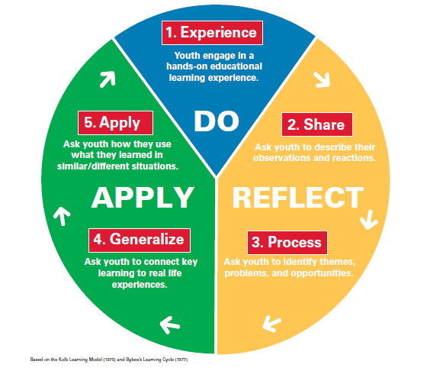
Research Base for All Youth Programming
DO: Children engage in a hands-on experience.
REFLECT: Children reflect on the experience and the concepts presented.
APPLY: Children apply learning to real life experiences and similar/different situations.

Slide 10

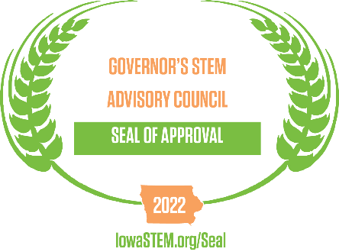
State Science & Technology Fair of Iowa
March 30th & 31st, 2023
Hilton Coliseum, Ames

Slide 11

State Science and Technology Fair of Iowa

Slide 12
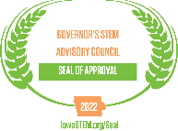
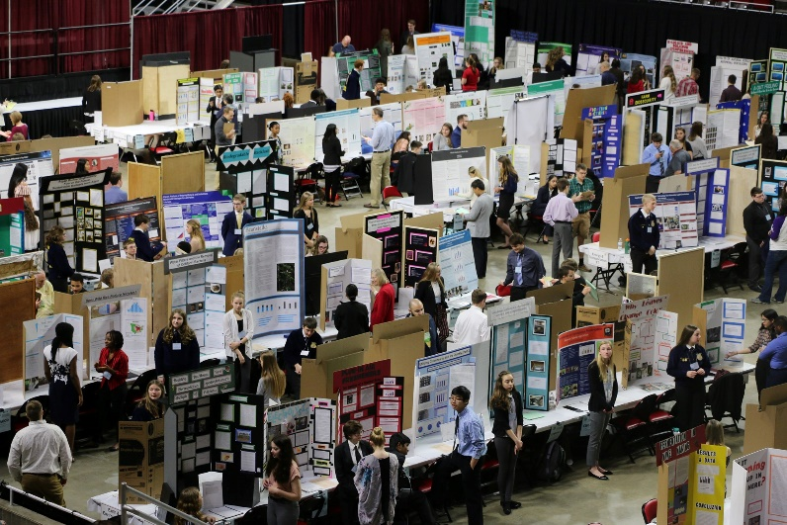
What is SSTFI?
Largest STEM Competition in Iowa
Program of Iowa 4-H
Recipient of the Governor’s STEM Seal of Approval
Youth complete STEM research projects to compete
  15 categories
  Must create an experiment and collect data

Slide 13














Categories of Research
Animal Science
Behavioral & Social Sciences
Biochemistry
Biomedical & Health
Cellular & Molecular Biology
Chemistry
Computer Science
Earth & Environmental
Engineering
Energy & Transportation
Mathematics
Microbiology
Physics & Astronomy
Plant Science
Robotics & Intelligent Machines

Slide 14
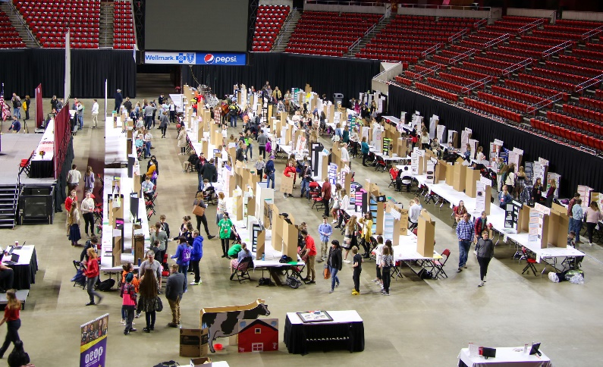
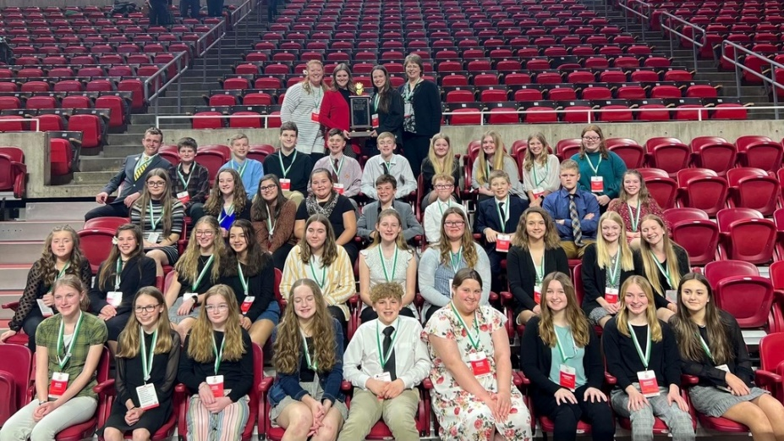
Who?
ALL Youth in 6-12th Grade
WhERE?
Hilton Coliseum in Ames

Slide 15


Slide 16
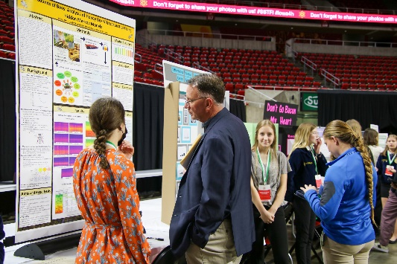
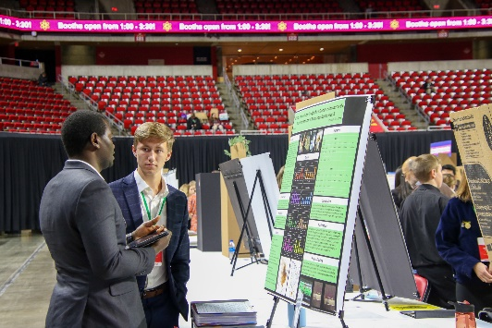
Ways to Become Involved?
Teachers/Mentor
  Encourage youth in STEM research
  Creating real world problem solvers, critical thinkers, high level questioning, tomorrow’s future leaders!
Business Partners
  Interact with youth by Judging
  Partnerships with SSTFI
    Scholarships
    Internships
    Special Awards
    Sponsorship

Slide 17
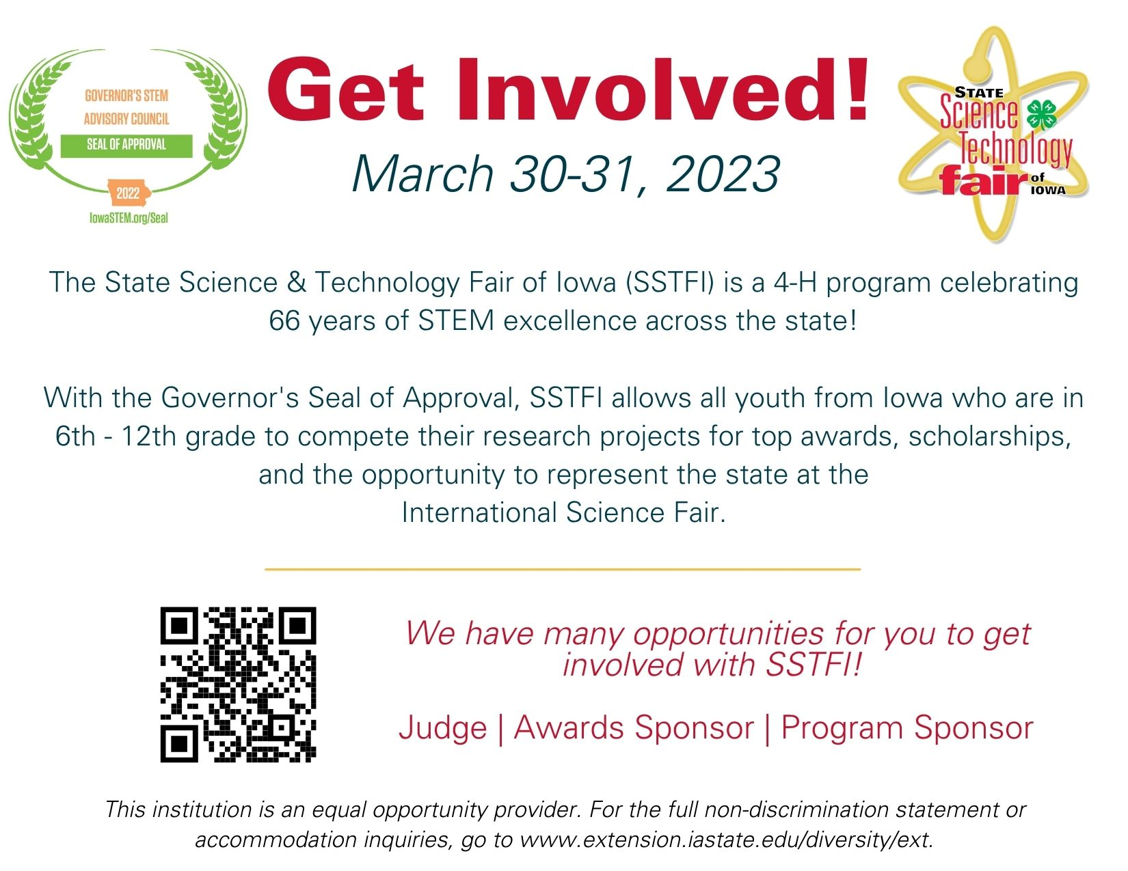

Slide 18
JOIN US WWW.EXTENSION.IASTATE.EDU
Questions?
Sara Nelson sdnelson@iastate.edu
Alexa Groff agroff@iastate.edu
This institution is an equal opportunity provider. For the full non-discrimination statement or accommodation inquiries, go to www.extension.iastate.edu/diversity/ext.

