Slide 1
K-16 MENTORING for College Access and Success
September 21, 2022
Christina Sibaouih, Iowa College Aid
Mary Sheka, Iowa MENTOR
Jason Wiegand, Iowa MENTOR

Slide 2
TODAY’s FOCUS
Connect
Connect with Iowa MENTOR and Iowa College Aid
Provide
Provide an overview of mentoring and positive outcomes
Increase
Increase knowledge about Future Ready Iowa Mentoring programs
Identify
Identify opportunities for involvement with mentoring
Notes:
Youth-serving organizations

Slide 3
Iowa MENTOR
Notes:
Iowa MENTOR offers several services and resources for our many mentoring programs throughout the state. One of our primary purposes is to help service and assist mentoring programs by providing technical assistance, resources, support, and trainings to our mentoring professionals.

Slide 4
MISSION and VISION

Slide 5
VOLUNTEER IOWA
Building volunteer capacity
National Service opportunities
State agency with connections to resources
Operational capacity for Iowa MENTOR
Vision: To create an Iowa where all citizens are empowered through service to meet community challenges and make lives better.
Notes:
Volunteer promotions campaign
Initiative of Volunteer Iowa
Org within an org within an org
Volunteering and AC programs support variety of volunteering opportunities
We support a specific type of volunteering. We are the experts on youth mentoring in Iowa.

Slide 6
PART OF A NATIONAL MOVEMENT
Affiliates of MENTOR National:
Non-partisan, public-private organizations
that galvanize local or statewide mentoring movements
Clearinghouse for training, resources, public awareness and advocacy
Link to local organizations and programs that foster and support quality mentoring relationships
Inform and distribute research and resources
Notes:
26, mostly nonprofits, powerful network across the country and our colleagues are a great resource
MAAC- voice for rural midwest

Slide 7
IOWA MENTOR PROGRAM PARTNERS
PROGRAM RESOURCES ​
PROGRAM PARTNERS | CERTIFIED PROGRAM PARTNERS:
Training and Technical Assistance
Networking
Referrals
Advocacy
Background Checks
Funding
Mentor Recognition
Notes:
Iowa Mentor strives to expand the network of quality mentoring programs that help build brighter futures for children and youth. Certification with the IMP provides support to youth mentoring programs across the state and affiliation with the network of quality programs. The IMP utilizes a process for certification through the National Quality Mentoring System (NQMS), based on the Elements of Effective Practice For Mentoring.
The National Quality Mentoring System (NQMS) provides a structured, systematic process for assessing the quality of a mentoring program’s practices in alignment with the Elements of Effective Practice for Mentoring™, Fourth Edition (EEPM).

Slide 9
Training and Consulting Support
PROGRAM RESOURCES
Monthly Training Webinars
Trauma Informed Care
Organizational Development
Mentoring structure
Relationship Centered Schools/SEL
White Saviorism
Mentoring specific
Annual Convening of Mentoring Professionals
Mentoring Conference and Non-profit Summit alternate

Slide 10
Elements of Effective Practice
for Mentoring (EEP)
STANDARD 1: RECRUITMENT
STANDARD 4: MATCHING
AND INITATING
STANDARD 2: SCREENING
STANDARD 5: MONITORTING & SUPPORT
STANDARD 3: TRAINING
STANDARD 6: CLOSURE

Slide 11
Iowa College Aid

Slide 12
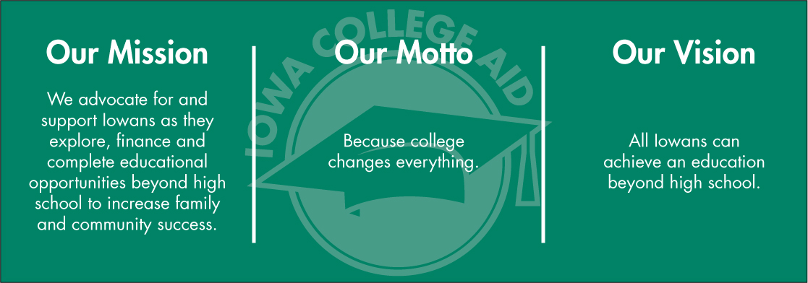

Slide 13
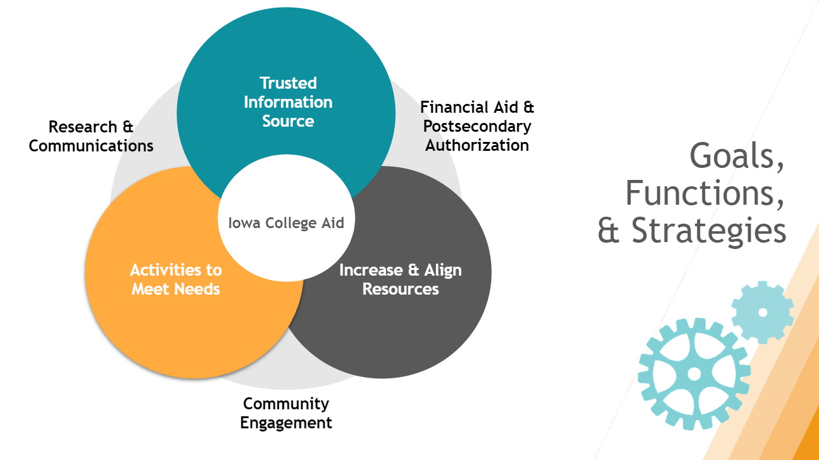

Slide 14
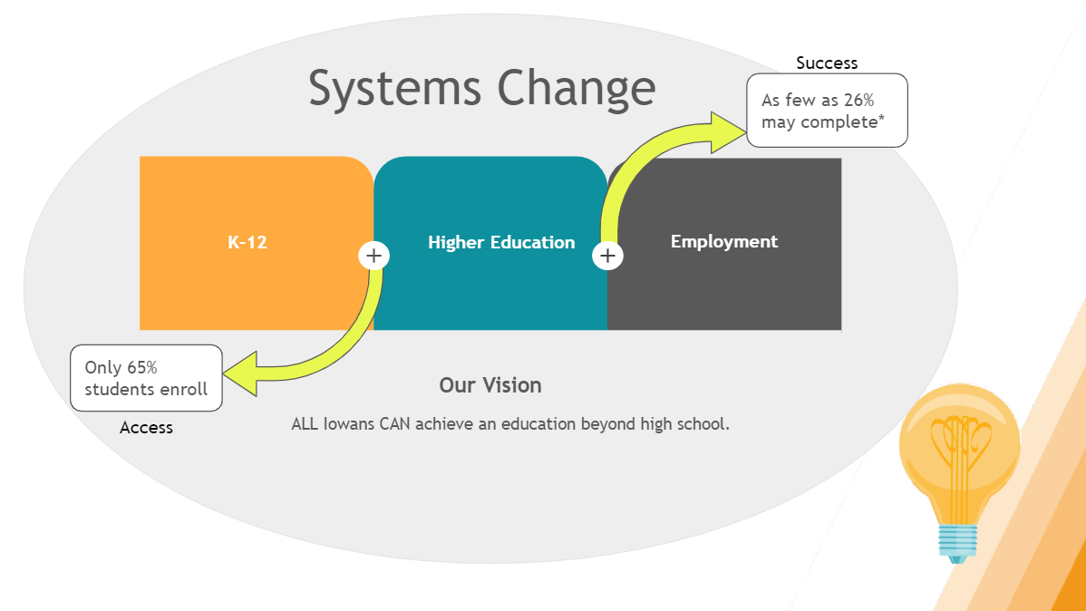

Slide 15
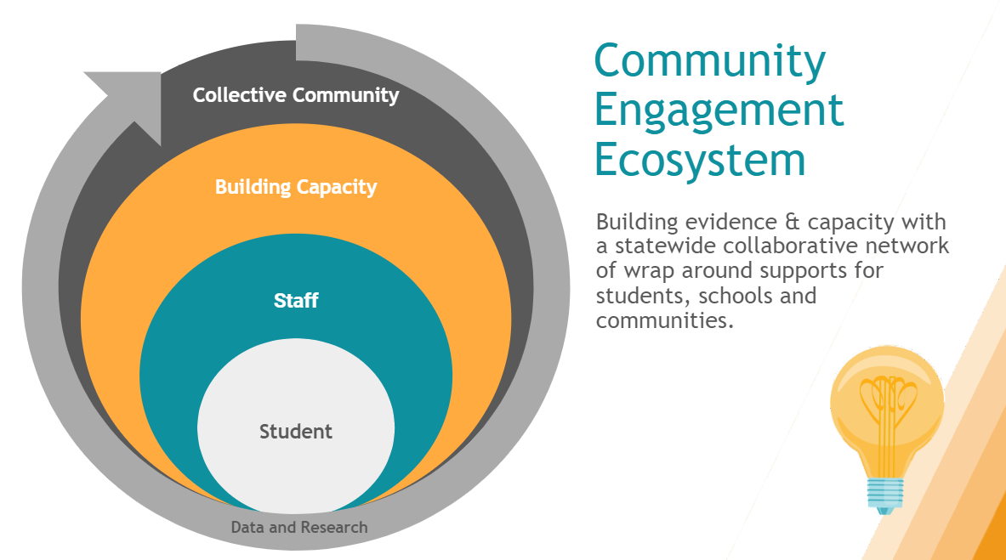

Slide 16
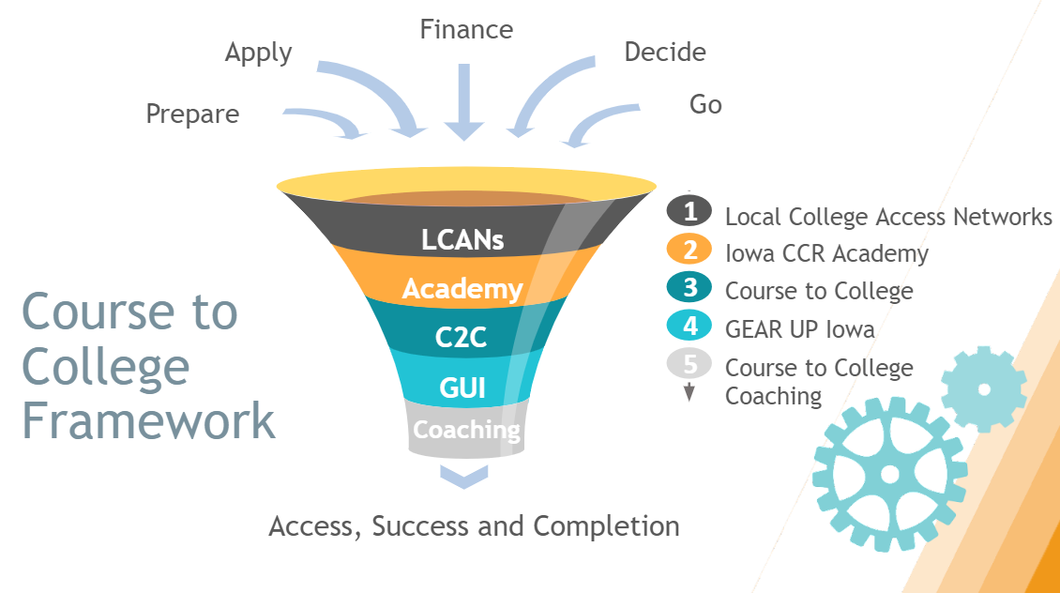

Slide 17
MENTORING 101

Slide 18
MENTORING 101
Intentional relationship
Structured program: one to one matches
Everyday mentoring: adults interacting with young people with a “mentoring mindset”
Notes:
Intentional relationship-someone who cares about them, assures them they are not alone in dealing with challenges and makes them feel like they matter
Mentoring, at its core, guarantees young people that there is someone who cares about them, so they know they not alone in dealing with day-to-day challenges, and makes them feel like they matter.
This year more than ever as all of us have experienced isolation: RELATIONSHIPS matter

Slide 19
POTENTIAL IS EQUALLY DISTRIBUTED OPPORTUNITY IS NOT
Notes:
THANK YOU AND REMINDER ABOUT WHY YOU DO WHAT YOU DO
Major driver of healthy development is who you know and who’s in your corner
Need to help all kids make those connections
Ultimately, mentoring connects a young person to personal growth and development, and social and economic opportunity. Yet one in three young people will grow up without this critical asset.

Slide 20
Notes:
THE NEED FOR WHAT YOU DO Many of us found our own positive mentors. My mentors: teachers, coaches, church I come from a place privilege where I had opportunity to make those connections. Many kids don’t have those natural connections or don’t seek them on their own.

Slide 21
We have had several major meta-analyses on youth mentoring in the last 20 years
All of them have found positive impacts for participants in youth mentoring programs.
2002 DuBois et al., meta-analysis - .18 effect size
2011 DuBois et al., meta-analysis - .21 effect size
2018 Raposa et al., meta-analysis - .21 effect size (may be higher)
Mentoring relationships can serve both prevention and intervention goals

Slide 22
On mental health outcomes…
Meyerson (2013, 39 studies) found global positive impact on…
Internalizing symptoms
Externalizing symptoms
Interpersonal relationships
School and academic functioning
Other studies have found reductions in onset and severity of depressive symptoms
Notes:
PPTL

Slide 23
On career-focused outcomes….
Allen and Eby (2004, 43 studies, formal and informal mentoring, including adults)
Higher compensation and promotion
Career and job satisfaction and commitment
Findings held true for both career-focused and psychosocial-focused mentoring
Their 2008 meta-analysis compared academic, workplace, and youth mentoring and found all three associated with “a wide range of favorable behavioral, attitudinal, health-related, relational, motivational, and career outcomes”
Mentoring is effective at keeping youth on career paths in fields in which they are traditionally underrepresented
Notes:
Career based programs that match middle and high school students with a career professional and work-based mentoring programs.
Also, training available for supervisors in workplace to serve as mentors.

Slide 24
On education…
Keller, DuBois, and Wheeler (2010, 3 major studies)
Decreased truancy, school-related misconduct, and absenteeism
Increased relationships with supportive non-familial adults, perceived academic abilities, and peer support
Strong impacts around school connectedness
Notes:
Many school-based programs across the state

Slide 26
Course to College Coaching

Slide 27
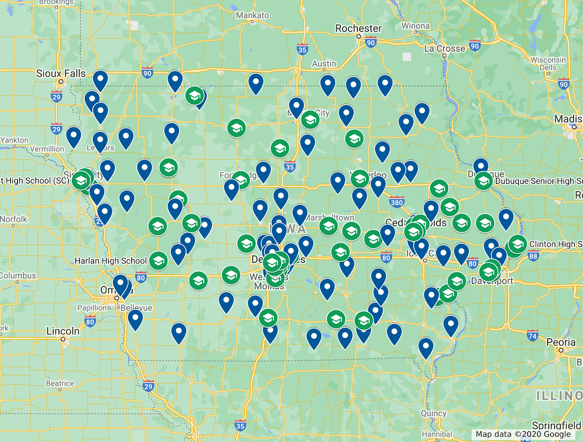
Course to College
An all-encompassing program supporting high schools in creating a college-going culture through five steps: prepare, apply, finance, decide, and go. Essential support and resources for schools to cultivate a college-going culture.
197 Partner High Schools
All 363 Receive FAFSA report

Slide 29
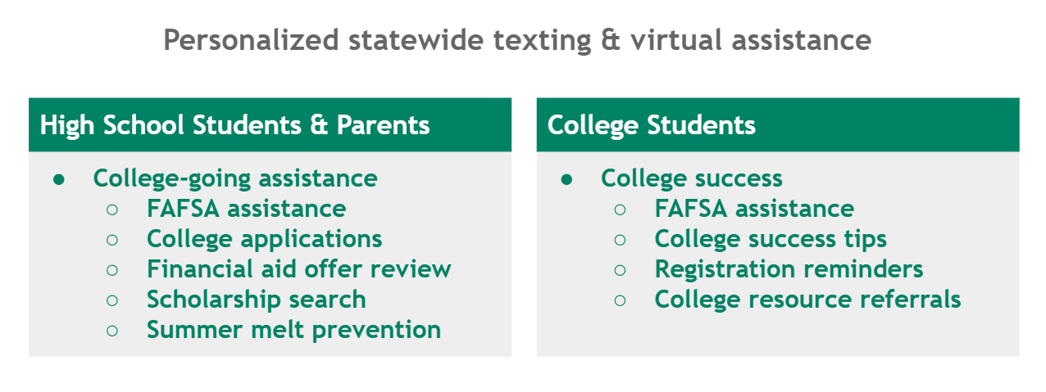
Virtual Coach

Slide 30
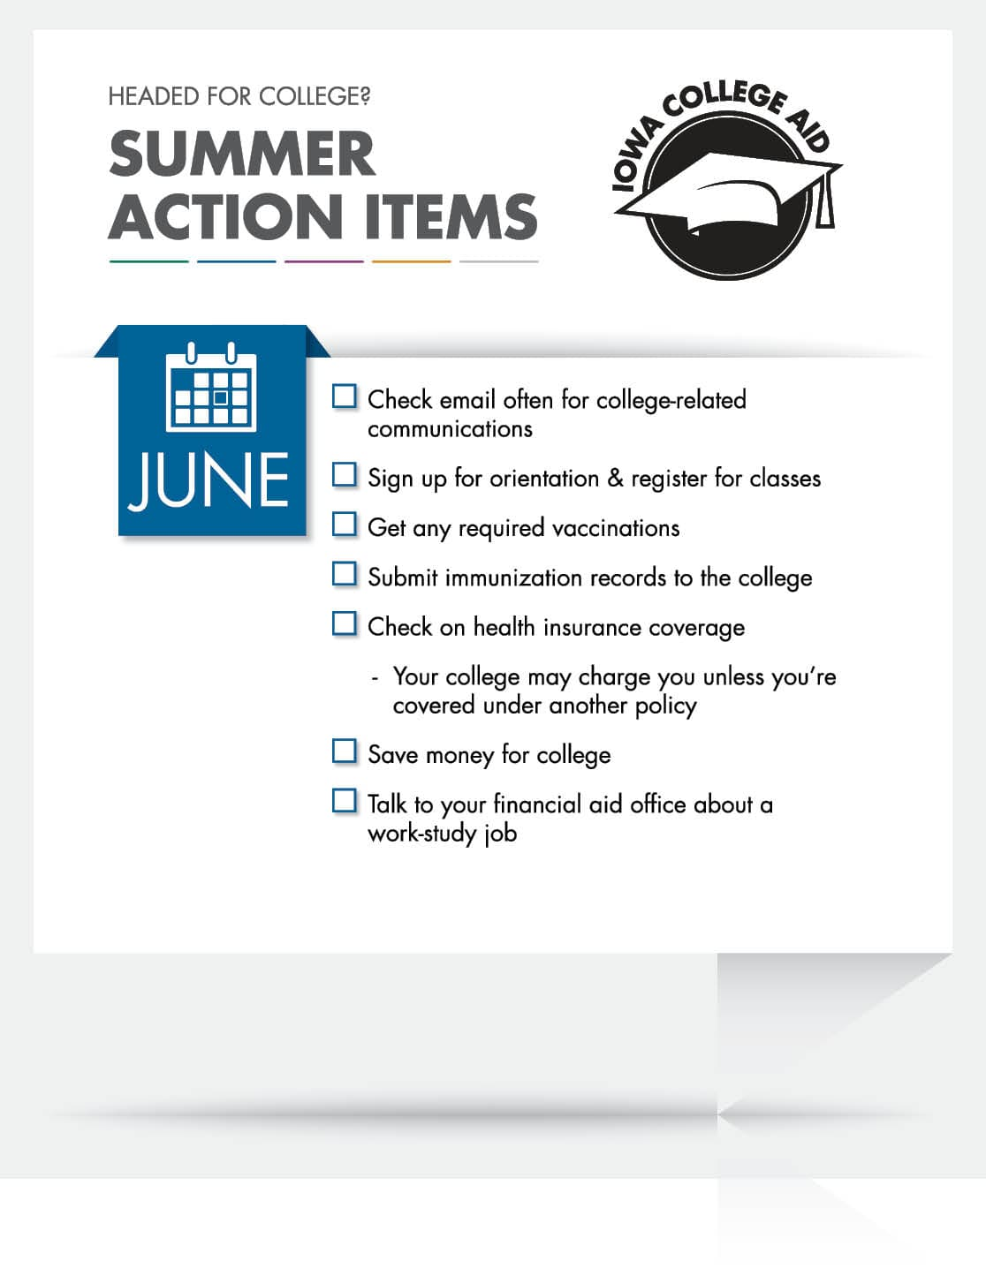
Virtual Coach
Texting Campaigns launched in 2020
Populations Served:
High School Students (grades 9-12)
High School Student guardians (grades 9-12)
College Students
Emphasis on Last-Dollar Scholarship
6 Active Campaigns
260,630 Messages Sent
22,763 Messages Received

Slide 31
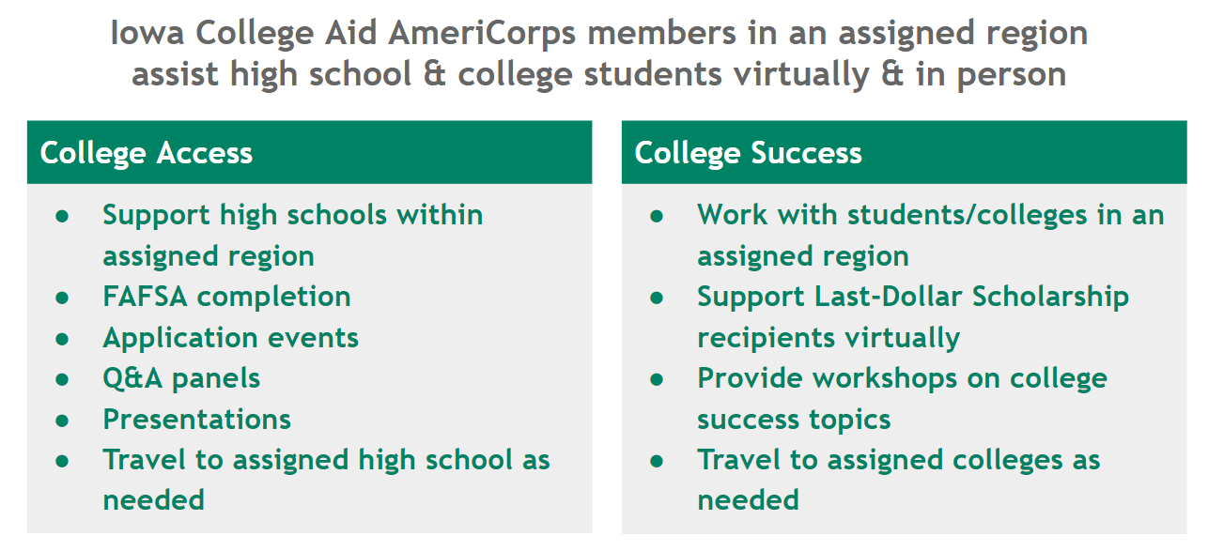
College Coaches

Slide 32
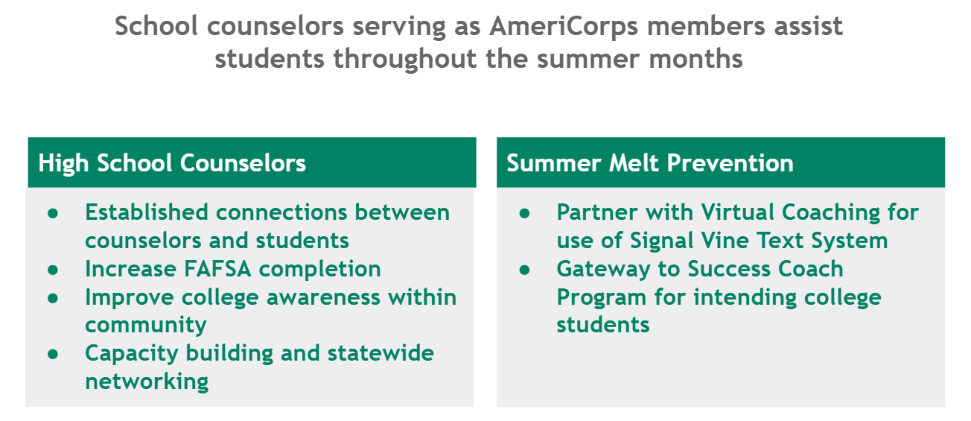
Summer FAFSA Associates

Slide 33
Student Leaders

Slide 34
Research Study
Our researchers examined the impact of these interactions on FAFSA and enrollment in college.
An electronic nudge alone has the least amount of impact on outcomes, compared to in-person counseling alone or a combination of electronic reminders and in-personal assistance.

Slide 35
FRI Virtual Career Mentoring is a first of its kind program that connects aspiring professionals with a network of career professionals throughout Iowa

Slide 36
Over 150 Last-Dollar Scholars are enrolled in the Future Ready Iowa Mentoring Program
Participating students come from 15 of the 17 eligible colleges across Iowa

Slide 37
Mentoring Program Goals
Connect students with professionals in the workforce
Guide students in developing and executing college-to-career goals
Increase work-related learning opportunities
Help students overcome academic & professional barriers
Improve job placement percentages in high-demand fields
Connect employers with a career-ready workforce

Slide 38
Matching Algorithm Factors
Career Field
Barriers
Location
Gender & Preference
Professional Goals
Additional Information

Slide 39
Match Engagement
Communicate through instant messaging & video call
Establish a mentoring agreement (1 hr./mo. Average)
Curriculum includes tasks related to:
Relationship building (informational interviews, Gallup StrengthsFinder)
Academic & Career Goal(s) development
Professional development activities (LinkedIn, etiquette, conferences)
Job shadow/internship(s)
Resume review
Mock Interviews

Slide 40
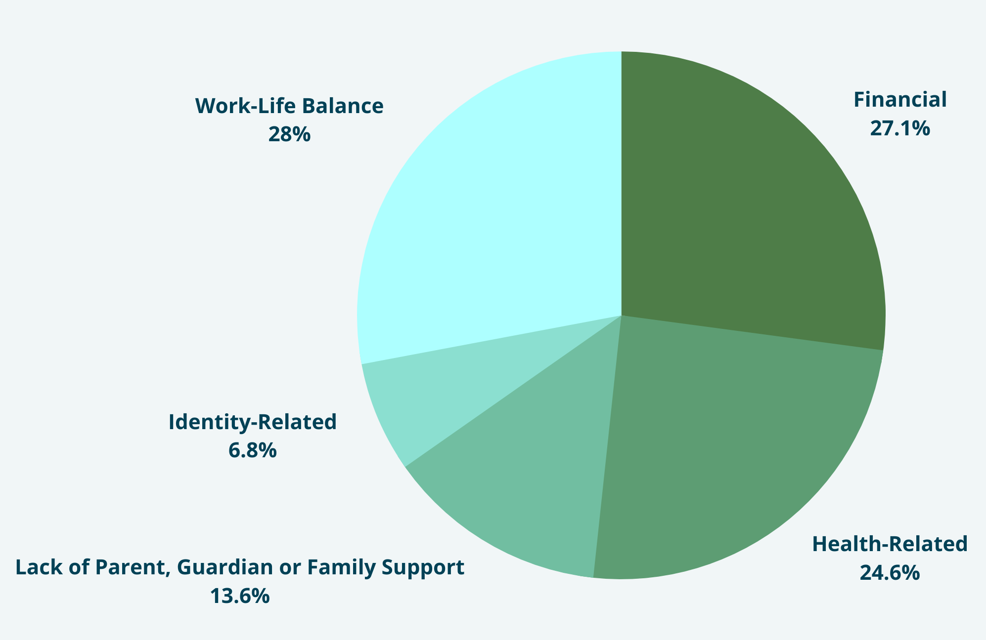
Student Profiles
ENROLLED STUDENTS
Information Technology @ 62
Healthcare and Biosciences @ 61
Advanced Manufacturing @ 14
Construction/Engineering @ 11
Management/Business @ 6
53% are First-Generation
Average Age: 31
Gender Breakdown:
55% Women
43% Men
2% Nonbinary

Slide 41
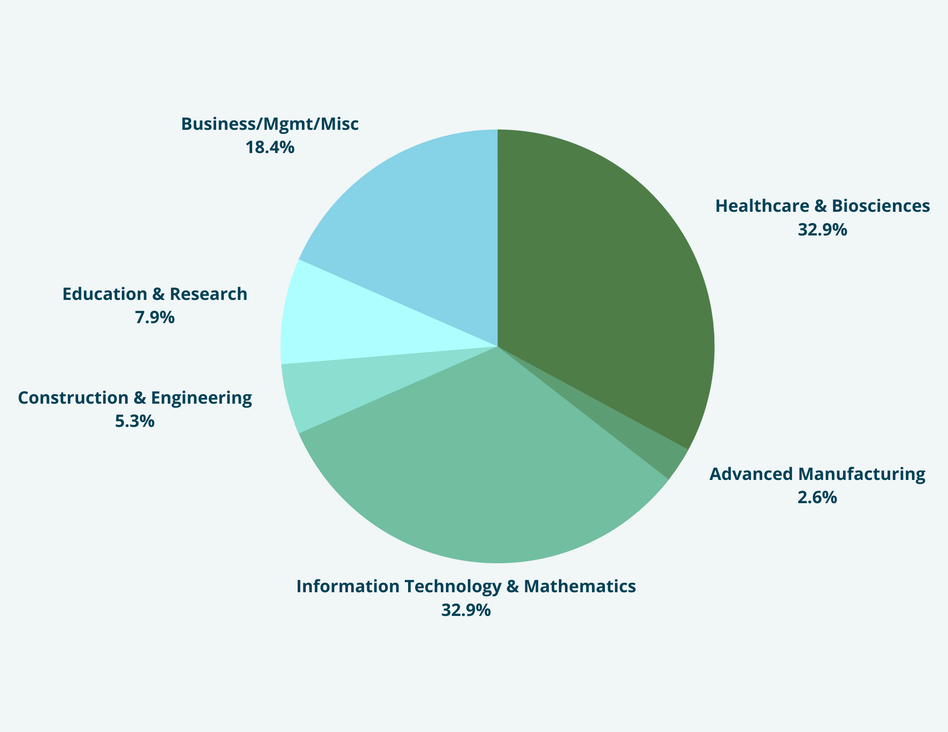
Mentor Profiles
ENROLLED MENTORS (81)
41% are First-Generation
Average Age: 42
Gender Breakdown:
50.7% Women
47.9% Men
1.4% Nonbinary

Slide 42
Career Mentoring Partners
Ankeny Community Schools
Blank Children’s Hospital, UnityPoint Health
Block Associates, LLC
Buena Vista University
Capgemini
Cedar Rapids Branding & Design
College of Veterinary Medicine at ISU
Des Moines Area Regional Transit Authority
Dupaco Community Credit Union
Dwolla
EMC Insurance
Focus OneSource
Folience
Hawkeye Community College
Iowa Healthcare Collaborative
Iowa State University
Mary Greeley Medical Center
Millenium Therapy
New Bohemian Innovation Collaborative, Inc.
Pratum
River Hills Community Health Center
Strategic America
Summit Family Dental
United Community Health Center
University of Iowa Hospitals and Clinics
US Army Corps of Engineers
USDA, Natural Resources Conservation Service
Van Meter Inc.
Visionary
Wells Fargo

Slide 43
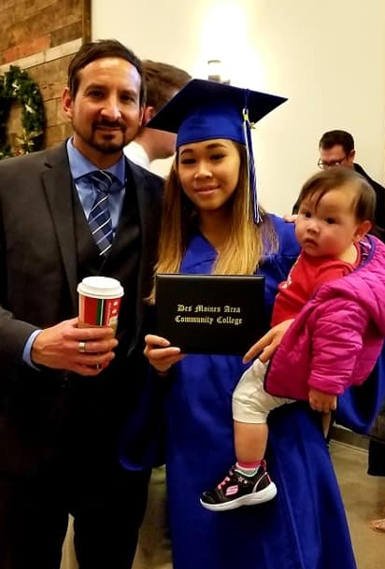
Student Benefits
Your mentor can serve as an outstanding professional reference
Expand your network
Explore professional development opportunities
Learn job readiness strategies and skills
Understand, appreciate, and communicate your strengths
Potential to gain a mentor for life!

Slide 44
PROGRAM FEEDBACK
“I think I found a new career path. It's been going up and up since I started my mentorship.” -Mentee, Tan
“Totally worth having conversations and helping!” -Mentor, Aaron
“My mentor went above and beyond to help me. She helped me with learning more about the field and developing my resume and cover letter.” -Mentee, Tiffany
Notes:
Add quotes and profile photos from participants

Slide 45
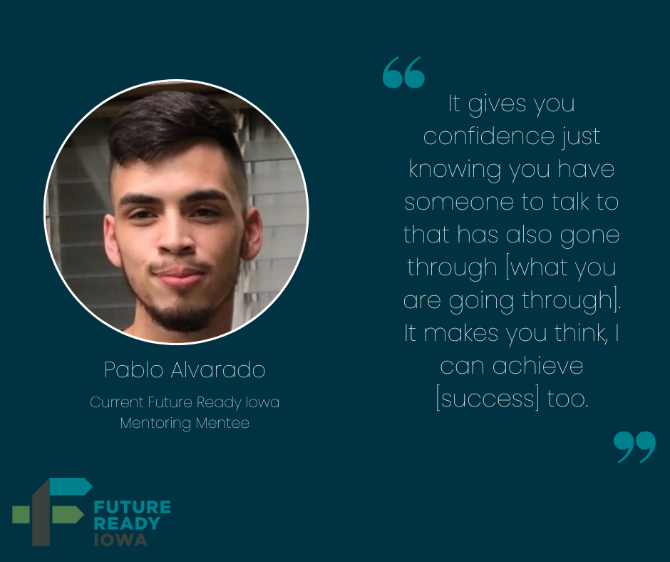
Sharing is Caring: How You Can Help
Learn more by visiting the website
Share this opportunity with employers
Connect leadership with appropriate professional organizations
Follow Volunteer Iowa on social media
Identify opportunities to share with faculty, staff, and students at eligible campuses

Slide 46
NEXT STEPS
Volunteer to mentor
Spread the word about Virtual Coach!
Connect us to professional organizations
Contact us for consulting in starting or strengthening mentoring in your org
Notes:
Shared some ideas today for your program.
Lots of other areas for your program we could work together on.
Or we can take on the BHAG of collaboration to meet community needs.
https://nationalmentoringresourcecenter.org/how-we-can-help/no-cost-assistance/

Slide 47
Stay Connected
Websites:
www.iowamentoring.org
https://iowacollegeaid.gov/Corps
https://iowacollegeaid.gov/VirtualCoach
https://www.futurereadyiowa.gov/volunteer
Email:
christina.sibaouih@iowa.gov
mary.sheka@volunteeriowa.org
jason.wiegand@volunteeriowa.org
Notes:
www.iowamentoring.org go to web page, scroll down, FB, newsletter

