Slide 1
GEAR UP Iowa Future Ready
Subtitle

Slide 2
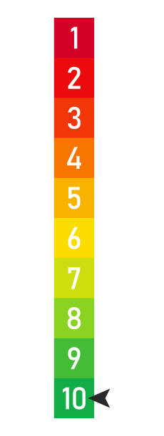
On a scale of 1 to 10… How much do you know about the GUI program?
UNFAMILIAR
ENOUGH TO BE DANGEROUS
EXPERT

Slide 3
GEAR UP Iowa
Program Services, Implementation and Impact

Slide 4
What is GEAR UP?
Gaining Early Awareness and Readiness for Undergraduate Programs (GEAR UP) is a grant program funded by the U.S. Dept. of Ed to support low-income, underserved students. State GEAR UP grants are seven-year grants that focus upon increasing:
Academic performance and preparation for postsecondary
High school graduation and enrollment in postsecondary
Student and family knowledge of postsecondary options, preparation, and financing
Grant | Years | Partner Districts | 7th Grade Cohort | Total 7-12 Served | 1st Year College Students | Partner Colleges
GEAR UP Iowa 1.0 | 2008-2014 | 17 | 5,385 | 7,003 | - | -
GEAR UP Iowa 2.0 | 2014-2021 | 12 | 6,300 | 9,455 | 3,463 | 9

Slide 5
What is GEAR UP’s Impact?
Proven Results
Beyond the Cohort
Highlights
22% increase in ACT, 100 more meeting admission scores
More likely to be on-track to graduate, higher GPA
Increase in math and reading proficiency
Increased attendance and expectations
20% increase in FAFSA
3-4% increase in enrollment
50% reduction in enrollment gap
Just as likely to persist
Outcomes connecting back to services and interventions.
Impacts evidenced in statewide data.
Evidence Base
Increasing Demand
Contributor to the national body of research.
More schools eligible and more schools interested.

Slide 6
GEAR UP Iowa Future Ready
Working with 5 AEA’s across the state of Iowa
GEAR UP Iowa serves 11 school districts across the state with 50% or more students on Free and Reduced Priced Lunch (FRPL)
$5.6 million in ARP Funds
Our Goal:
69% of GEAR UP Iowa students will enroll in postsecondary
Over 40 partners
3,463 2.0 students currently enrolled in postsecondary
Currently in year 2
Family Engagement

Slide 7
Strategies to Implementation
District Level | Staff Level | Student Level | Student level
Collaborative alignment with state college and career readiness efforts | Increase school capacity for college and career counseling and advisement | Targeted wrap around supports to reduce achievement gaps for low-income and underserved students | Create early, varied and targeted college and career exploration experiences to build college knowledge
Curricular alignment Middle to High School transition supports Support of Individualized Career and Academic Plan (ICAP) and integration | Iowa College and Career Readiness Academy for staff and school teams Course to College Partnership School planning teams representing teaching, counseling and administration | Social emotional skill development (including development of an individualized personal development plan) Disaggregation of services and supports to address specific student and family needs Academic support | Targeted, immersive and experiential college and career visits/training One-on-one and virtual college process and pathway assistance College application events FAFSA and financial literacy training

Slide 8
Comprehensive Implementation Plan & Services

Slide 9
Why GEAR UP Iowa Future Ready?
COVID has exacerbated college enrollment equity gaps among historically marginalized groups, first generation college students, and students with lower socioeconomic status (SES) students.
Current systems supporting college and career readiness are fragmented and untimely to meet student needs.
Our Strategies: Building a Foundation in Year 2
Comprehensive implementation plans
Collaborative alignment with state college and career readiness efforts
Academic Support, CCR Readiness, Social Emotional Development
Create early, varied and targeted college and career exploration experiences to build college knowledge
Dedicated support staff and identification of a GUI/FR team
Strong partnerships! Targeted wrap around supports to reduce achievement gaps for low-income and underserved students

Slide 10
GEAR UP Iowa Future Ready Plan
EACH YEAR
Current senior class
Iowa College Aid will receive $5,670,750 from state COVID-relief funds to launch the Future Ready GEAR UP Iowa Program to directly support partner school districts to implement targeted supports for:
Midd
TARGET COHORT: Class of 2025
Current 10th Graders
Through Graduation
MIDDLE SCHOOL
Alignment & Collaboration

Slide 11
3 Framework Components
Schools determine the appropriate services for each student or group of students
Academic Assistance
This component focuses on ensuring students are academically prepared for postsecondary education by building a rigorous academic foundation and developing essential academic behaviors
College and Career Exposure
This component focuses on ensuring students and families take the steps necessary to successfully enroll in postsecondary education, an apprenticeship, a training program or the military.
Social Emotional Skills
This component focuses on building students’ social emotional skills to prepare them to better advocate for themselves and believe that they are postsecondary-ready.

Slide 12
Implementation Plan Requirements
Meeting with Middle School
Have your high school teams meet with your key middle school stakeholders to discuss future planning and alignment with district plans and GEAR UP Iowa initiatives
Academic Support Targeted support for students based on their ICAP and learning needs
College and Career Exposure Recruit students to attend at least one of the campus field trips (dates on next slide)
Social Emotional Skill Development
Course to College
Ensure your school is registered as Course to College partner site and meet those requirements, ICAN assistance available at no cost to you:
FAFSA/School Support Events
Financial Literacy
Transition Planning
Virtual College Coach
Get students opted-in to receive virtual assistance (texting), for support as they transition into college or postsecondary pathways
Middle School
Class of 2025
Class of 2023

Slide 13
Year 2 : Implementation Plan Guidelines
Meet and Plan with Middle School
Have your high school teams meet with your key middle school stakeholders to discuss future planning and alignment with district plans and GEAR UP Iowa initiatives. Plan at least one partnership or effort to align school curriculum and/or advising to maximize student transition to high school, training and/or postsecondary education
Transition Supports
Alignment of resources to assist in middle to high to postsecondary transitions. ICAN resources/presentations, as well as district participation in Virtual Coaching program
I
District Level - Alignment

Slide 14
Year 2 Implementation Plan Guidelines
Professional Development
Staff will attend key trainings related to the grant and grow staff college and career readiness capacity, including Iowa College and Career Readiness Academy courses for staff and school teams.
Course to College Partner
Ensure your school is registered as Course to College partner site and meet those requirements, ICAN assistance available at no cost to you:
FAFSA/School Support Events
Financial Literacy
Transition Planning
School Planning Team Meetings
School Planning Teams should consist of stakeholders and individuals who are committed to creating a college-going culture throughout the school. The school planning team will meet regularly to assess, plan, and review student data related to the implementation of GUI services, activities and programs. School planning teams should represent the people needed to accomplish the work of the implementation plan.
Staff Level - Capacity

Slide 15
Year 2 Implementation Plan Guidelines
Advising
Efforts around ICAP, includes annual verification of student career interests to inform and expand real-world, professional work-based learning opportunities, review of student course selection, and advising on classes that optimize their ability to pursue their career interests.
Social Emotional Supports
An individualized personal development plan developed by students to identify the skills, habits and attitudes they want to develop to support their educational and career goals. Developed in concert with regular career planning activities in the school, it will integrate social emotional skills with students’ plans.
Wrap Around Supports
Disaggregation of services and supports to address specific student and family needs.
Academic Assistance Targeted support for students based on their ICAP and learning needs, including remedial and supplemental.
Student Level - Equity

Slide 16
Closing the Gaps
Academics
Social Emotional
Intentions
Recover learning loss
Tutoring
Credit recovery
Competency based academics
Address mental health
Emotional support
SE development
Wrap around supports
Increase Student Intention
Increase College Exposure
Increase Career Exposure

Slide 17
Improve Student’s Experience
Raise PSE intention
Increase College Enrollment
ICAP PSE Planning
Coaching and counseling around K-12 Plan and PSE Plan
PSE Experiences
SEL (College Fit)
Student & Family Knowledge & Engagement
ACT Completion
FAFSA Completion
Financial Aid Options
Removing Barriers
Equitable opportunities
Effective interventions
Systems change

Slide 18
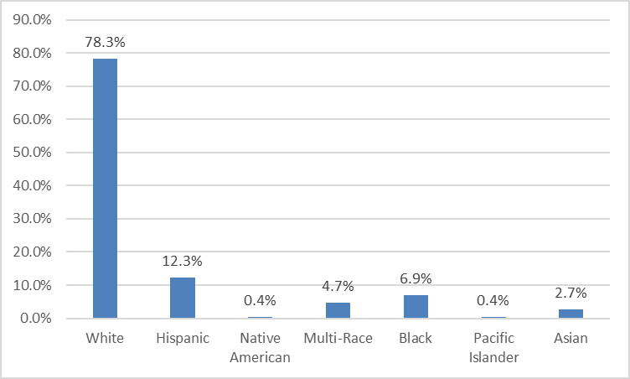
State of Iowa
Postsecondary Readiness Data
State Demographics
2021 Postsecondary Readiness Index Percent
50%
Postsecondary Readiness Index is determined through Multiple pathways where students can participate and demonstrate readiness for life beyond high school. Includes: Participation in college entrance exam and ACT or SAT score; college level, postsecondary, or advanced coursework; career and technical education concentrators.

Slide 19
2020 Outcomes
% of students enrolled within 1 year: 60.5%
% enrolled in Remedial English: 4.9% (2 year) 1.2% (4 year)
% enrolled in Remedial Math: 9.3% (2 year) 0% (4 year)
Postsecondary Intent
2020: 75%
2021: 72%
FAFSA Completion
2020-21: 52.1%
2021-22: 52%
Goals
Increase FAFSA completion
Expand college-going culture
Increase academic self-efficacy
Maintain high postsecondary intentions

Slide 20
The GUI FR Team

Slide 21
GEAR UP Iowa Central Office Staff
Leadership
Christina Sibaouih
Program Director
Karmon Long
Program Coordinator
Amber Miller
Program Facilitator
Districts: Clinton, Columbus Junction, Davenport, South Tama
Christine Nguyen
Program Facilitator
Districts: Fort Dodge, Marshalltown,
Storm Lake
Graci Zeiger
Program Facilitator
Districts: Centerville, Des Moines,
Davis County, Saydel
Facilitators
Research
Wade Leuwerke
GEAR UP Iowa Research & Training Director
Haiying Li
Community Engagement Program Research & Evaluation
Support
Thomata Doe
Community Engagement Assistant
Roscoe Lewis
Accountant III
Crystal Woods
Accounting Administrative Assistant

Slide 22
GUI FR Facilitators
School District Management
Implementation Planning
School Planning Team Support
Student and school staff engagement
Participatory planning
Event assistance
Compliance
Service tracking in Salesforce
Reimbursement claims tracking and approval
Reporting and documentation
Training on systems
Speciality Areas
GUI FR Coordinator
Oversight of program wide compliance and implementation
Supporting facilitators and schools
School engagement
Professional development
Training and Onboarding
Implementation planning
Equity & engagement for underrepresented students
Partnership engagement
GEAR UP Advisory Council (GUAC) Lead
In-Kind contributiion

Slide 23
GEAR UP Iowa School Teams
Dedicated support staff in each GEAR UP Iowa Future Ready School
Staff hired with GUI FR funds
Support staff already employed with school
Identification of GUI FR team
To create impactful and sustained change for the students take an entire team
Teachers
Support staff
Administrators
Hired GUI FR Staff
Representative in the GEAR UP Advisory Council
Helps inform the work of future GUI FR planning and initiatives

Slide 24
The Value of Partnerships

Slide 25
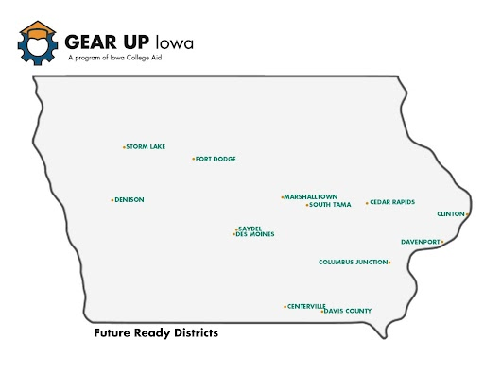

Slide 26
GUI FR Partnerships
11
School Districts
4,985 students
18 High Schools
05
Government Agencies
Iowa Department of Education
Iowa Workforce Development
State Treasurer
Iowa STEM Council
Area Education Agencies
12
DMACC
EICC
Indian Hills CC
WITCC
Grand View University
Iowa State University
University of Iowa
University of Iowa
Simpson College
University of Northern Iowa
Kirkwood CC
Drake University
Colleges & Universities
06
ICAN
Texas Instruments
College Board
Evelyn K Davis Center
Community Youth Concepts
Iowa Safe Schools
Community Orgs & Businesses
...and counting

Slide 27
Implementation Plans: Partner Services
AEA Learning Online
Instructional design, coding and hosting of online learning modules for students, families and staff.
Texas Instrument
Technology Package: No Cost
Classroom Coaching for Teaching with Technology: No Cost
Governor's STEM Council
Scale-Up Curriculum: No cost, $2,500 curriculum for each school
Teacher Externships: No cost, Slots available for 2 teachers each year for each school
Colleges and Universities
Moving from College Visits to Educational Field Trips

Slide 28
Implementation Plans: Partner Services
Iowa Insurance Division
Financial Literacy: National Theater
Financial Literacy: Funding the Future
Iowa Jump$tart Coalition
Financial Literacy
ISU 4-H & Extension Offices
Iowa WorkForce Development: Iowa Works Centers
Evelyn K. Davis Center
Student placement with employers and services from Financial Empowerment Center.

Slide 29
What Does Partnership Mean to Us?
GEAR UP Iowa works with over 40 partners and various levels of commitment.
Collaboration
Enhancing each other’s capacity for mutual benefit
Cooperation
Sharing Resources
Sharing Resources
Coordination
Altering activities/ways of working to achieve a common purpose
Altering activities/ways of working to achieve a common purpose
Altering activities/ways of working to achieve a common purpose
Networking
Exchanging information for mutual benefit
Exchanging information for mutual benefit
Exchanging information for mutual benefit
Exchanging information for mutual benefit
(Himmelman, 1996)

Slide 30
Ways to Partner with GEAR UP Iowa
Participate in the local CARTeam
Ask your organization to contribute to the GEAR UP Iowa scholarship fund or create a new scholarship on behalf of your company
Volunteer at a GEAR UP event such as a family night, financial workshop, or tax prep workshop
Donate school supplies to a GEAR UP school
Host a group of students for job shadowing
Participate in a college or career fair
Become a mentor to a GEAR UP student
Sponsor a GEAR UP Iowa event such as the statewide conference, or a college or career fair at a school
Donate cash or gift cards for GEAR UP Iowa schools to use toward events
Sponsor a GEAR UP Iowa student to attend the National Youth Leadership Summit

Slide 31
Thank you for your time!

