Slide 1
Mount Mercy University
Fully Committed to Educating Iowa’s Workforce
Building Programs with Industry Input
We Educate Those in Need
Freshmen receiving scholarships 100%
First Generation Students 50%
Pell or ITG Eligible 38%
We Educate Iowa
85% of Students are Iowa Residents
We Help our Community
# Service Hours 41,700/year
Financial Impact of Volunteerism $1M+/year
Students completing internship 75%
Graduates who stay in the Corridor 80%
Help us Help more
Provide data, time, projects
We Provide High Quality Education
Average Class Size 16
Student/Faculty Ratio 13:1
Students employed/in grad school
9 months post graduation 96%

Slide 2
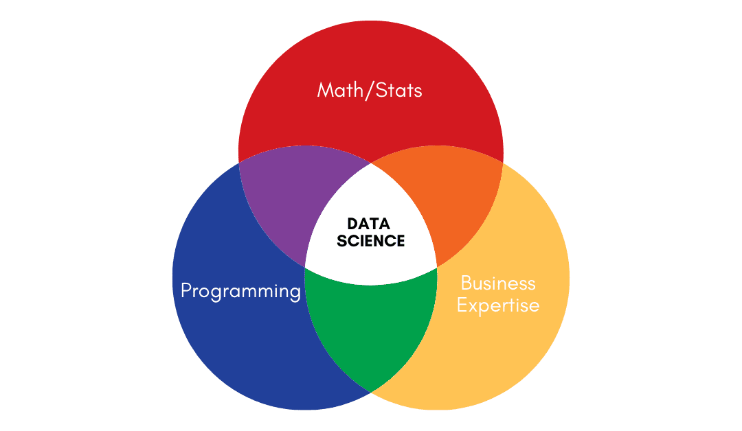
Data Science @MMU
A new program built with industry input
What is Data Science?
Theme 1
Cover slide
Buzz words
Big Data
Machine Learning
Artificial Intelligence
Uses
Customer Analytics
Recommender Systems
Predictive Maintenance

Slide 3
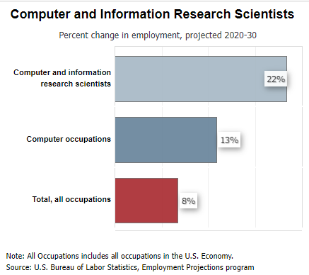
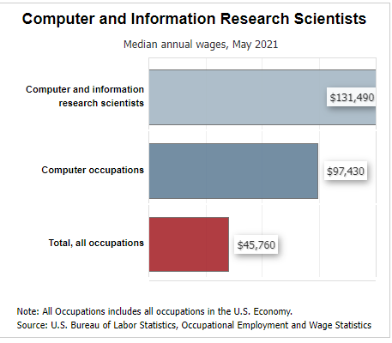
Data Science @MMU
A new program built with industry input
Theme 1
Cover slide

Slide 4
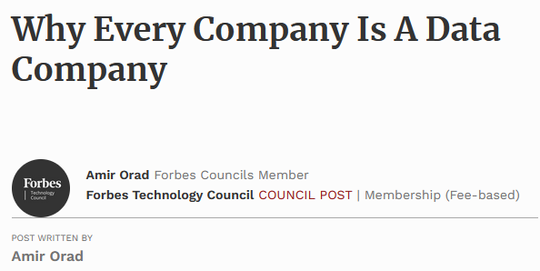
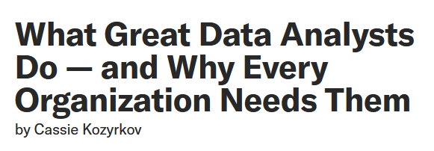
Data Science @MMU
A new program built with industry input
Theme 1
Cover slide

Slide 5
Data Science @MMU
A new program built with industry input
Let’s ask some businesses what they are looking for in a new hire in data science!
Theme 1
Cover slide

Slide 6
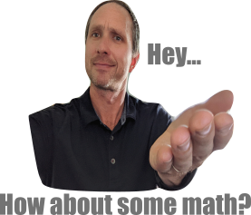
Data Science @MMU
A new program built with industry input
Theme 1
Cover slide

Slide 7
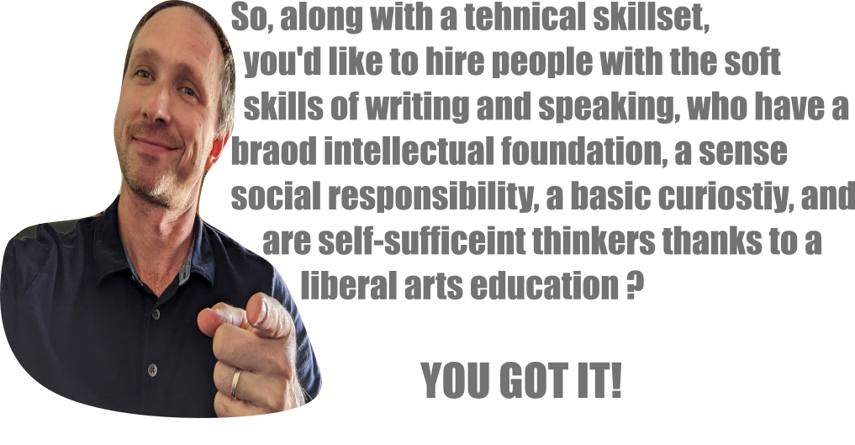
Data Science @MMU
A new program built with industry input
Theme 1
Cover slide

Slide 8
Data Science @MMU
A new program built with industry input
What did we learn (even if we already knew)?
Q: What skills make for a great new hire in data science?
Be part of a team
Be able to communicate
Be able to ask the right questions
Be able to break a problem down into pieces.
Be courageous

Slide 9
Data Science @MMU
A new program built with industry input
What did we learn (even if we already knew)?
Q: What skills make for a great new hire in data science?
Be part of a team
Be able to communicate
Be able to ask the right questions
Be able to break a problem down into pieces.
Be courageous
Implicit assumptions in these answers:
We assume they will have learned the basic technical skills, and you know what they are.
We know we’re going to have to train them in for our specific needs.
We need you to make sure they have the soft skills.

Slide 10
Data Science @MMU
A new program built with industry input
Writing across STEM curriculum
Did your math homework look like this?
No Context
No explanation
Not presentable
Assumes the reader knows the answer
Not an adult problem.

Slide 11
Data Science @MMU
A new program built with industry input
Writing across STEM curriculum

Slide 12
Data Science @MMU
A new program built with industry input
Writing across STEM curriculum
Writing assignments
Contextualize
Explanations
Presentable
Educating the reader
CLOSER to an adult problem.

Slide 13
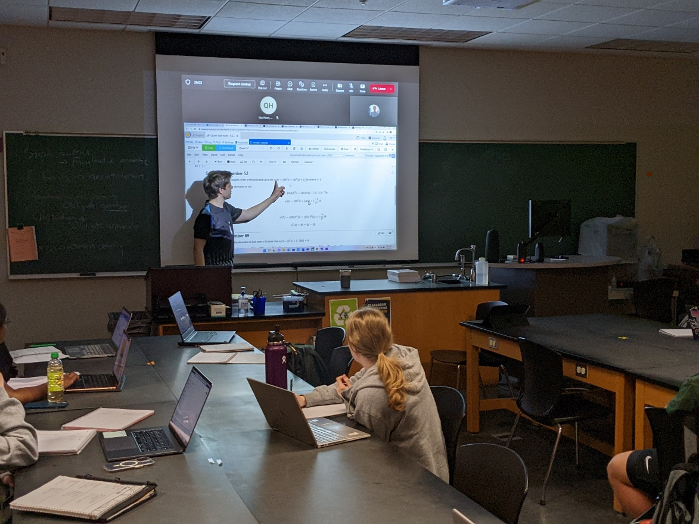
Data Science @MMU
A new program built with industry input
Speaking across STEM curriculum

Slide 14
Data Science @MMU
A new program built with industry input
Data Science Majors will at all levels of the major:
Write
Speak
Collaborate
Be courageous!

Slide 15
Data Science @MMU
A new program built with industry input
Data Science Majors will at all levels of the major:
Write
Speak
Collaborate
Be courageous!
..and yes, lots of math and computing!

Slide 16
Data Science @MMU
A new program built with industry input
rtodd+FR_IA@mtmercy.edu
But we need YOUR help!
Donate your data
Give your time
Propose a project

