Slide 1
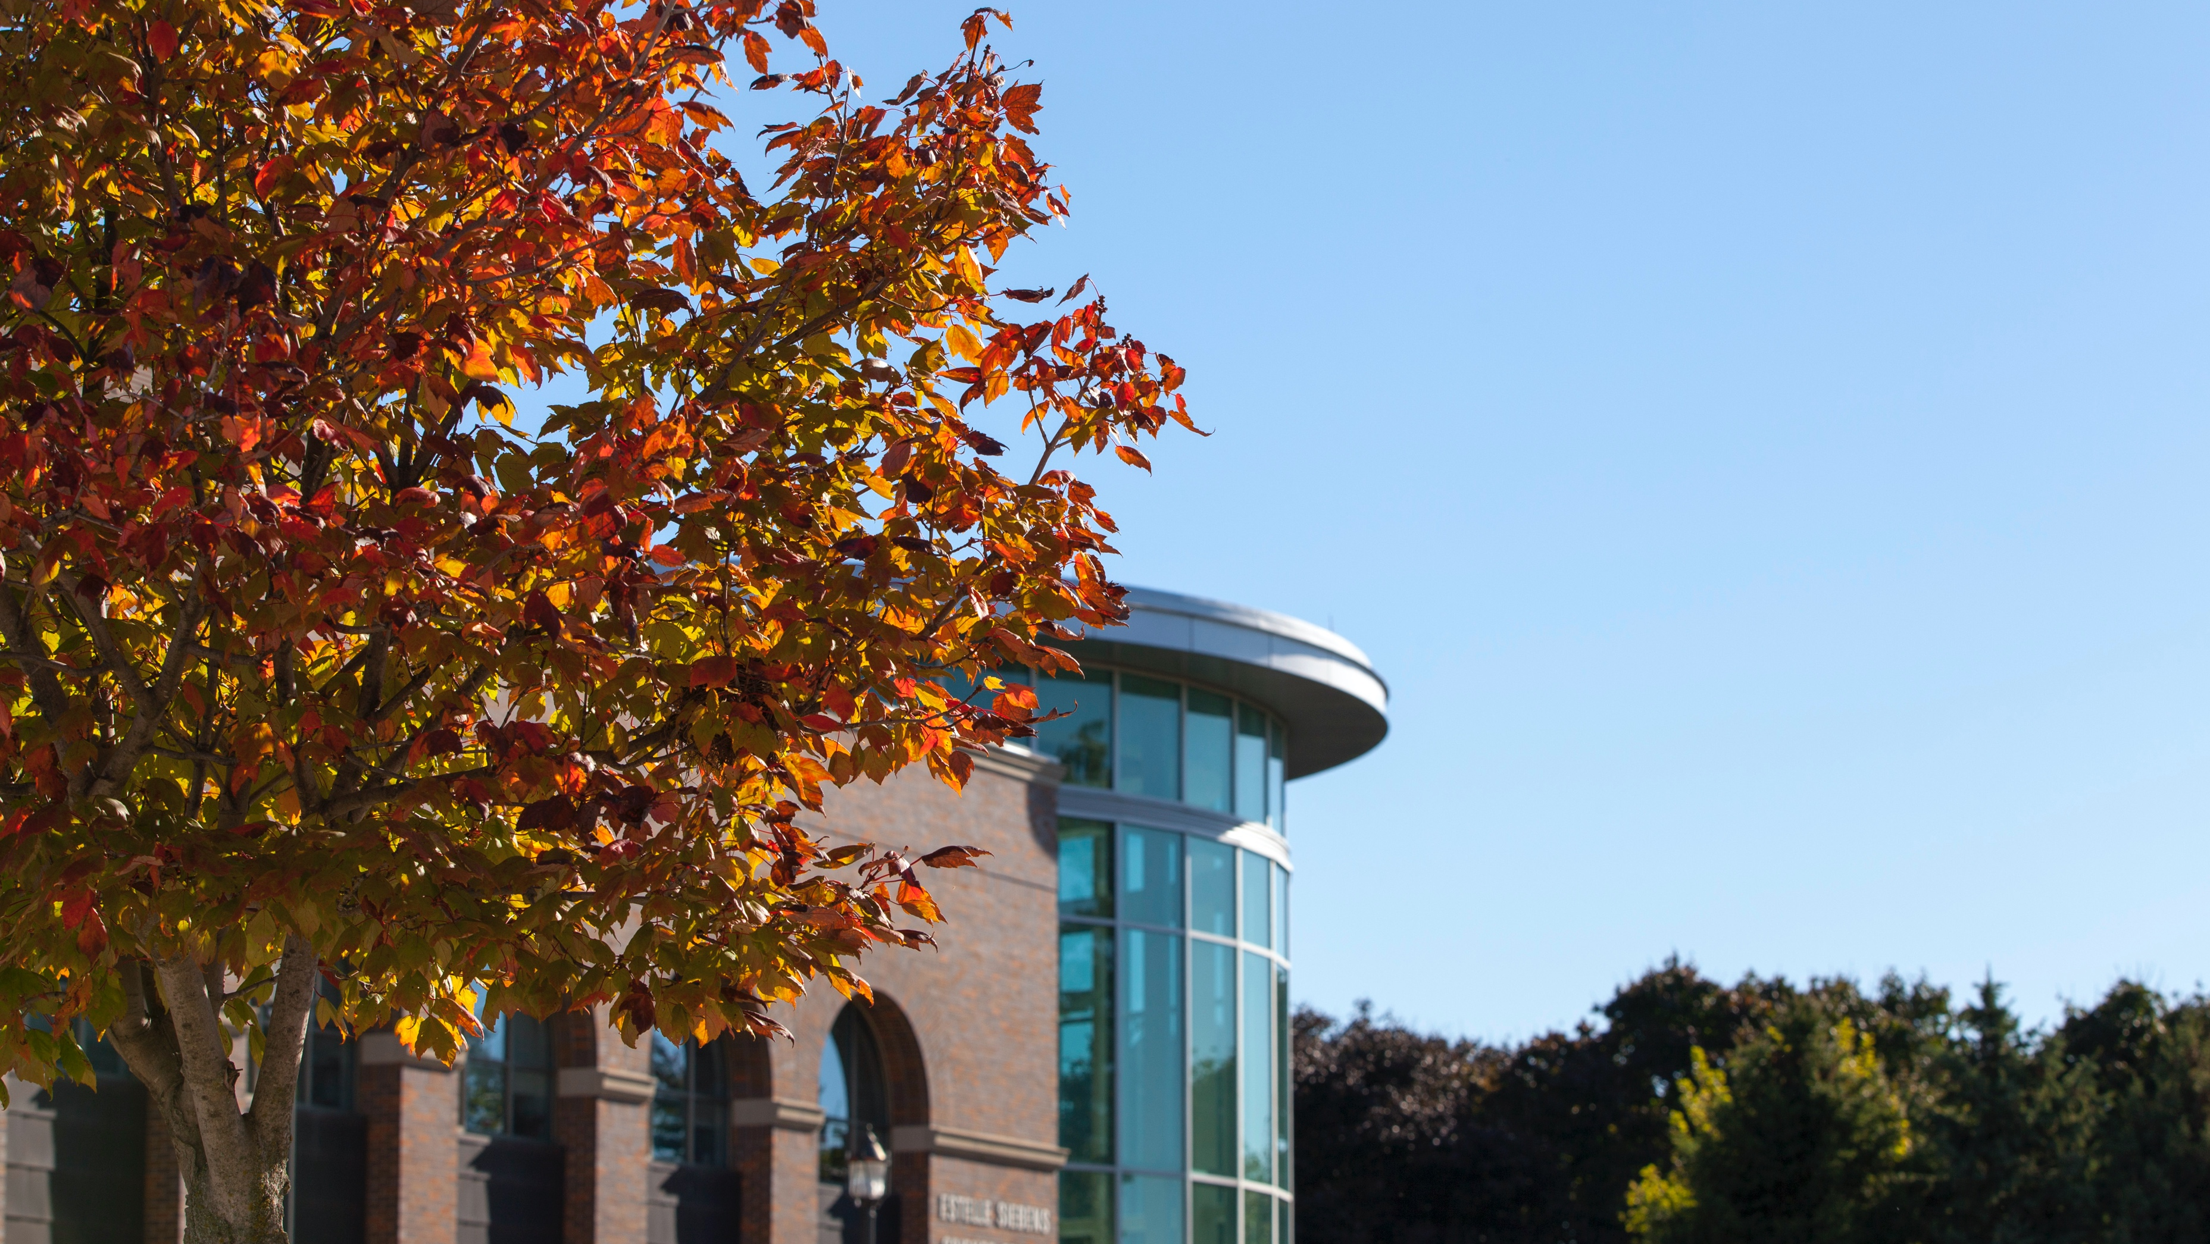
Undergraduate Rural Medicine Education and Development
Buena Vista University
URMED

Slide 2
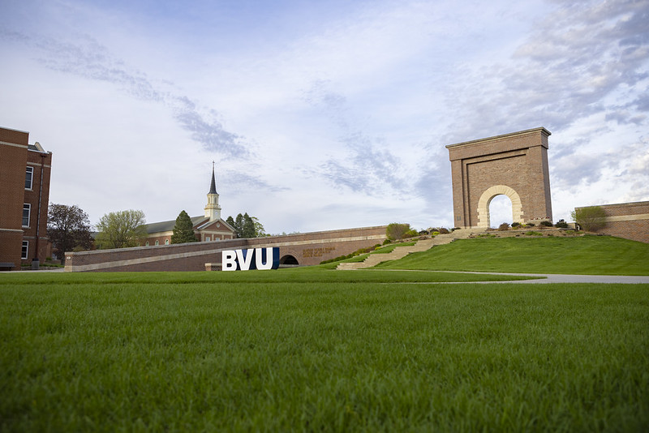
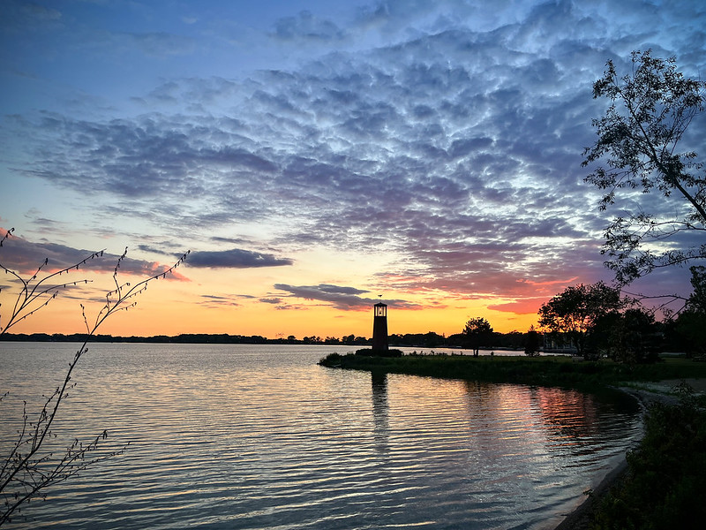

Slide 3
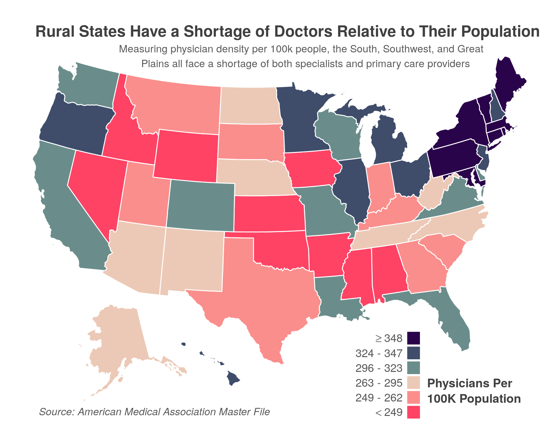
Access to Health Care is a challenge in many rural settings

Slide 4
Per Capita Rates of Health Professionals – Selected Occupations
Occupation | Health professionals per 10K, Rural | Health professionals per 10K, Urban
Dentists | 2.9 | 4.3
Registered Nurses | 65.3 | 93.6
Licensed Practical Nurses/Licensed Vocational Nurses | 25.1 | 20.6
Physician Assistants | 8.1 | 10.2
Physicians (MDs) | 10.9 | 30.8
Physicians (DOs) | 1.8 | 2.4
Primary Care Physicians | 5.3 | 7.9
Total Physicians | 12.7 | 33.3
Nurse Practitioners | 6.5 | 8.1
Total Advanced Practice Registered Nurses | 6.5 | 8.1
Nurse Anesthetists | 1.2 | 1.6
Source: HRSA Area Health Resources Files, 2017 and 2018.
Access to Health Care is a challenge in many rural settings

Slide 5
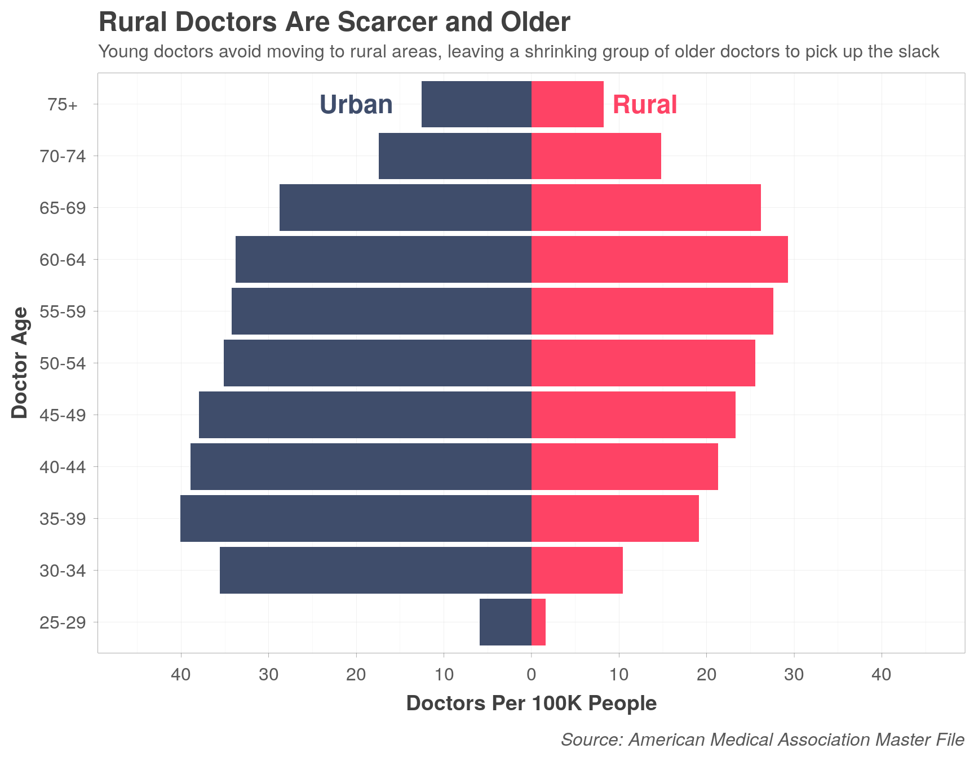
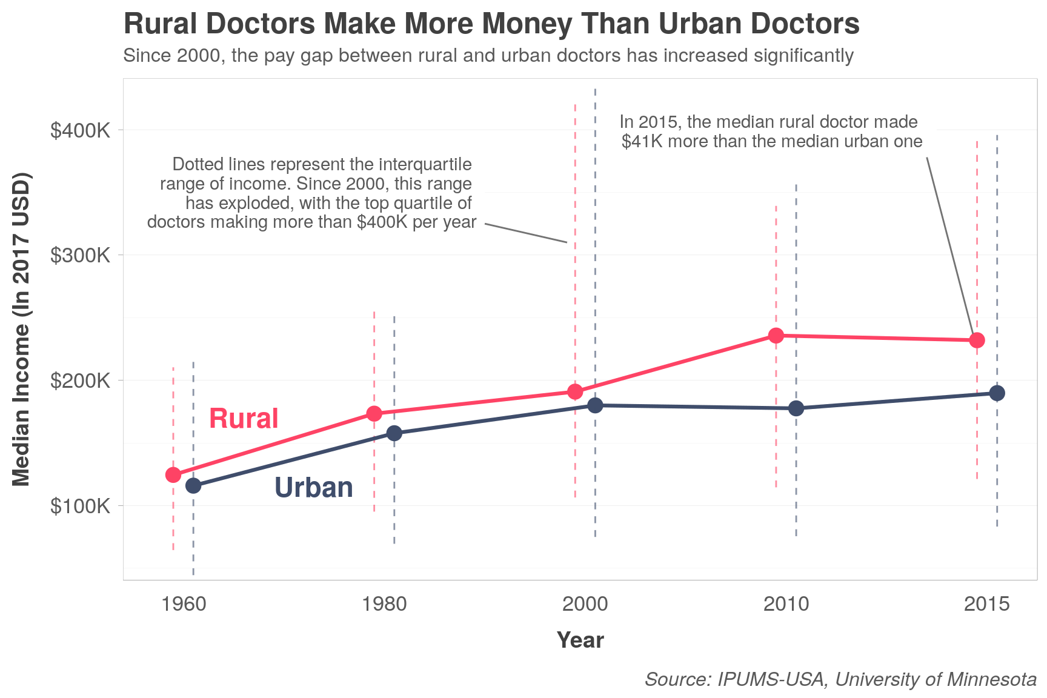
Access to Health Care is a challenge in many rural settings

Slide 6
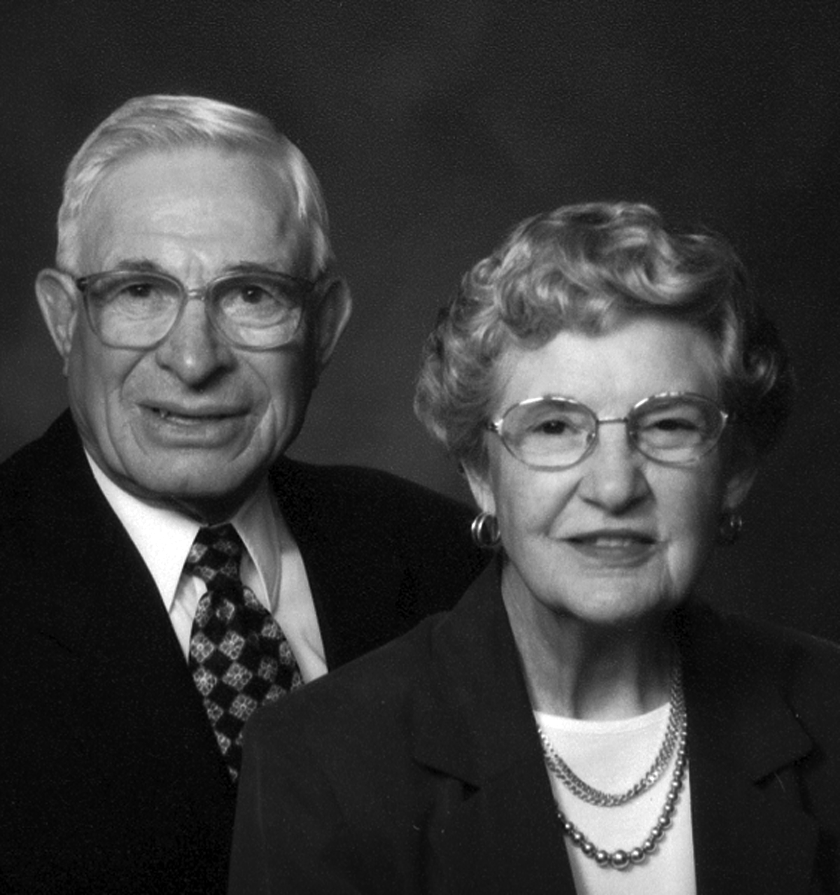
Undergraduate Rural Medicine Education Development
Delwin and Meda Otteman

Slide 7
Formal creation of the URMED program in 2008:
Community outreach
Part of their long-term physician recruitment strategy
BVU students gain valuable clinical experiences
Addresses area of national need: preparing students for health professions careers in rural settings

Slide 8
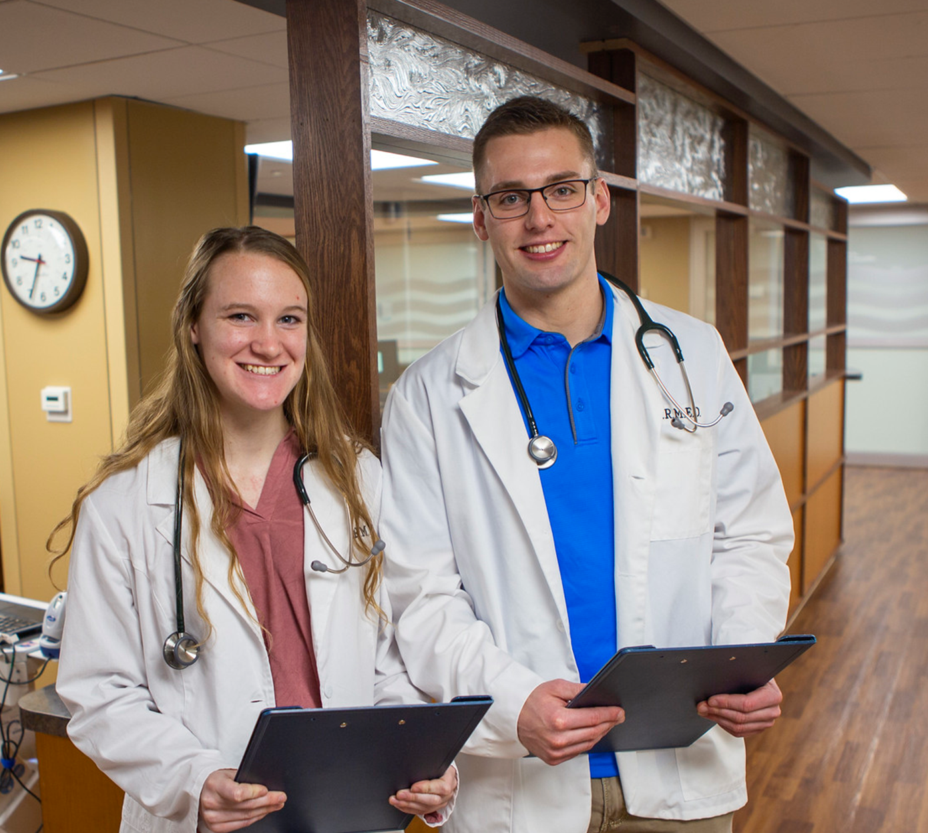
URMED Program Layout:
Fall dinner for with a health professional and a tour of BVRMC
Monthly dinners with health practitioners
Day trips for hands-on training opportunities
Suturing
Casting
Cardiac Stress Test
Medical Simulation Laboratory

Slide 9
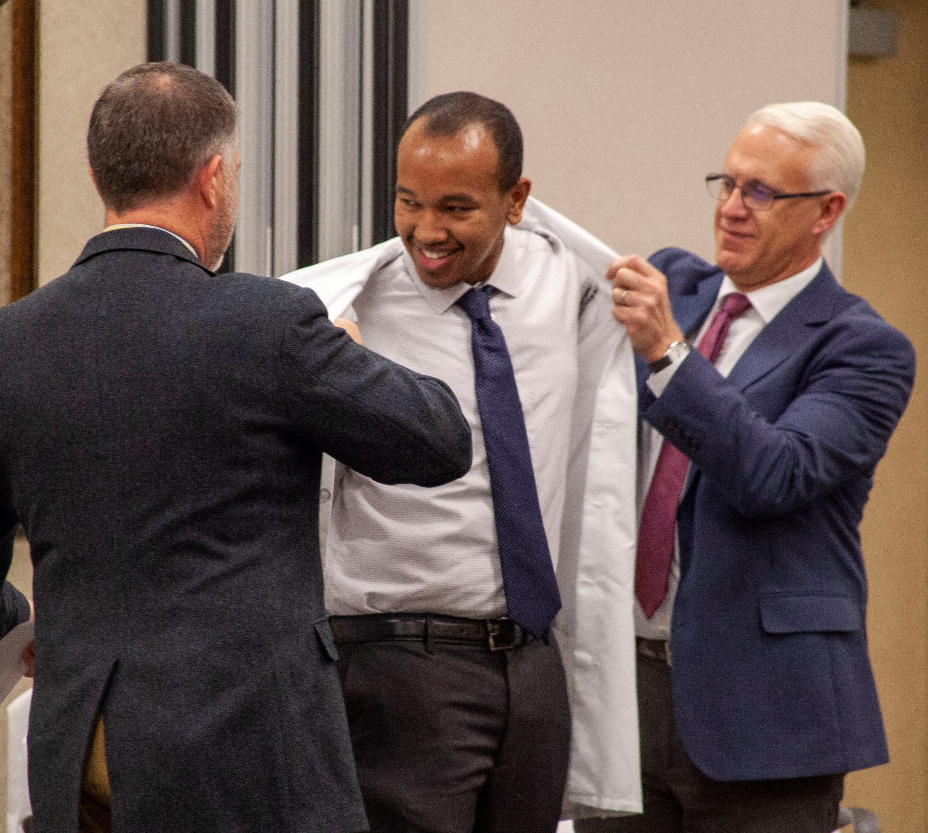
May term paid internships ($3,000 for 3 weeks)
Emergency Room
Family Practice
Specialties like Cardiology, Oncology, Ophthalmology, Radiology
Surgery
Obstetrics
Physical, Occupational and Speech Therapy
Hospital Laboratory
Hospital Pharmacy
Hospital Admissions and Business Office

Slide 10
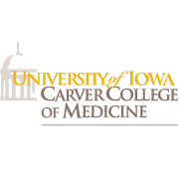
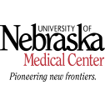
Medical school and health professions placements
32 URMED Scholars
24 Medical School or now practicing
16/21 practicing in rural settings
2 Physician Assistants
2 Nursing
1 Biomedical Research
3 Currently in application process

Slide 11
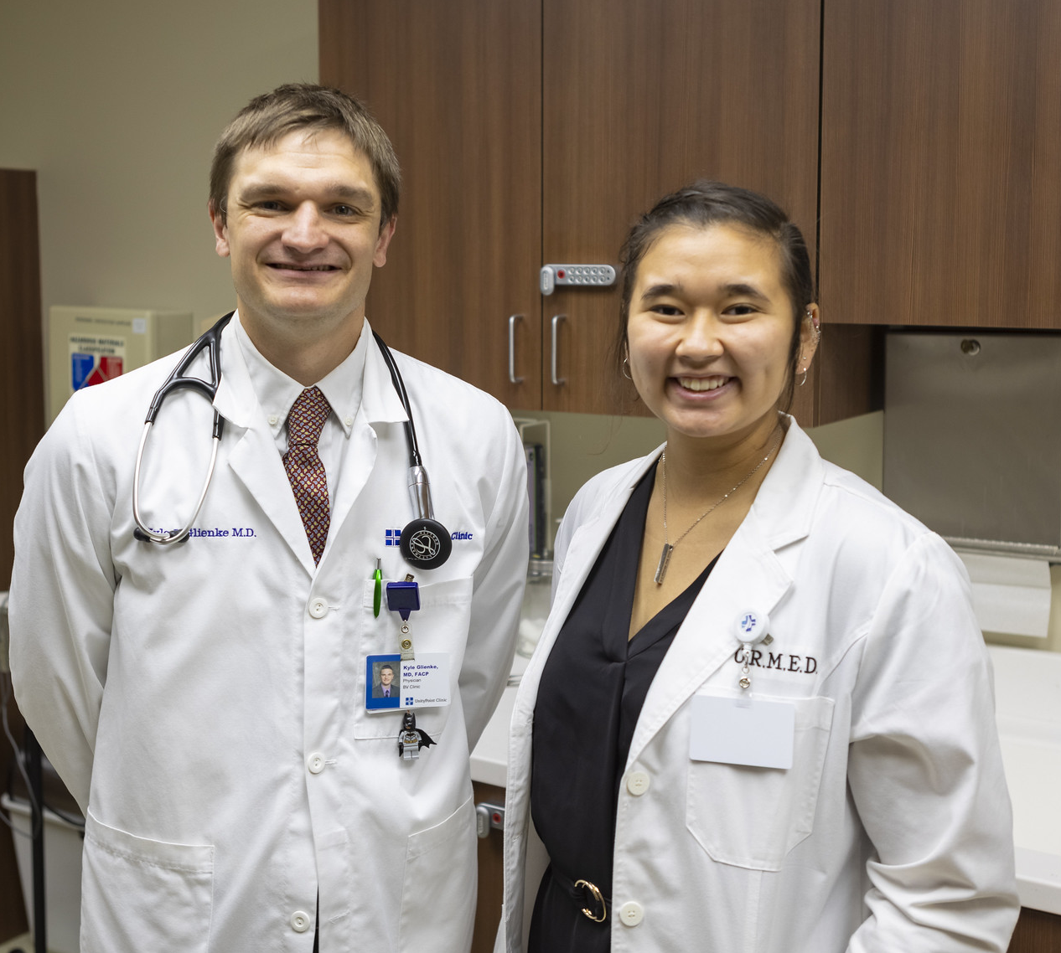
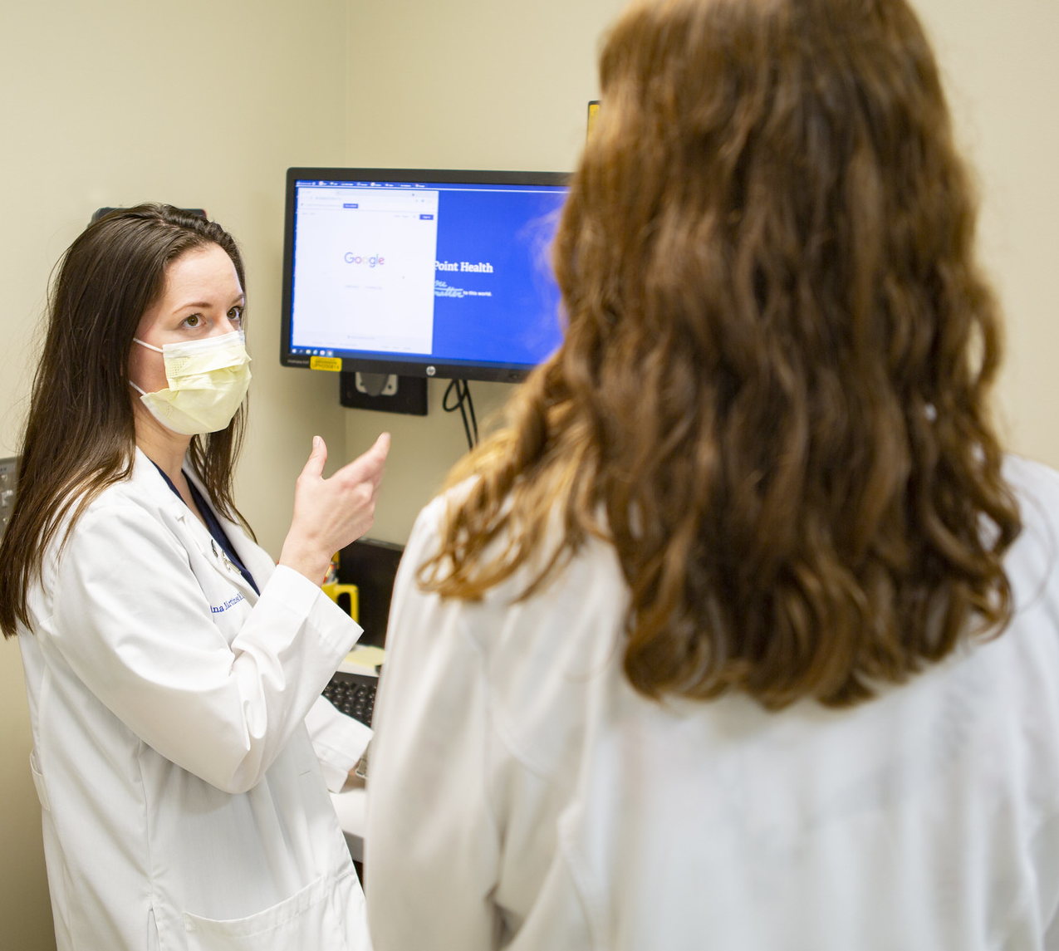
URMED comes full circle

Slide 12
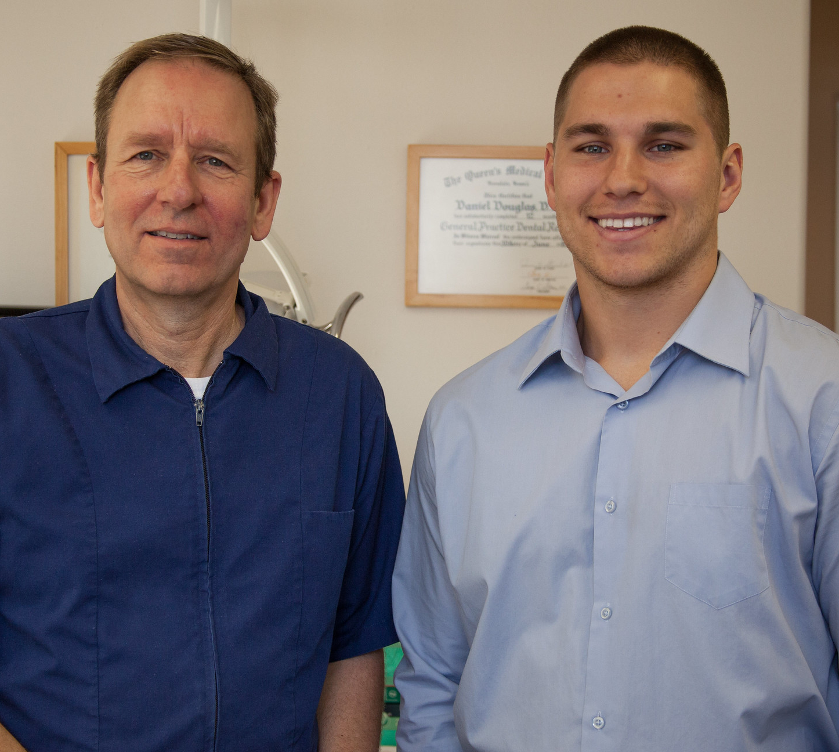
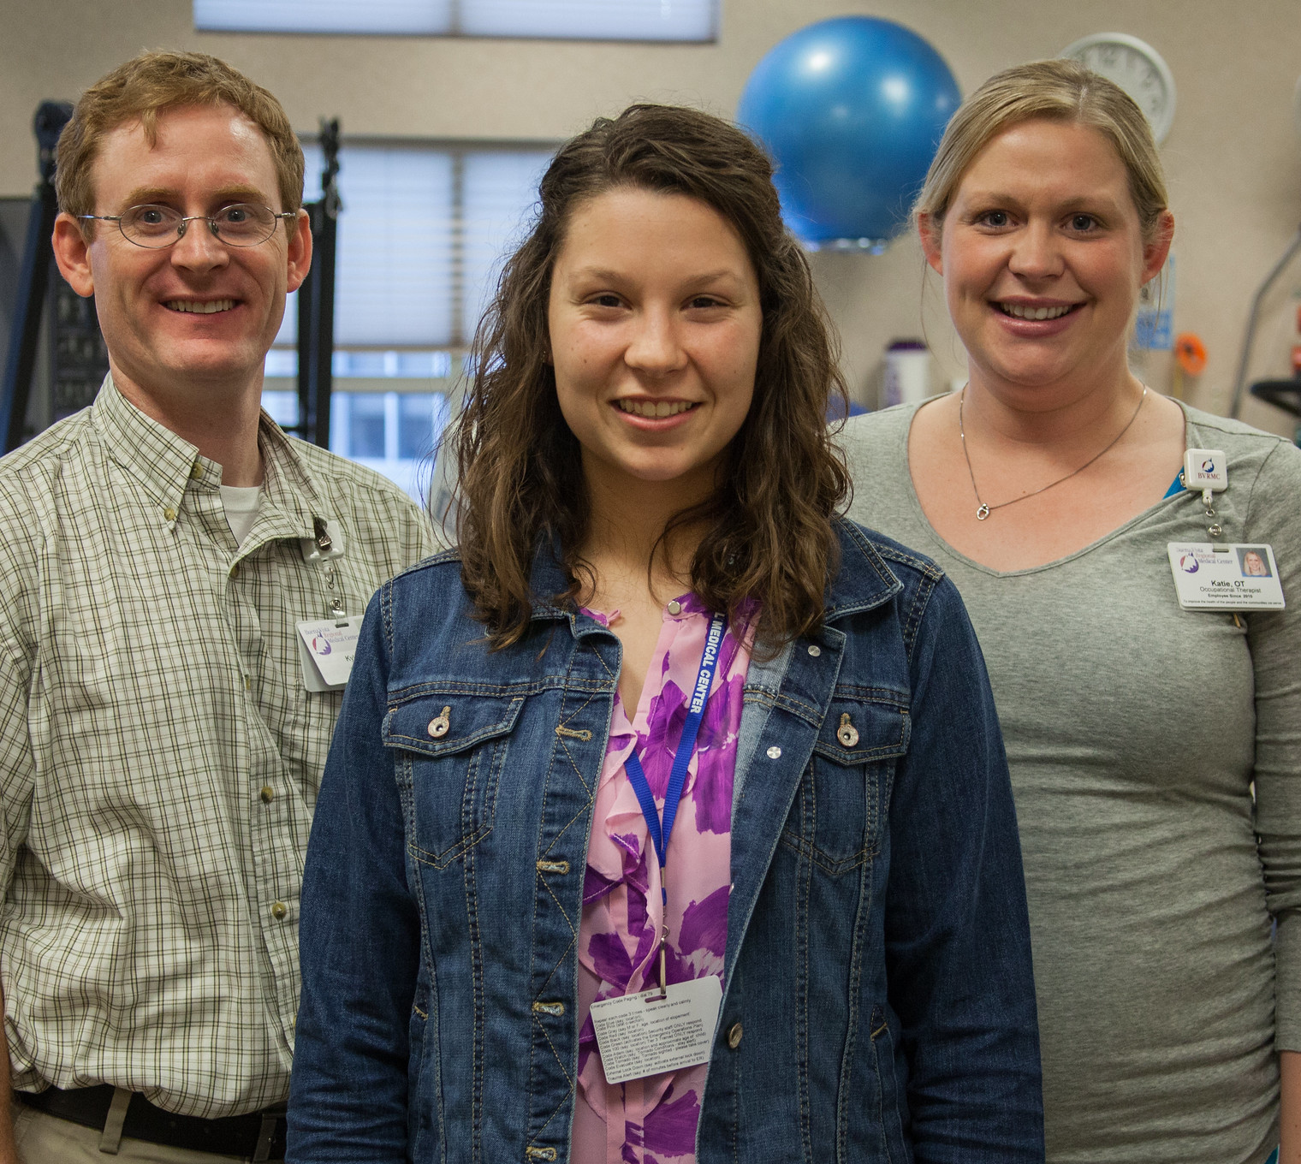
URMED expanded to pharmacy, dentistry, optometry, physical and occupational therapy
Example – Now BVU graduate dentists (Univ. of Iowa) in Primghar, Manning, Storm Lake, and Freeman (SD)

Slide 13
Making a difference for rural health care access in Iowa
URMED

