Slide 1
Board of Regents
Governing Iowa’s Public Universities

Slide 2
What is the Board of Regents?
Oversight and governance of Iowa’s public universities and special schools
Key priority: Maintain educational quality and access
Nearly 70,000 students enrolled at Iowa, Iowa State and UNI

Slide 3
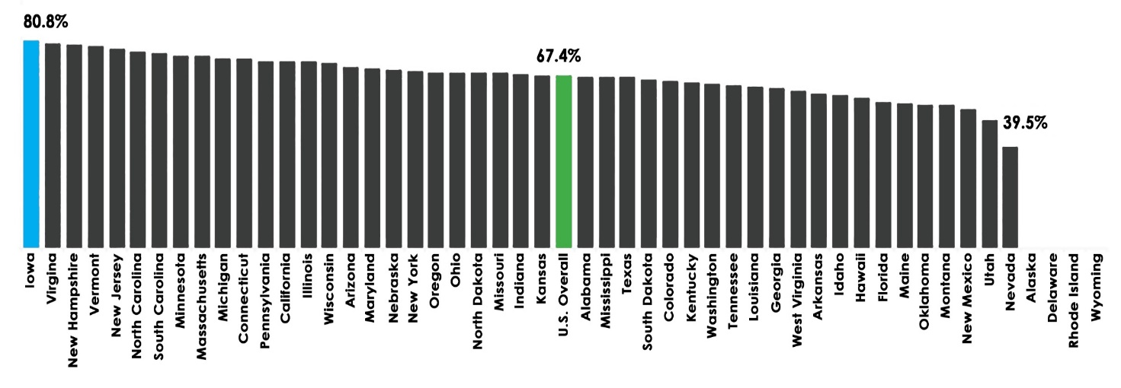
Degree Attainment Outcomes
80.8 percent of students who start college at one of Iowa’s public
universities earn a degree, the best degree attainment rate in the nation.

Slide 4
U.S. Census Bureau Collaboration
Regent University graduates matched to national data to show:
How much our graduates earn 1, 5, & 10 years after degree (adjusted to 2019 dollars)
Where they are employed across the country (industry & geography)

Slide 5
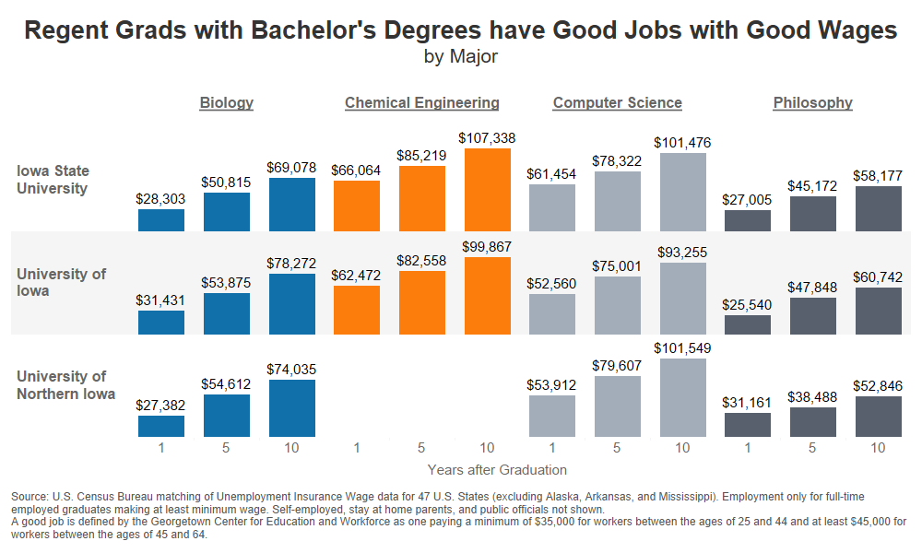
U.S. Census Bureau Collaboration

Slide 6
The Impact of Experiential Education on Career Readiness
Kellie Mullaney, Director of Engineering Career Services

Slide 7
Engineering Graduates in Iowa
We help add more than 400 engineers to the State of Iowa workforce every year and 800 more to the global workforce
During the past year, engineering grads have gone on to work full time at over 500 different Iowa companies

Slide 8
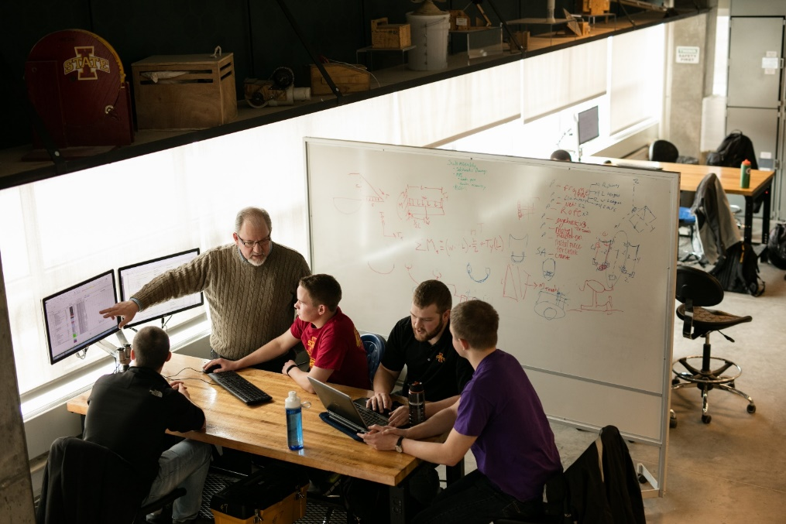
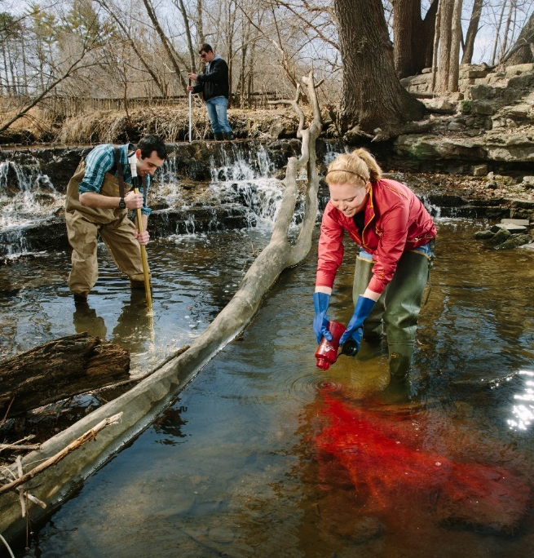
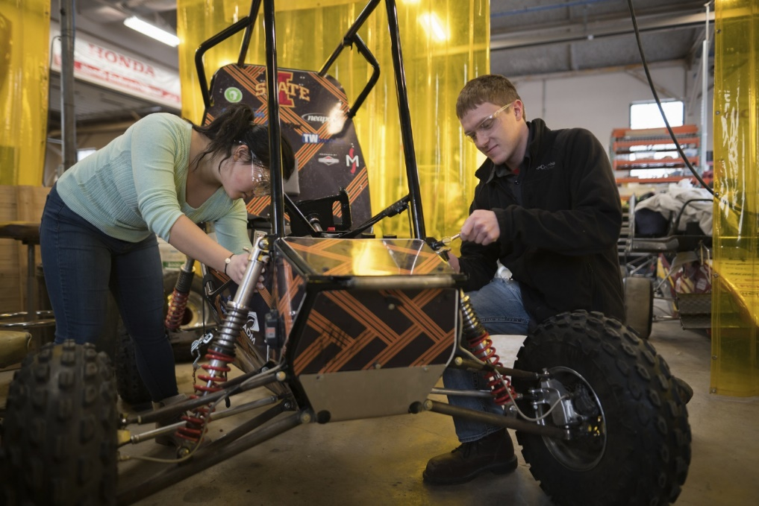
Focus on Experiential Education
Emphasis on integrating hands-on experiences
Co-ops/Internships
Innovation and Entrepreneurship Programs
Research on Campus
Student Organizations/Teams
Notes:
Have a large focus on experiential education – don’t just listen/read, but actually gain hands-on experience through:
These are in addition to the laboratory and design courses already required through the curriculum

Slide 9
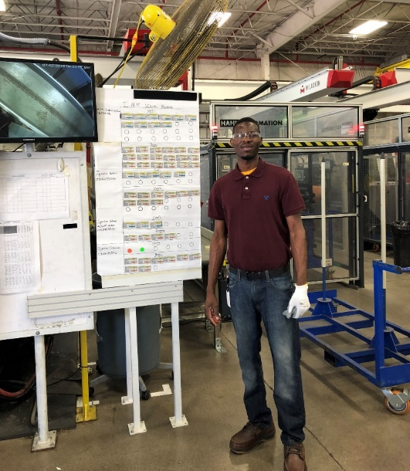
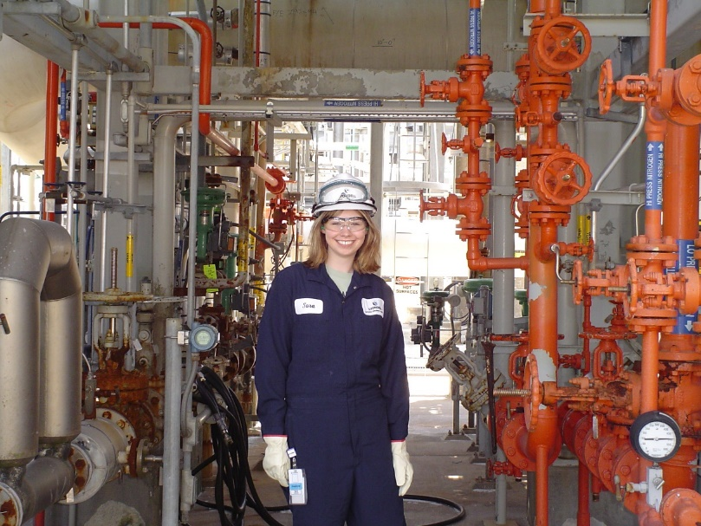
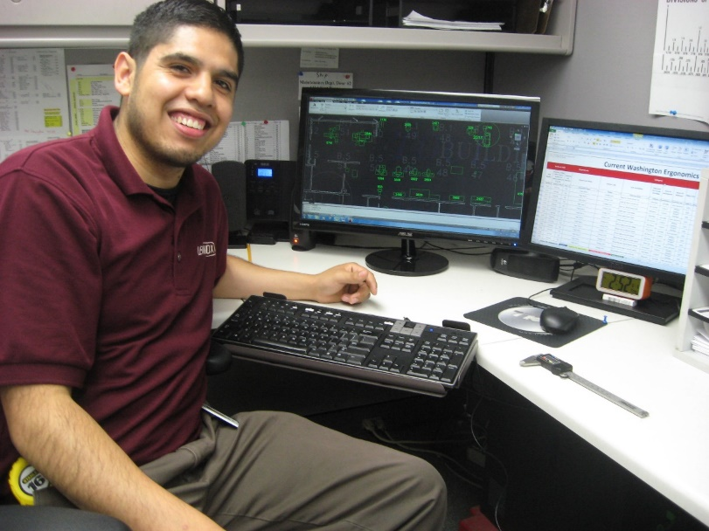
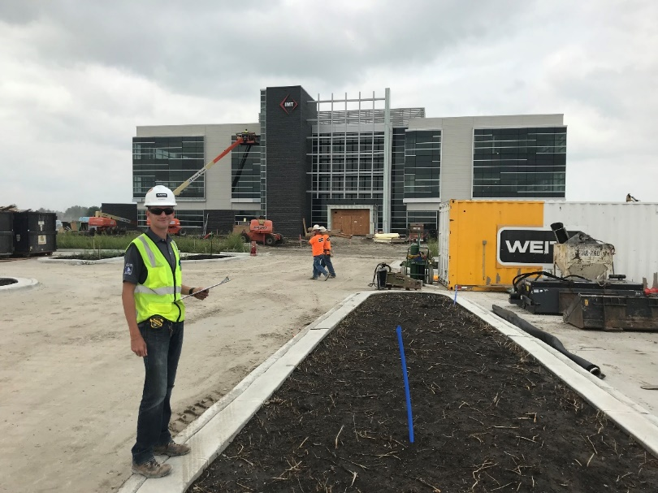
Co-ops/Internships
Approximately 75% of engineering students complete at least one
Benefits
Students with co-ops/internships have a consistently high likelihood of joining the workforce
Learn what it’s like to apply engineering skills in a work environment
More confident going into career
Develop professional and technical skills
Opportunity for companies to directly work with students

Slide 10
Experiential Education Prepares Students to Enter the Workforce
97% of students in 2021-22 academic year would recommend their experience to another student
Notes:
82%; 77%

Slide 11
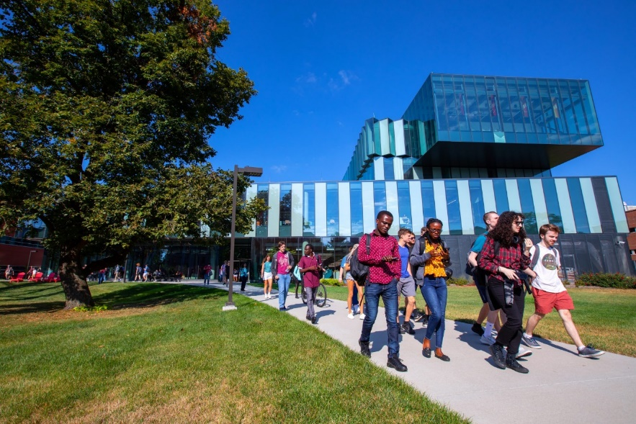
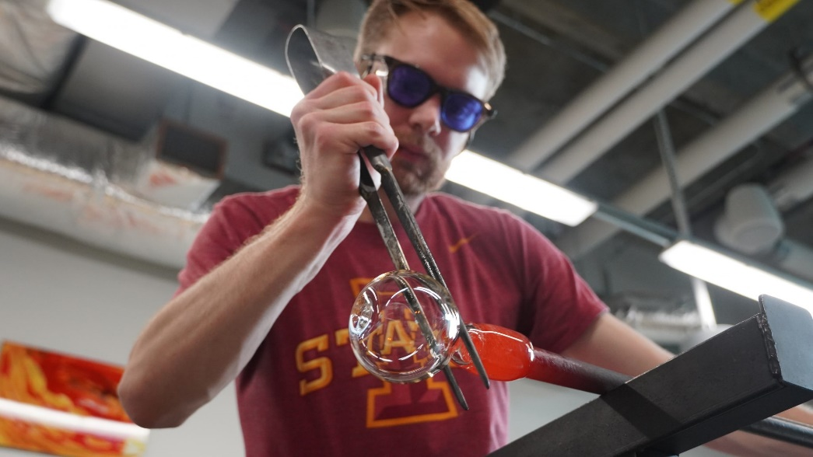
Innovation and Entrepreneurship Programs
Undergraduate programs ranked #11 in the country for the second year in a row.
Student Innovation Center
All colleges on campus are represented and interdepartmental-collaboration is encouraged
Electronics, textiles, 3D printing, Woodworking, Welding, Digital Modeling, Composites Fabrication, Digital Media, Cooking, Glassblowing, etc.
Pappajohn Center for Entrepreneurship,
Help students realize the potential in their ideas and make them a reality.
CyStarters has helped to start 64 businesses

Slide 12
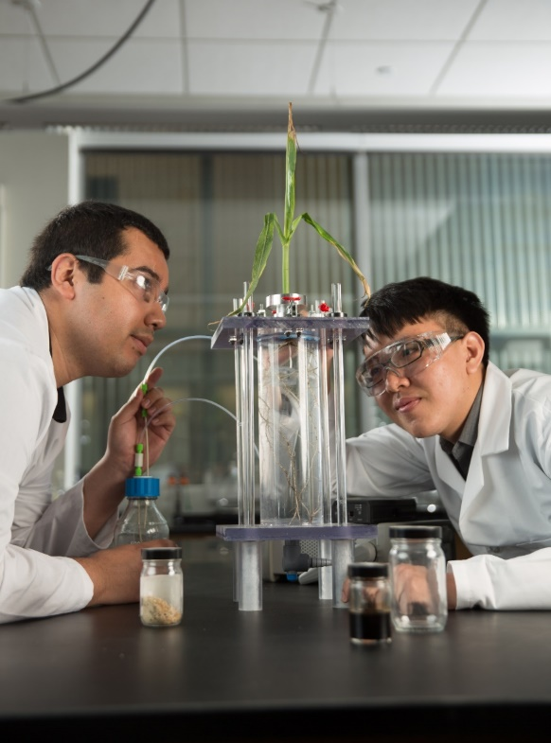
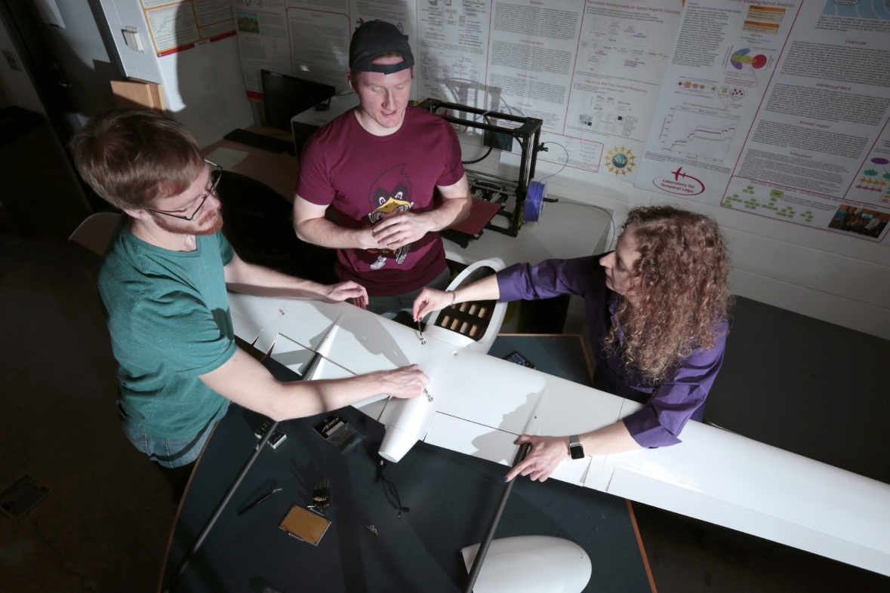
Research
#16 national ranking for research among universities without a human medical school
Students can connect with faculty to collaborate and lead projects

Slide 13
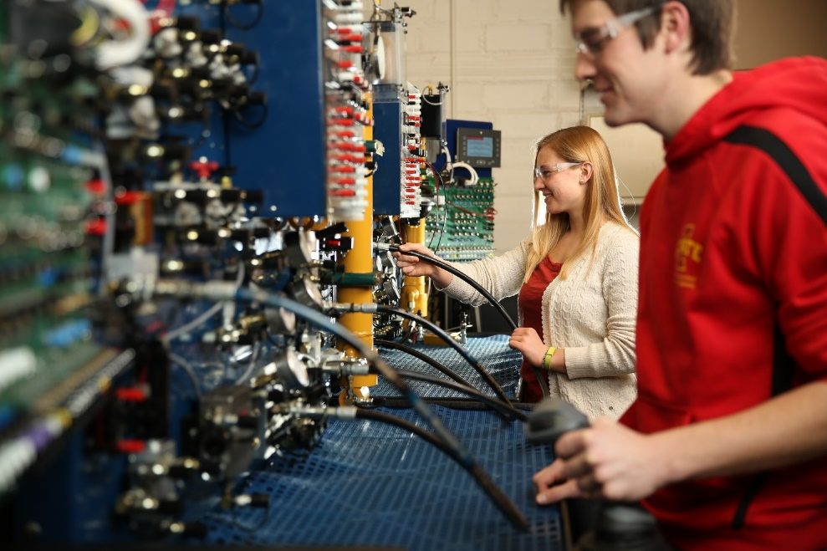
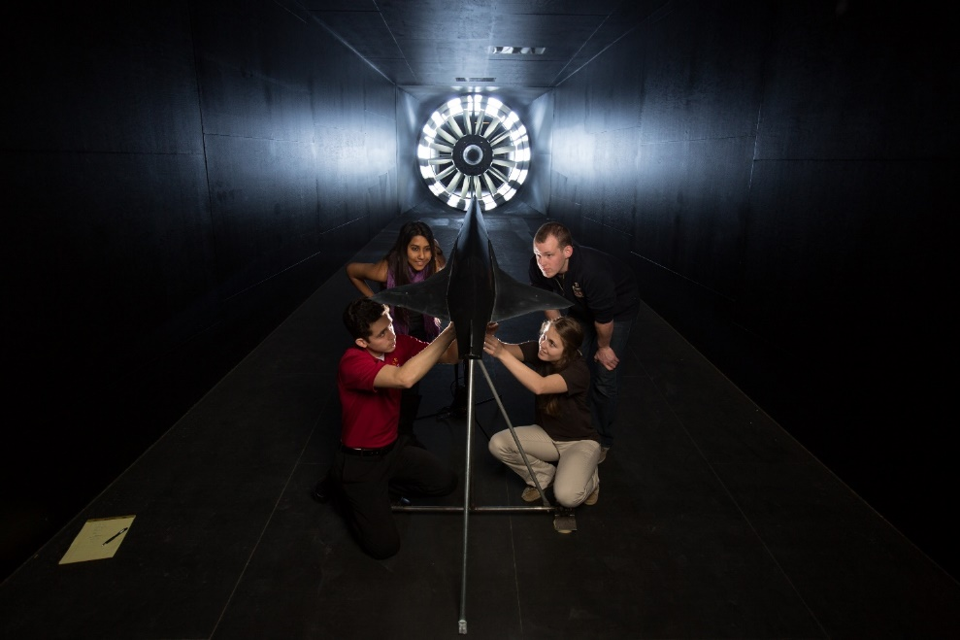
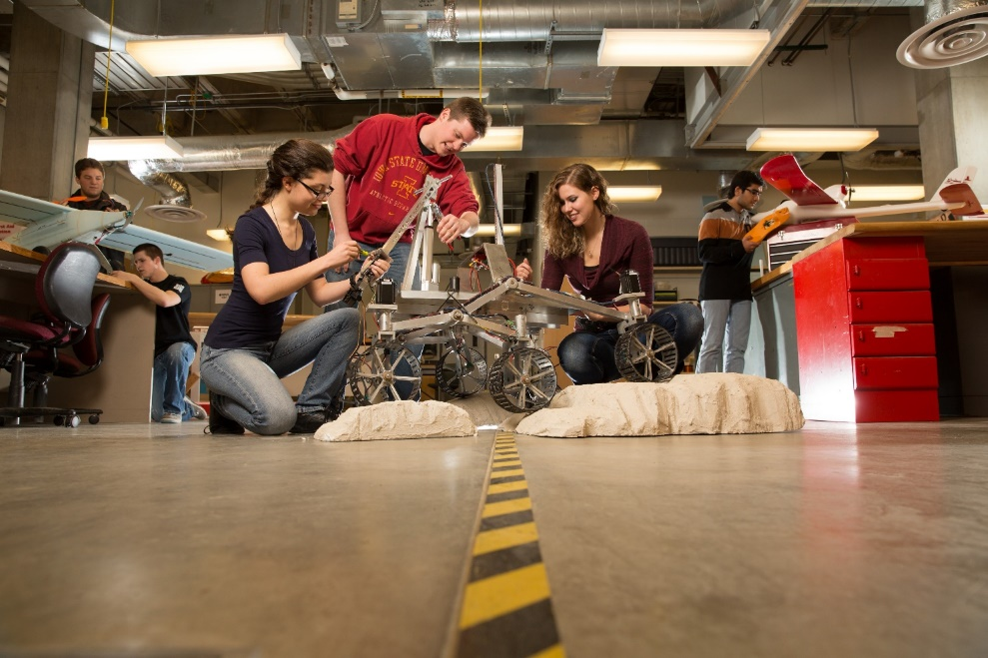
Student Orgs
Over 900 at ISU; over 90 in Engineering
Helps students build their networks and professional skills like collaboration, communication, planning, time management, leadership, etc.

Slide 14
Work-Based Learning in Educator Preparation at UNI
2022 Future Ready Iowa Summit
Dr. Benjamin Forsyth, Director of Educator Preparation

Slide 15
A little bit about Educator Preparation at UNI…

Slide 16
UNI Ed Prep Enrollment (as of Fall 22)
Business | 19
Early Childhood | 170
Elementary | 1111
Middle | 127
PE | 119
Art | 95
Science* | 46
English | 113
Spanish/TESOL | 59
Math | 71
Music* | 116
Special Education | 154
Tech/Engineering | 13
Theater | 18
Hist/Soc Sci | 219
TOTAL UGRAD | 2172
School Counseling/Soc Work | 36
Spanish/TESOL | 8
English Teaching | 16
Math Ed | 22
Science Ed | 23
Principalship | 94
International Teacher Leader | 31
PE/Pedagogy | 11
Special Ed | 4
Art Ed | 13
Early Childhood/Elementary | 22
Speech Language Pathology | 27
Literacy | 6
School Library | 47
Superintendency | 34
School Psych | 36
TOTAL GRAD | 430(274)
Notes:
UNI is in the top 2
Speech pathology includes grad/undergrad

Slide 17
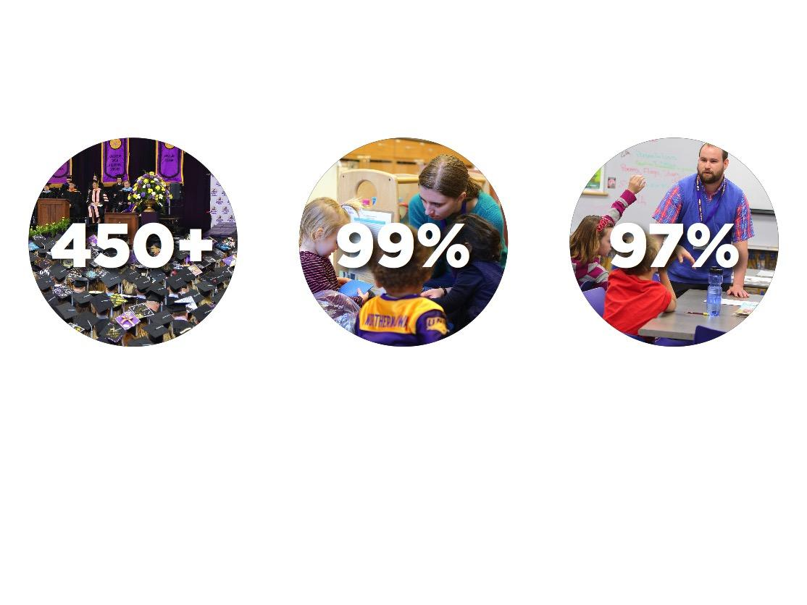
FACTS ABOUT UNI UNDERGRADUATE TEACHER EDUCATION
More than 450 new teachers graduate from UNI each year, making our education program the largest in the state of Iowa
99% of Iowa school districts and all 99 counties employ UNI education grads — and UNI alumni educators are employed in every state in the U.S.
97% of our graduating teachers were employed or continuing their education within six months of graduation
DID YOU KNOW?
UNI actually began as a teacher preparation school!

Slide 18
WHAT MAKES US THE LEADER IN TEACHER EDUCATION?
Education majors acquire 725+ hours of hands-on experiential learning in PK-12 classrooms by graduation
350+ school district partnerships
Teaching majors receive guidance from a team of more than 1,000 mentors and cooperating teachers
UNI graduates more teachers annually than 99% of U.S. institutions that offer bachelor’s degrees in teaching

Slide 19
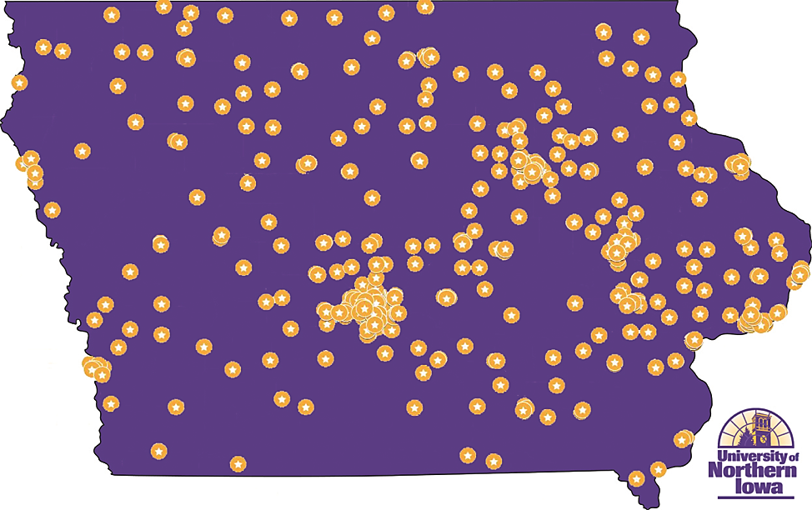
Where are our graduates?
Distribution of UNI TEACH Grant Recipient Alumni across Iowa (2018)
10,000+ alumni educators
Employed in 99% of Iowa School Districts
In all 99 counties
Nearly 90% of Teacher Candidates stay in Iowa

Slide 20
Five Work-Based Learning Initiatives
Cedar Valley Degree Links
Purple Pathway for Paraeducators
2+2 Online Education Degree
UNI@IACC
RAPIL Internship Program
Faster Pathways
Innovative Partnerships
Alternative Options

Slide 21
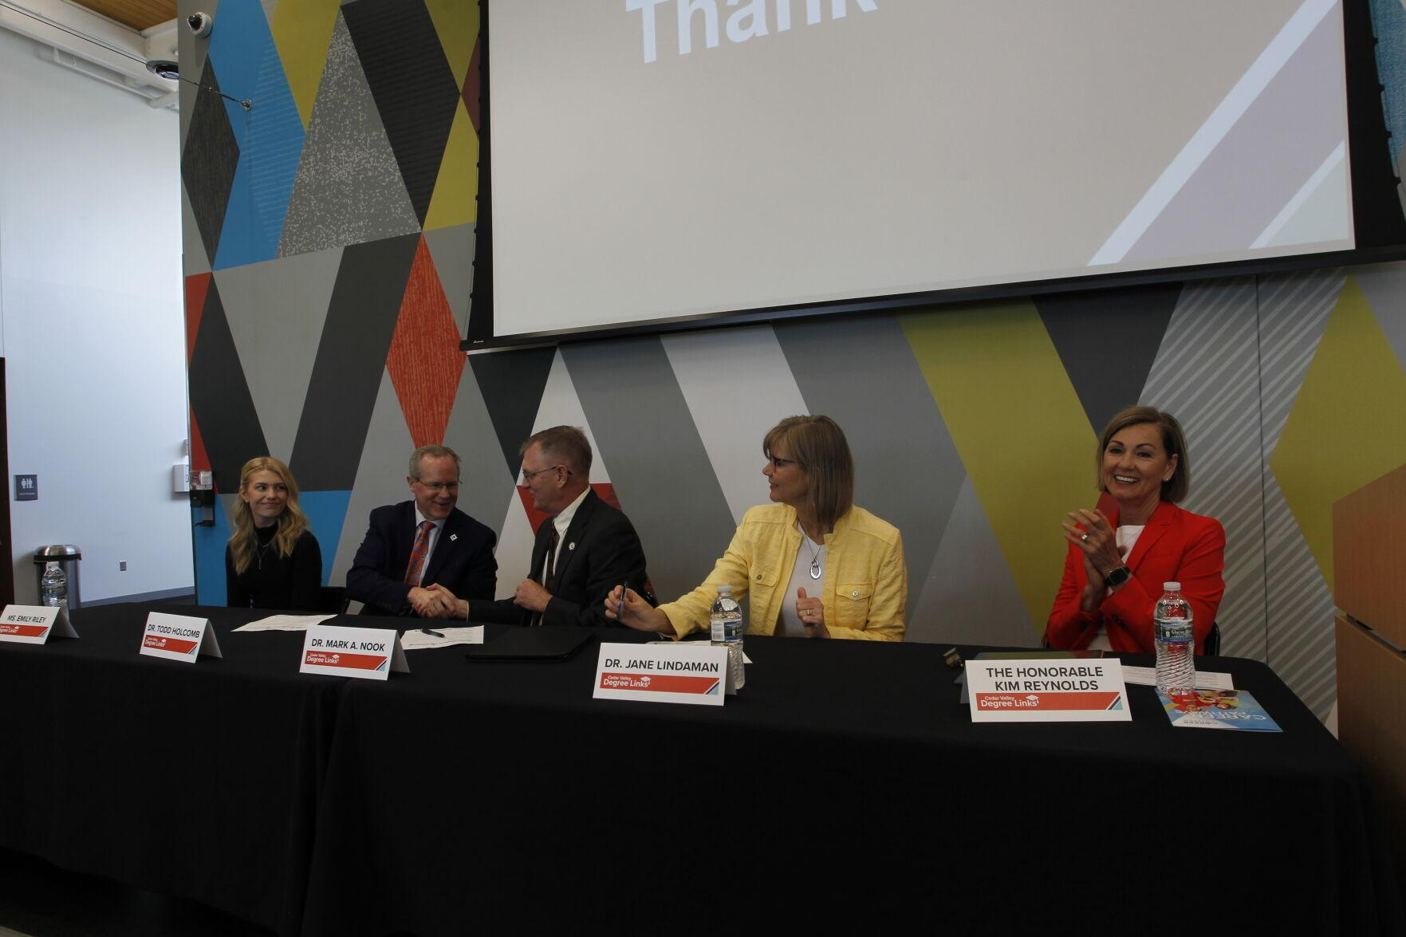
Cedar Valley Degree Links—Degree in Three
Partnership between Waterloo Schools Career Center, Hawkeye Community College and UNI
Elementary Education students can complete their degree in 3 years post-high school

Slide 22
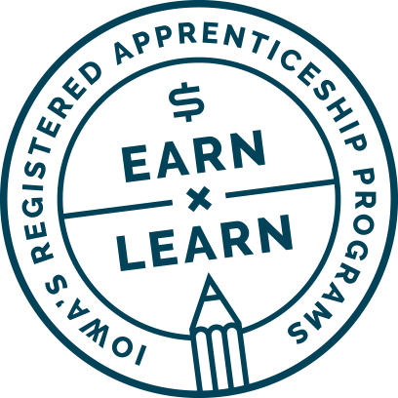
Purple Pathway for Paraeducators
Fully online program allowing paraeducators to earn their degree in two years without leaving the classroom
RTI Provider for 22 school districts receiving funding through the Teacher and Paraeducator Registered Apprenticeship (TPRA)
First cohort serves 67 paraeducators from 32 school districts across the state

Slide 23
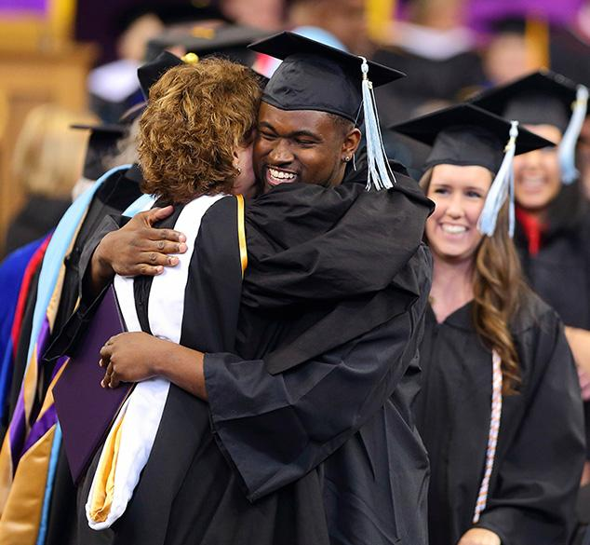
2+2 Online Education Degree
Flexible online pathway for students who have stepped away from college or started late
Provides flexibility due to family/work obligations or other life circumstances
Options for Early Childhood, Elementary, Middle Level, and Literacy emphases
Working to be registered apprenticeship eligible
Program has exploded in size to more than 100 students starting next May

Slide 24
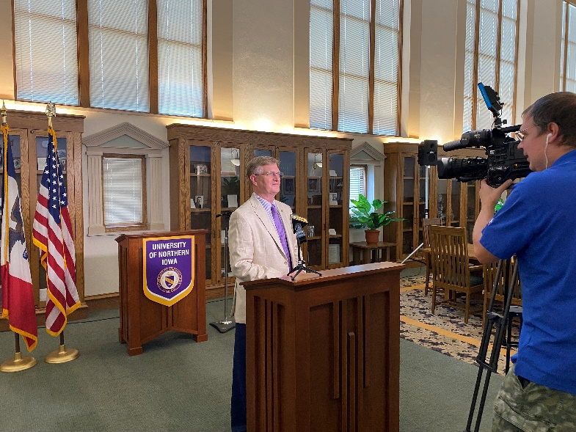
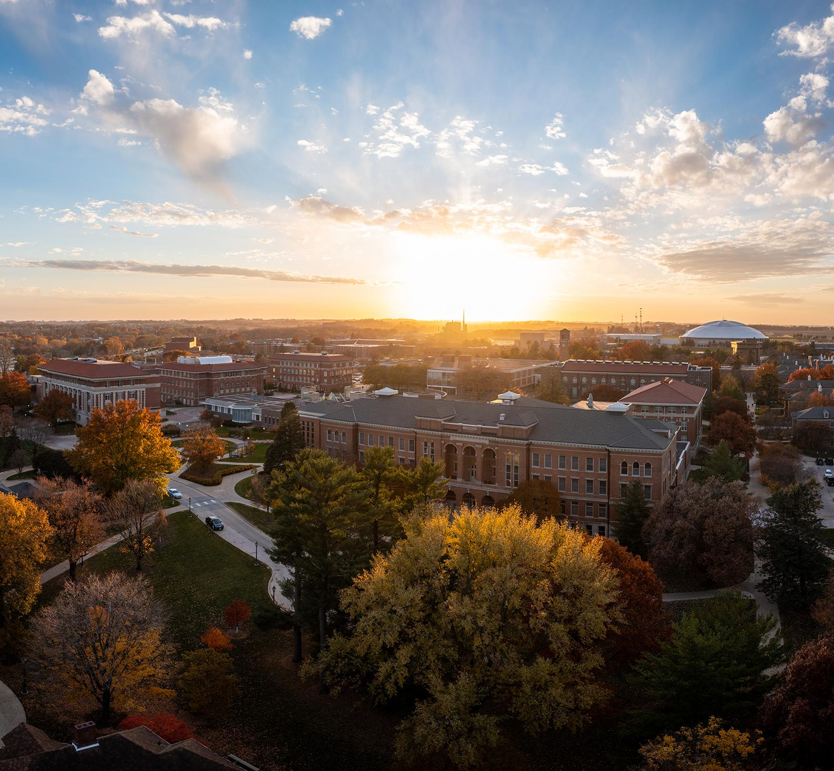
UNI@IACC
Expanded Partnership with Iowa Community Colleges (IACC)
Allows place-bound learners access to affordable, high-quality pathways to in-demand careers
Uses $4.166M American Rescue Plan funding for a Future Ready Scholarship Program that reduces eligible students’ tuition
Eight eligible programs including Elementary Ed

Slide 25
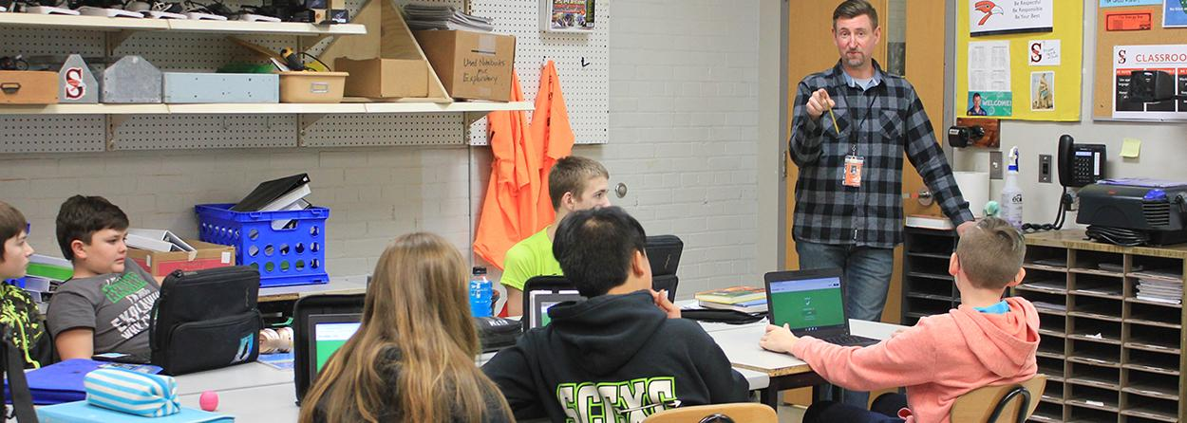
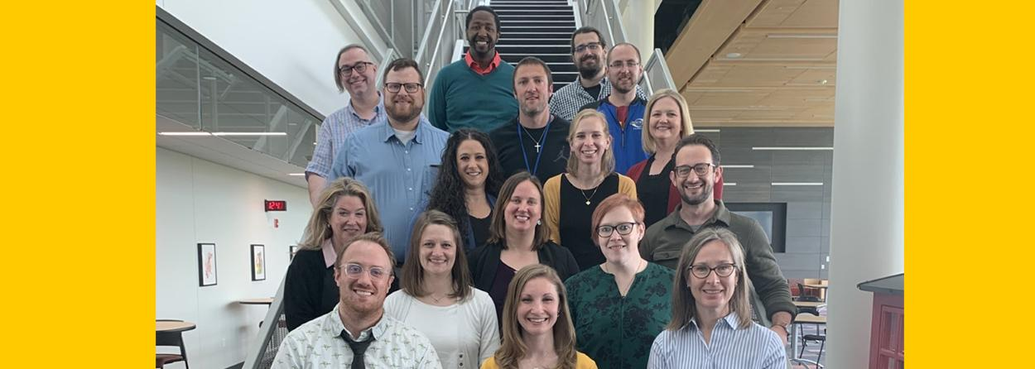
Regents Alternative Pathway to Iowa Licensure (RAPIL)
Two-year internship program for adult learners pursuing a degree in education
Collaborative program run in partnership across all three Regent’s Universities
78 students in the program with experience from dozens of career backgrounds

Slide 26
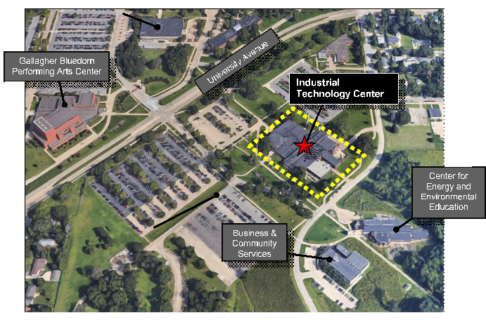
One last thing!
UNI’s Industrial Technology Center is getting an $44M upgrade!
Home to many CTE / Work-Based Learning efforts
Allows UNI to provide greater preparation for STEM disciplines, Construction Management, Electrical Engineering Technology, Tech and Engineering Education, Graphic Technology, Manufacturing Technology and Technology Management

Slide 27
Thank you

