Slide 1
Community Colleges for Iowa
Exploring Student Outcomes and Trends
Future Ready Iowa Summit
September 2022

Slide 2


Slide 3
Trends
Short-term noncredit program growth and alignment
National leadership in joint/concurrent enrollment
Linkages and accountability to workforce needs

Slide 4
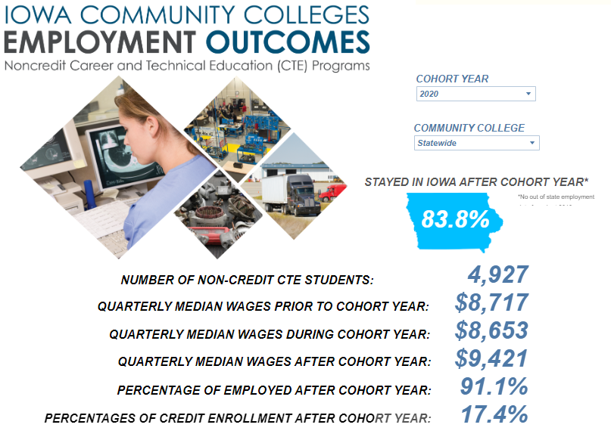
Noncredit Programs

Slide 5
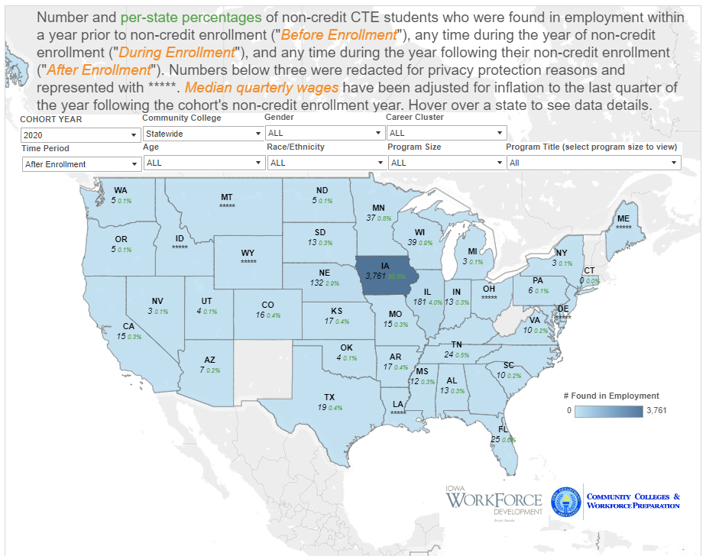
Noncredit Programs

Slide 6
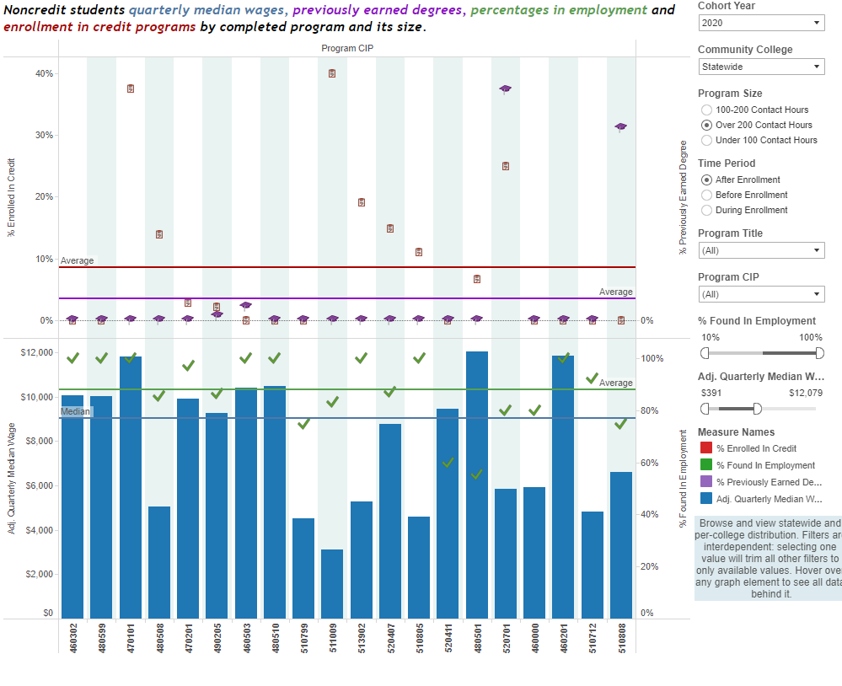
Noncredit Programs

Slide 7
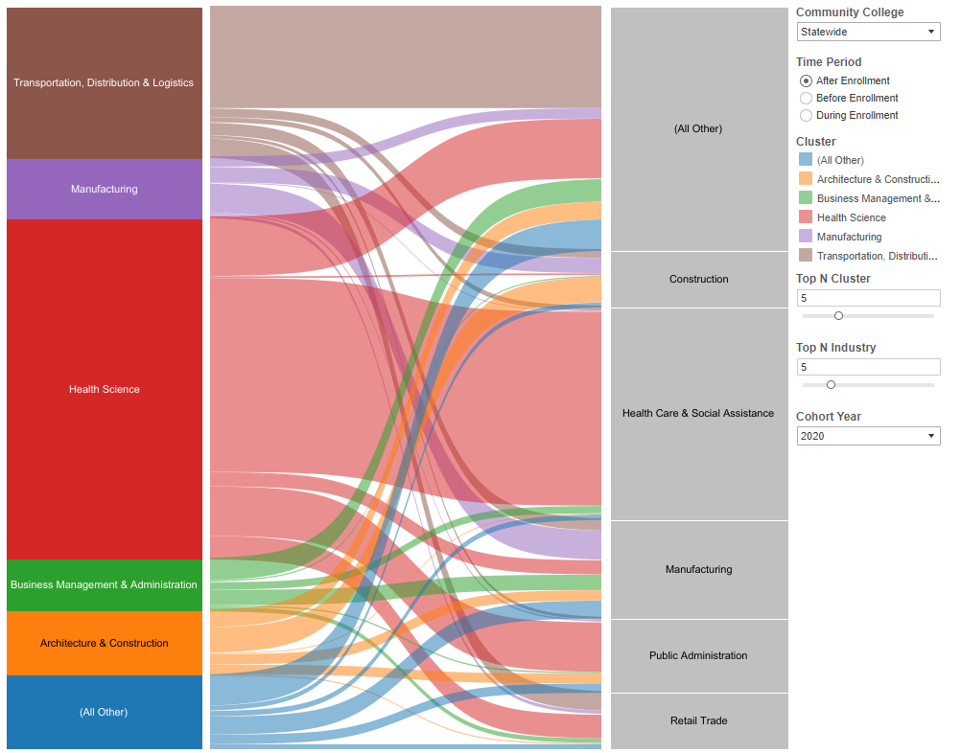
Noncredit Programs

Slide 8
Joint/Concurrent Enrollment
Jointly enrolled students are high school students enrolled in community college credit coursework. The report here is based on the 2011 Iowa high school graduating class; high school students were followed to postsecondary education enrollments and completions for eight years following high school graduation. The student cohort was split into two groups: those who experienced joint (dual) enrollment (JE) and those who did not enroll in joint (dual) enrollment options (NJE).

Slide 9
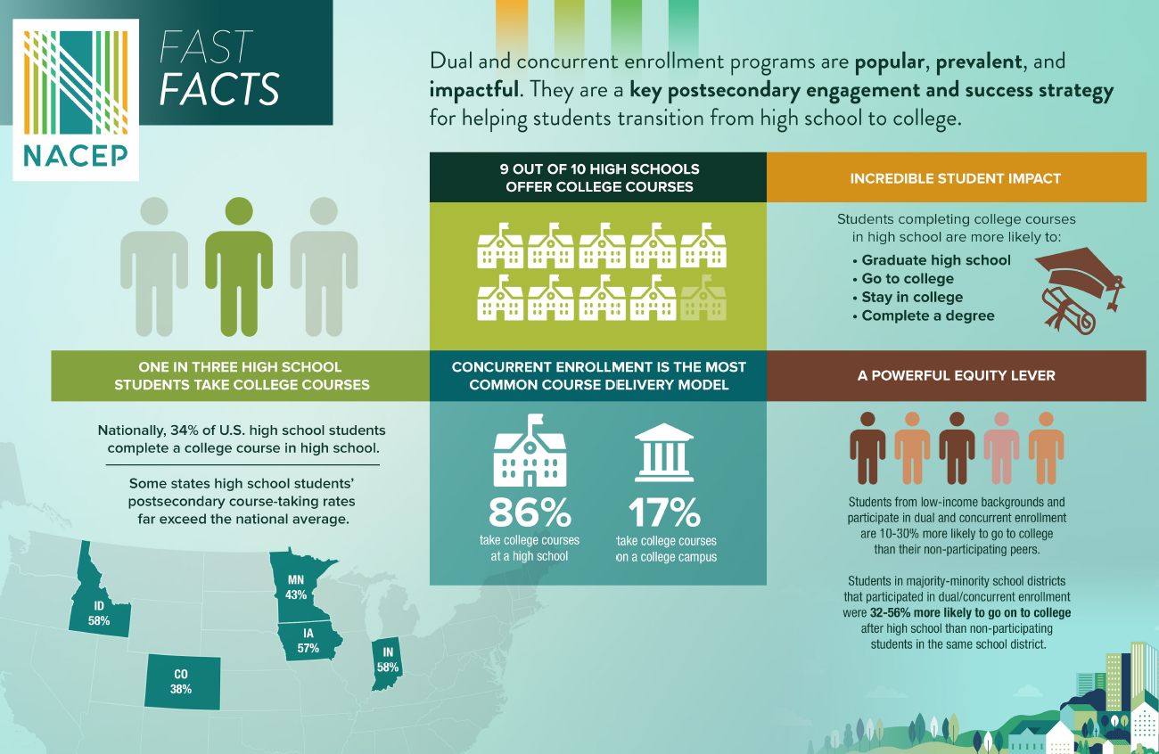
Concurrent Enrollment

Slide 10
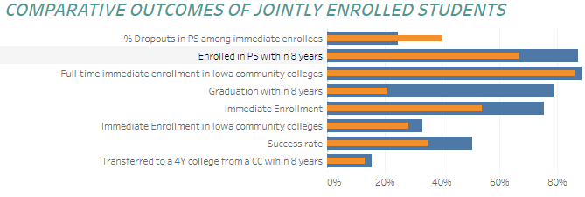
Joint/Concurrent Enrollment

Slide 11
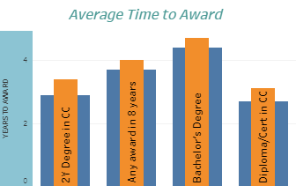
Joint/Concurrent Enrollment

Slide 12
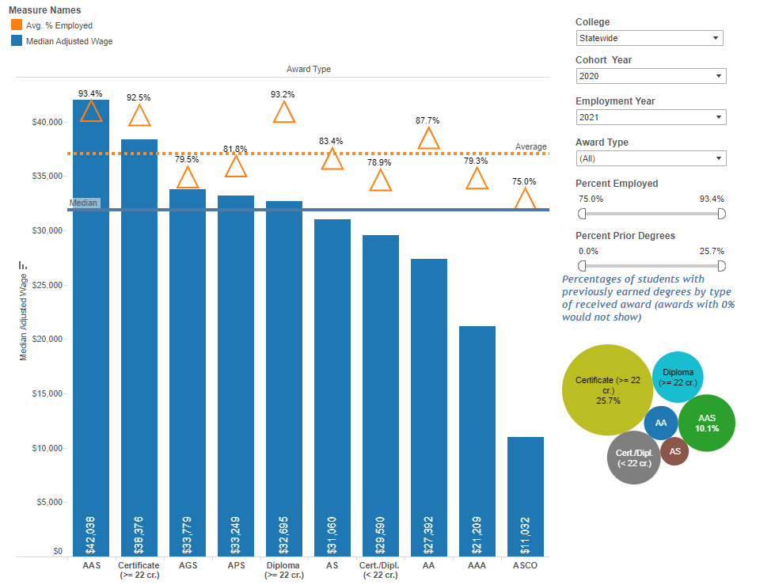
Workforce Accountability

Slide 13
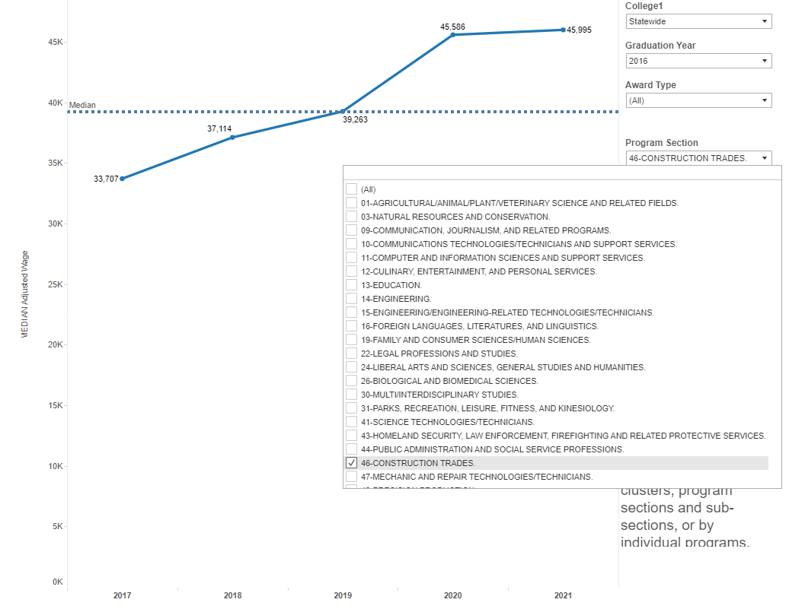
Workforce Accountability

Slide 14
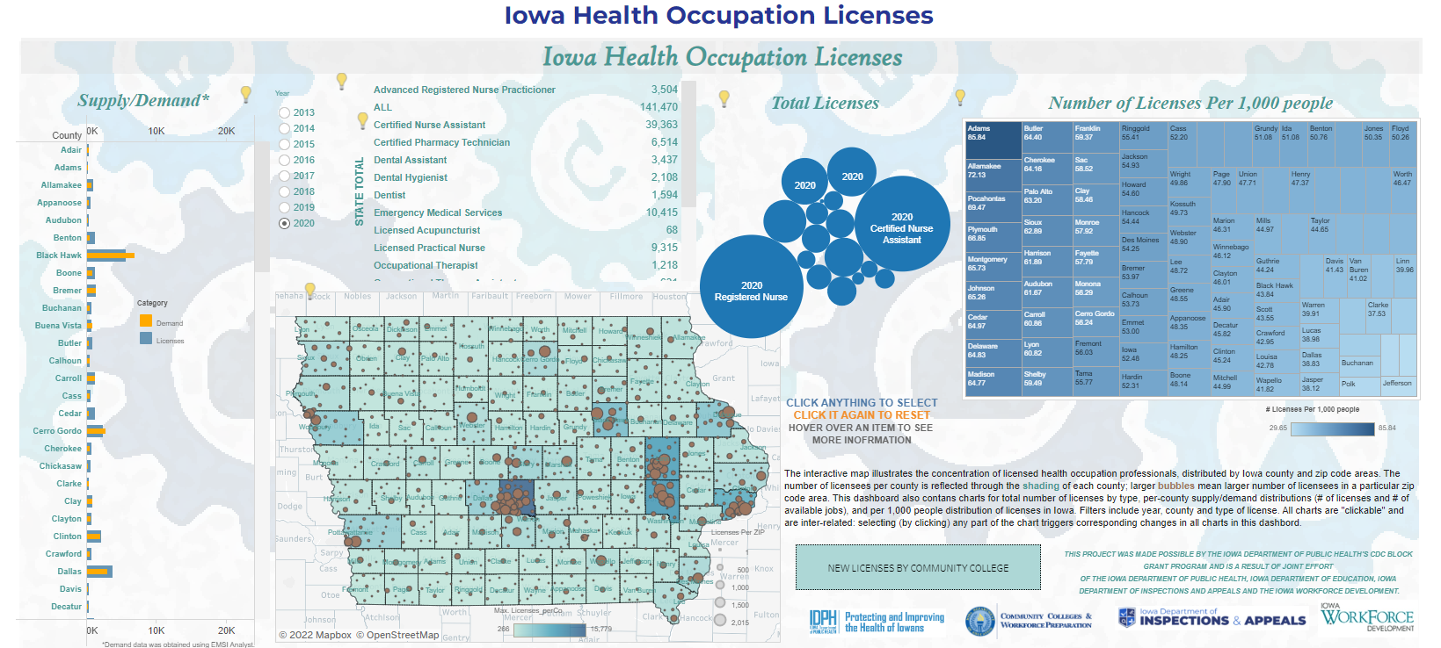
Workforce Accountability

