Slide 1
Serving Iowans:
How to reach the people you can't reach

Slide 2
About the Department
of
Human Rights

Slide 3
What does the future
look like?

Slide 4
How We're Changing

Slide 5
How We're Challenged

Slide 6
Big Opportunity #1
Actively Incubate and Invest
in Ethnic and Faith-based
Nonprofits

Slide 7
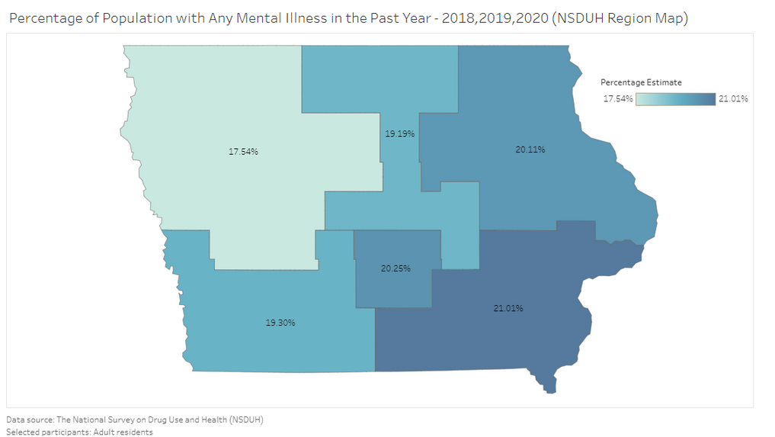
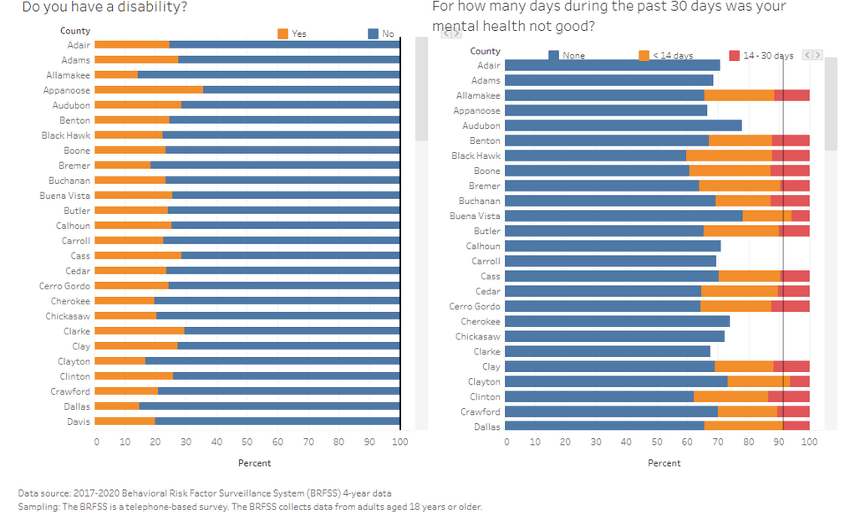
Big Opportunity #2
Intentionally Share and Assess Administrative Data

Slide 8
Our Future for Iowa -
We offer unprecidented opportunity
for everyone

Slide 9
What's next?
Monica Stone
monica.stone@iowa.gov

