Slide 1
What is a Registered Apprenticeship
Who is a strong candidate for a registered apprenticeship?
https://www.earnandlearniowa.gov/

Slide 2
Registered Apprenticeship objectives
Goal: Future Ready Goal: 70% of Iowa’s workforce to have education or training beyond high school by 2025.
Goal: Reduce the socioeconomic, ethnic and language achievement gaps in kindergarten through 12th grade and increasing equity in postsecondary enrollment.
Goal: Increase the percent of traditional-age students and adult learners who earn postsecondary degrees, certificates or other quality credentials.
Goal: Advance how degrees, certificates, and other credentials awarded by Iowa postsecondary institutions align with high-demand job needs and job-placement rates.

Slide 3
What is a Registered Apprenticeship
OVERVIEW:
Employer Driven Training Program
Combines On-the-Job Training and Related Training Instruction
Allows apprentice to earn a paycheck while they learn on the job
Apprentice earns a National Credential
EMPLOYER BENEFITS:
Customized Training
Increased Knowledge
Enhanced Employee Retention
A safer workplace
Upskill current employees
Higher productivity

Slide 4
Registered Apprenticeship models
SPONSOR:
Any person, association, committee, or organization operating an approved and listed as Registered Apprenticeship Program
Eligible programs can apply for funding and support through IWD
RA MODELS:
Time Based Apprenticeship
Competency Based Apprenticeship
Hy-Brid Apprenticeships
Quality Pre-Apprenticeship
High School Registered Apprenticeship

Slide 5
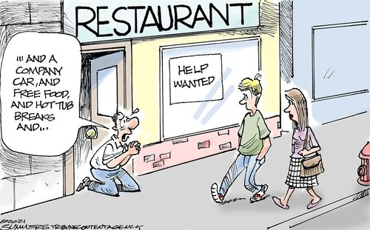
What do our statistics say?
Iowa Unemployment Rate 3.7%
(U.S. Bureau of Labor Statistics)
Iowa reached 70.4% labor force participation in November 2019
(U.S. Bureau of Labor Statistics)
There are jobs, there is low unemployment, but fewer people in the workforce

Slide 6
Why RA and WBL?
$77K Average Starting Salary
Average starting salary after an apprentice completes an apprenticeship program
93%Employment Retention
Percentage of apprentices who retain employment after apprenticeship completion
$300K+Lifetime Earning Advantage
Apprentice graduates earn more over their lifetime compared to peers who don't

Slide 7
Support? Questions?
KRIS BYAM
KRISTOPHER.BYAM@IWD.IOWA.GOV
https://www.earnandlearniowa.gov/

