Slide 1


Kathy Leggett
Future Ready Iowa
Kathy.Leggett@iwd.iowa.gov
Closing
Iowa’s
SKILLS GAP

Slide 2
Future Ready Iowa
Review of FRI
Strategies
Metrics
Work to Date
Strategy to Action
I want to hear from you -

Slide 3
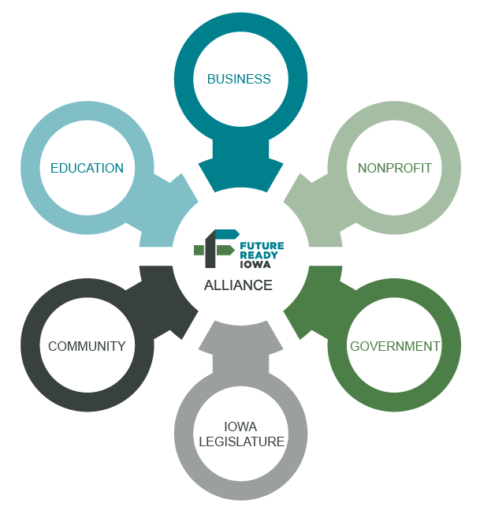
70% of Iowa’s workforce with education or training beyond high school by 2025.
Future Ready Iowa
Alliance Task: In 2017, create a strategic plan to reach ambitious goal of 70% of Iowa’s workforce having education or training beyond high school by 2025

Slide 4
Initiative Across Multiple Entities
Future Ready Iowa
Better Align Education and the Workforce
Accelerate Opportunities to meet Workforce Needs
Address Barriers

Slide 5
Why Future Ready Iowa?
It is projected that 68% of the jobs in Iowa will require training beyond high school by 2025.
Close the skills gap in Iowa.
To better align education and the workforce to meet employer needs.

Slide 6
PROJECTED
SKILLS GAP
Iowa’s Jobs by Skill Level, 2019
52%
ARE MIDDLE-SKILL JOBS
Sources: 2018 Occupational Employment Statistics, Labor Market Information Division

Slide 7
Iowa is experiencing a
Middle-Skill Job Gap
Iowa’s Jobs and Workers by Skill Level, 2019-20
Sources: 2019 Occupational Employment Statistics, Labor Market Information Division, Iowa Workforce Development. 2020 Current Population Survey, U.S. Census Bureau.

Slide 8
Percent of Employers who Perceive they have difficulty filling positions due to:
Applicants lack the QUALIFICATIONS needed
56%
GENERAL lack of Applicants
48%
Lack of applicants due to
wages offered
28%
Lack of applicants due to benefit package provided
21.7%
Employer Perception of
Applicants
2019 WORKFORCE NEEDS SURVEY
Lack of applicants due to type of work required
30.7%

Slide 9
Metrics
70% of Iowa’s workforce with education or training beyond high school by 2025.
62.1%
Percentage of Iowans who have completed certificates of education or training beyond high school (2021 Laborshed study)
71.4%
Percentage of Iowans who received a certificate and adults who have received some postsecondary education/training that, according to them, added value to their career path (2021 Laborshed study)

Slide 10
Five Strategies
Future Ready Iowa
Funding
Barriers
Work-Based Learning
21st Century Skills
Grassroots

Slide 11
Last Dollar Scholarship
Funding Strategy
Funds postsecondary credentials up to an associates degree in high-demand occupations.
Target High School graduates and adults – this can be used to upskill adult employees.
Not income means tested – focus on providing more opportunities for Iowans to gain needed skills to fill high demand jobs to meet Iowa’s workforce needs.
As employers with open occupations on the high demand list, you can leverage this funding for your current employees

Slide 12

Last-Dollar Scholarship
Funding strategy
20-21 School Year
Recipients (3 of 6 terms)
State of Iowa
7,689
Scholarship Amount Provided
$44,081,545 (1/28/22)
Last Dollar Scholarship
For Iowans seeking up to an associates degree in a high-demand job at Iowa colleges or universities.
Funded at $23 million in FY23

Slide 13
Last Dollar Scholarship- Top Occupations
Program Associate Degree Nursing Licensed Practical/Vocational Nurse Training Computer Programming, Specific Applications Automotive Technology (AA) Medical Assistant Welding Technology/Welder Radiologic Technology/Science – Radiographer Diesel Truck Technology (AA) Transportation Storage and Distribution Managers Heating, Air Conditioning, Ventilation and Refrigeration Maintenance Technology Technician

Slide 14
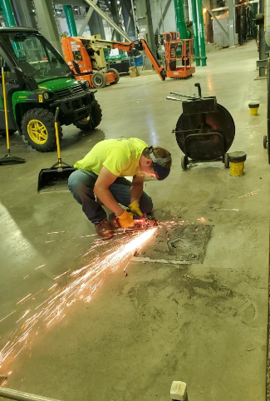
Summer Youth Internships
Funding Strategy

Slide 15
Future Ready Iowa
Summer Youth Internship Program
Grant Purpose
To provide high school youth internship opportunities that allow them to explore and prepare for high-demand careers, to gain work experience, and to develop personal attributes necessary to succeed in the workplace.
Anticipated Funding Opportunity- Jan/Feb 2023
www.futurereadyiowa.gov

Slide 16
Future Ready Iowa
Summer Youth Internship Grants
2021
Projects 26
Average Award (state investment) $44,516
Participants 438 (93%)
Participants (identified barriers) 369 (78%)
Credentials Earned 425
Employers 158
Average Cost per Participant $2,462
2022 –
34 projects recently completed

Slide 17
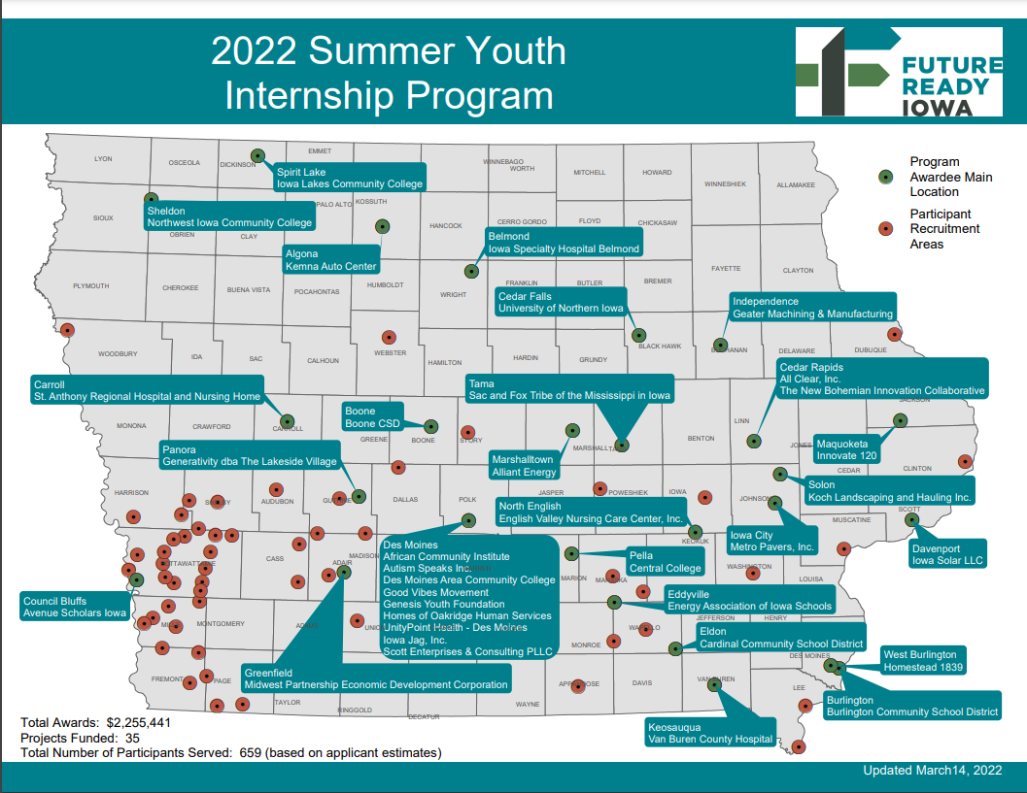

Slide 18
Strategy 2
Align + Expand Existing Ecosystem of Support
Addressing Barriers for obtaining education, training and employment
Transportation
Clothing
Testing Fees
Child Care
Supplies and Equipment
Wi-Fi and Internet connections

Slide 19

STRATEGY 3
EXPAND HIGH QUALITY WORK-BASED LEARNING
EXPERIENCES IN HIGH DEMAND CAREERS
Work-based learning for all students
Quality pre-apprenticeships
Registered apprenticeships
Internship programs
Leverage existing programs such as STEM BEST and Iowa Intermediary Networks, Work-based Learning Clearinghouse
RA Contact: Kristopher Byam – Kristopher.byam@iwd.iowa.gov
RA Contact: Linda Fandel – Linda.Fandel@iwd.iowa.gov
Greer Sission – Department of Labor – sesson.greer@dol.gov

Slide 20
REGISTERED APPRENTICESHIP
What is Apprenticeship?
Apprenticeship is an industry-driven, high-quality career pathway where employers can develop and prepare their future workforce, and individuals can obtain paid work experience, classroom instruction, and a portable, nationally-recognized credential. It includes:
Paid Job - Apprentices are paid employees who produce high-quality work while they learn skills that enhance their employers' needs.
On-the-Job Learning- Develops skilled workers through structured learning in a work setting.
Classroom Learning - Improves job-related skills through education in a classroom setting (virtual or in-person).
Mentorship - Provides apprentices with the support of a skilled worker to assist and enhance critical hands-on learning.
Credentials - Offers a portable, nationally-recognized credential to be issued at the completion of the program.
Hot Mix Asphalt Operator

Slide 21
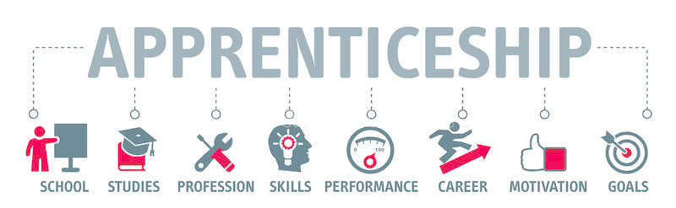
REGISTERED APPRENTICESHIP
PROGRAMS IN HIGH SCHOOL
79 Iowa high schools (Not including teacher para and healthcare grants) are currently participating in Registered Apprenticeship programs with
More than 27 different occupational programs.

Slide 22

STRATEGY 4
PREPARE STUDENTS FOR A CHANGING WORLD
Update Iowa’s 21st century skills in our 2019 state academic standards and identify other early learning academic approaches.

Slide 23

STRATEGY 5
ENGAGE THE BUSINESS COMMUNITY
AND OTHER REGIONAL COLLABORATORS
Develop a grassroots strategy that maps out existing regional and local workforce partnerships and fills identified gaps.

Slide 24
Future Ready Iowa
Summer Youth Internship Program
Boone CSD – Boone Award: $21,356 Number of Participants Served: 10
The project will place 10 students who have completed 11th or 12th grade into internships with local partners in welding, electrical, HVAC, construction, and agriculture .
The project's goals are for 70% of students placed to be those with disabilities or identified with barriers such as low socio-economic status. Preference will be given to students who meet this demographic and who have graduated from high school and intend to enter the workforce.
Intended outcomes are for 100% of interns to complete the 6-week, minimum of 20 hours/week program that includes a 4-hour employability skills course that connects their internship to additional training credential programs through DMACC WTA and apprenticeships. An additional goal is for 60% of participants who are high school graduates to obtain full-time employment after the internship
https://www.youtube.com/watch?v=_oBjieW2J5M

Slide 25
Future Ready Iowa
Summer Youth Internship Program
St. Anthony Regional Hospital and Nursing Home - Carroll Award: $22,550 Number of Participants Served: 6 Interns will participate in weekly workshops, staff mentorship, and a hybrid curriculum involving online, observation, and hands-on training. Each participant will have a weekly one-on-one debriefing with the project coordinator to identify barriers to success and troubleshoot issues. The curriculum will be centered around healthcare employability skills, healthcare career readiness, and career-specific experience and training
Van Buren County Hospital – Keosauqua Award: $32,876 Number of Participants Served: 8 Van Buren County Hospital has designed an internship program that will expose high school youth to a variety of healthcare career fields. Participants will spend time in several areas including the emergency Department (EMT & Paramedic), Laboratory (Medical Lab Technician), Radiology (Radiology Tech). During the last two weeks of the internship the students will pick two areas of highest interest and spend the remaining time in these areas to obtain a more in-depth experience. In addition, they will participate in simulated healthcare procedures, work to increase their employability skills, and take an Emergency Medical Responder Course. Those successfully completing the course will earn the EMR credential. This credential ladders to the EMT credential.

Slide 26
Opportunity - Postsecondary Readiness Report - 2022
58.6% of the Class of 2021 Iowa public high school’s graduates enrolled in post-secondary education in the fall immediately following high school graduation.
This is compared to those with intent upon graduation in 2021 (72.1)
We have huge potential to impact estimated 10,000 graduating students per year

Slide 27
Strategic Vision to Action
Opportunities
  LDS
  Internships
  Pre Apprenticeships
  Registered Apprenticeships
  Project Based Learning
  Business Partnerships
  Any time any where learning
What is in the way?
  What challenges and/or barriers exist for you?
  What solutions do you have?

Slide 28
Questions?
Kathy Leggett
Future Ready Iowa
Iowa Workforce Development
Kathy.Leggett@iwd.iowa.gov
515-204-1378

