Slide 1
Statewide Impact with a Future Focus: Career & Technical Education Initiatives at the Iowa Department of Education

Slide 2
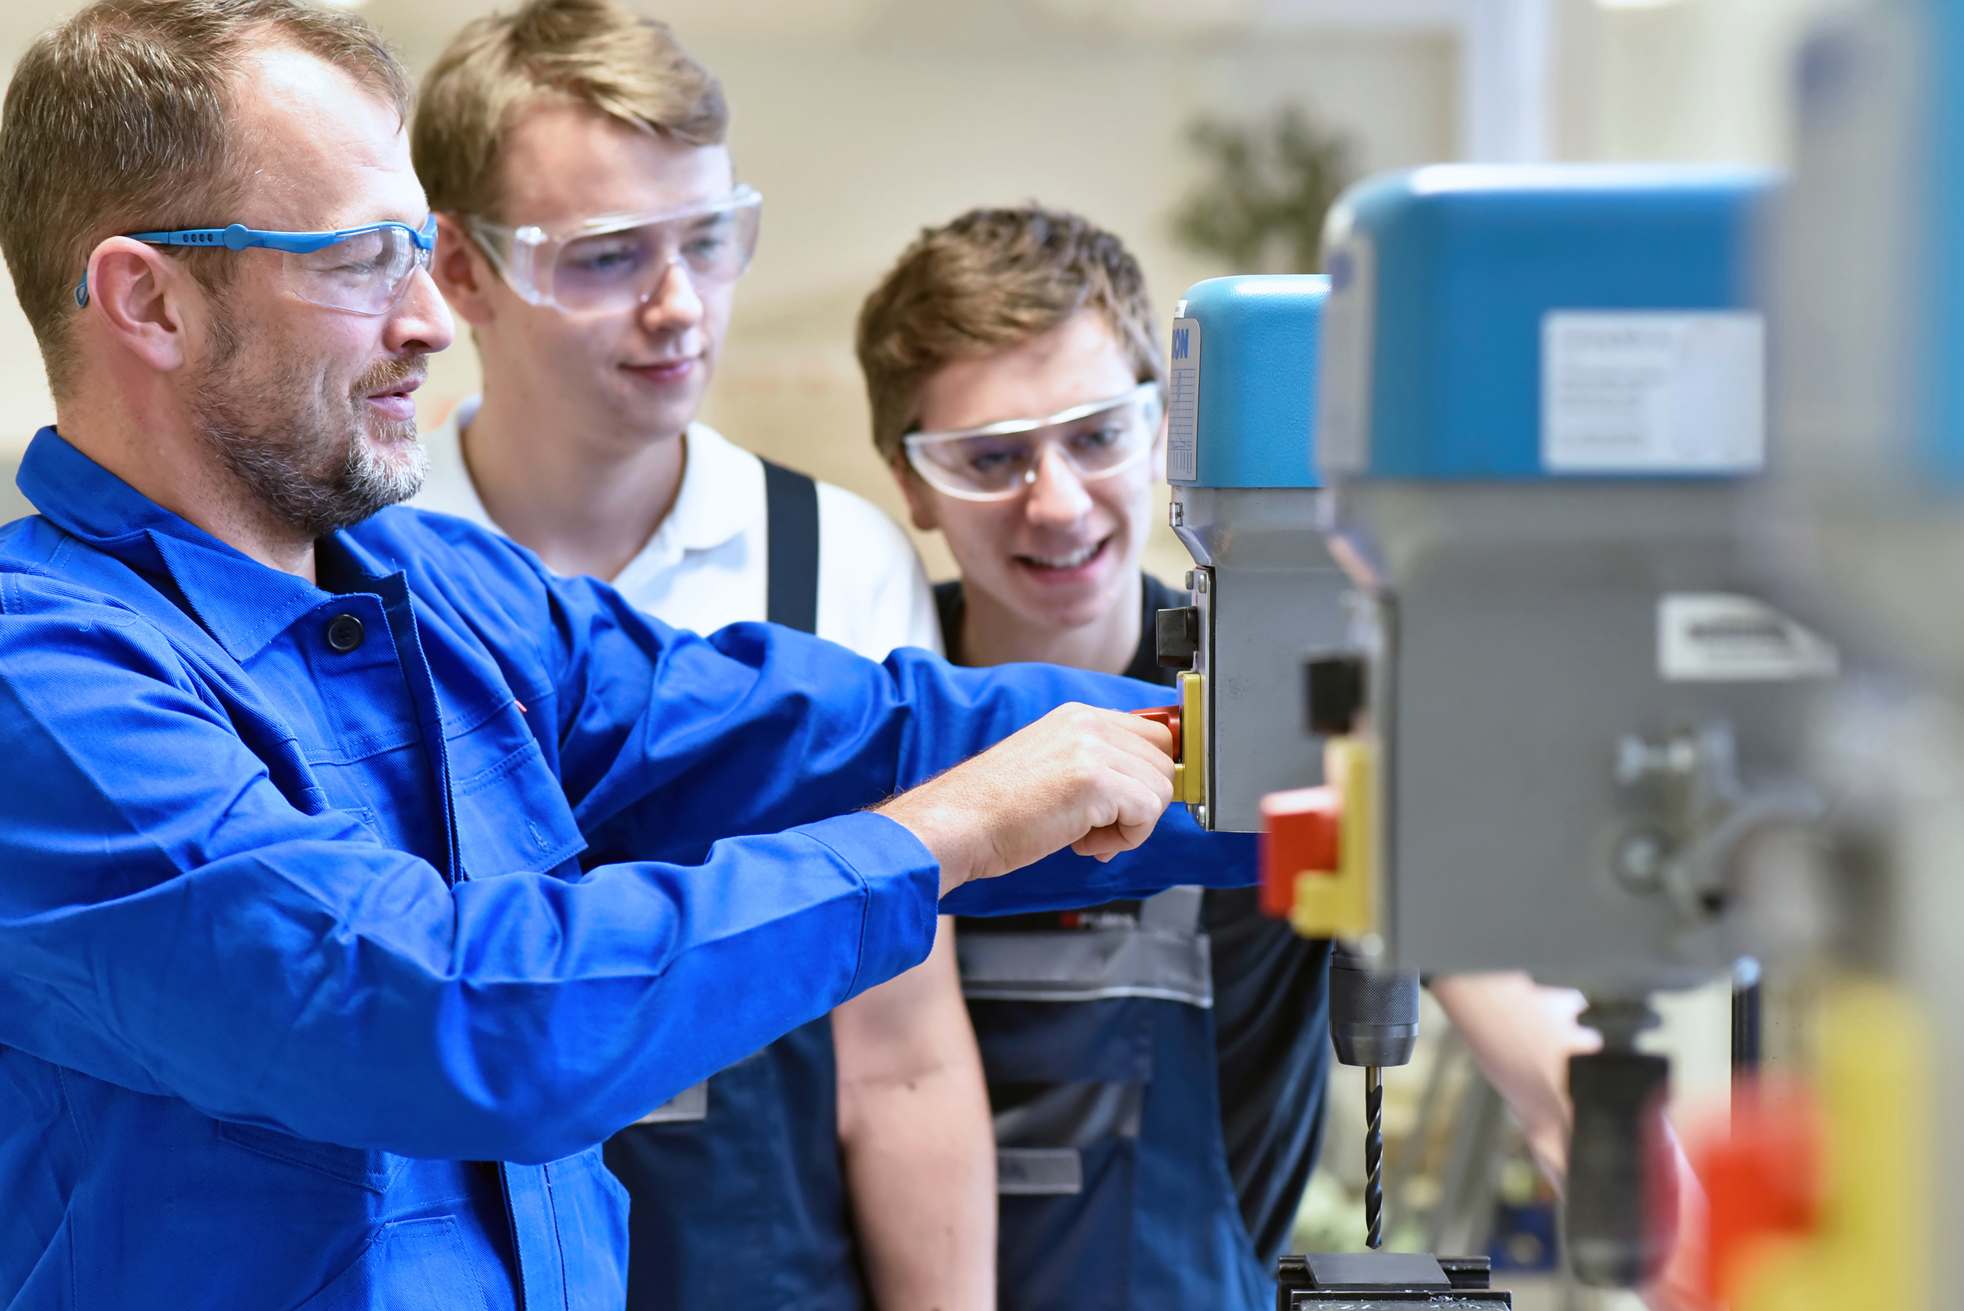
Priority of the State Board of Education:
All students will have equal access to robust career and technical education, work-based learning experiences and community college credit opportunities through an integrated system.
State recognized the need to expand, align, restructure and reform CTE in Iowa.
Moving towards a consistent and cohesive statewide system that adequately supports innovative, high-quality secondary CTE programs.
Significant reforms through HF2392 Redesign of Secondary CTE & Perkins V State Plan as a roadmap for implementation.
Goal: Consistent & equitable access high-quality CTE globally competitive programs comprehensive career pathway system explore and pursue career and college opportunities.
IOWA DEPARTMENT OF EDUCATION

Slide 3
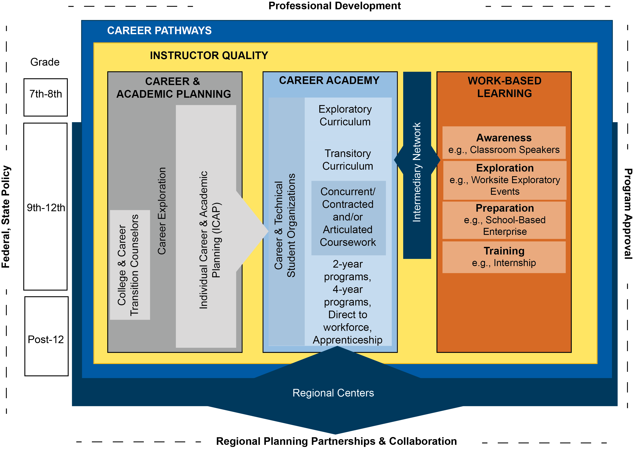
Cohesive CTE System: ALL learners can flow seamlessly to the right program at the right time, with the necessary skills needed on their path to a career.
IOWA DEPARTMENT OF EDUCATION

Slide 4
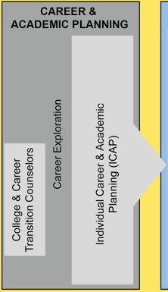
Foundational aspect of system rooted in career exploration and academic planning to support an early pathway into CTE.
Too often career exploration & academic planning activities were a “check-the-box” exercise.
IDOE: Taking a more holistic and meaningful approach integration of high-quality, high-value, career-related experiences through a variety of opportunities available to students.
Individual Career & Academic Plan (ICAP): Requirement for work-based learning (WBL) and Free Application for Federal Student Aid (FAFSA).
WBL incorporates the identifications of WBL experiences to support students postsecondary education or training and career options.
FAFSA process for advising students on FAFSA completion prior to graduation.
Cohesive CTE System
IOWA DEPARTMENT OF EDUCATION

Slide 5
Over 30 CCTCs 10 Community Colleges 60 High Schools
College & Career Transition Counselors (CCTC)
As Iowa continues to prepare high school students to be college and career ready, the support provided through Iowa’s current CCTC model has helped provide high school juniors and seniors with the additional career-based services needed to be successful after high school graduation.
Des Moines Area Community College:
AY2022 – 7 CCTCs – 13 districts
AY2023 – 9 CCTCs + 1 – 15 districts
CCTC Impact:
AY22 – Served 1,610 students (1,104 seniors)
Each student met with a CCTC on average 3.6 times during the year
95% of the contacts were in person.
CCTCs STATEWIDE
“We were excited to be able to support our local school districts in a new way. We have been able to expand our partnerships and support the high school counseling teams in a way we haven’t been able to in the past”
-Gail Zehr, District Coordinator of College & Careers Transition
IOWA DEPARTMENT OF EDUCATION

Slide 6
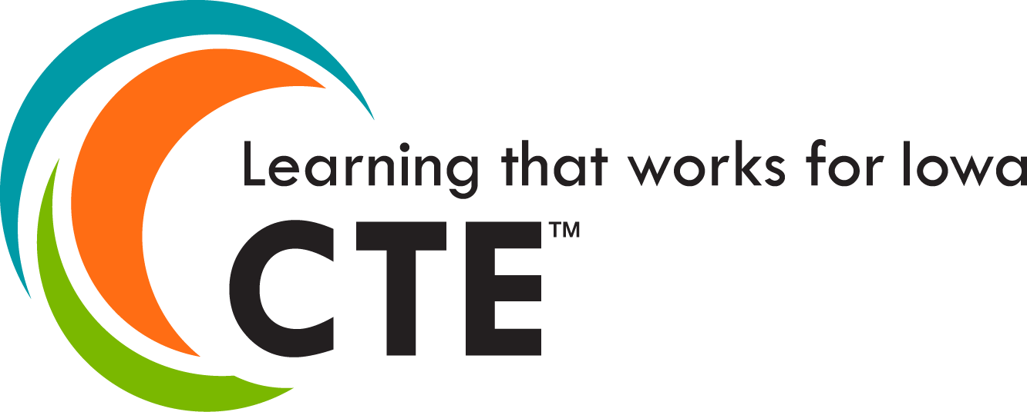
Cohesive CTE System
Overview of Secondary CTE Programs
CTE programs across the state provide high-quality, integrated programming comprised of secondary exploratory and transitory coursework to prepare students for higher-level, specialized academic and technical training using State Board of Education adopted CTE standards.
Six Broad Service Areas/Career Pathways Programs offered provide clear and consistent foundational expectations for what students need to learn in high-quality CTE programs across the state.
CTE Programming = 12 units of coursework within 4 of the 6 CTE service areas.
Self-study program review and approval process ensures programs are relevant, safe, and responsive to the needs of students and the state’s labor market needs.
Instructor-driven, focused on continuous improvement, and promotes collaboration
Focused Goal: High-quality CTE programming, emphasizing quality, sequenced secondary CTE programs that align to numerous postsecondary opportunities, through greater access to more and intentional use of concurrent enrollment and Career Academies.
Agriculture, Food & Natural Resources
Information Solutions
Applied Science, Technology, Engineering, and Manufacturing
Health Sciences
Human Services
Business, Finance, Marketing and Mgt.
IOWA DEPARTMENT OF EDUCATION

Slide 7
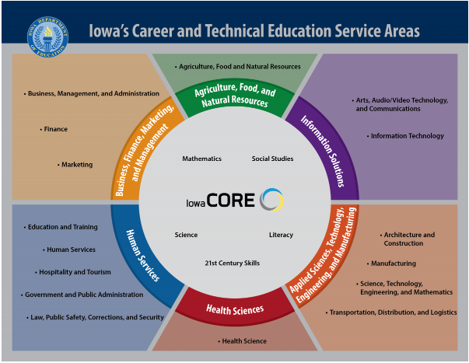
CTE Career Pathways
Snapshot of the Data in CTE
Statewide 100,044 high school students in CTE
70% participation 9-12
School district CTE programs: avg. 6 (5.9 AY21)
Statewide CTE programs: 1,738
ASTEM (559)
Human Services (368)
Business, Finance, Marketing (323)
Agriculture (259)
Health Sciences (144)
Information Solutions (85)
CTE courses: avg. 38
Upward trend: 29.7% were college credit
Close to a 33% increase over the
past 5 years
IOWA DEPARTMENT OF EDUCATION

Slide 8
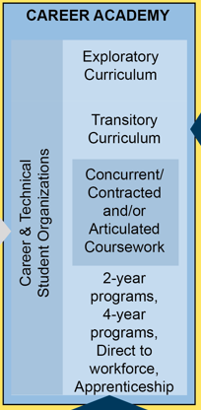
Cohesive CTE System
A Model CTE Program: The Career Academy
A model CTE program starts with strong CTE offerings and career exploration and development activities beginning in the middle grades that allow all students to explore and identify their interests, set career and college goals, and develop academic plans that help position the student to successfully achieve those goals.
1) access to an array of secondary CTE offerings
2) start with broad concepts and skills that progress in specificity toward targeted training opportunities within a given industry
A detailed program model “The Career Academy” CTE Redesign Efforts/HF2392
Built on the program of study & integrated into the program approval process
The Career Academy integrates several Iowa-specific programs and initiatives
ICAP, WBL, Industry Standards, Concurrent Enrollment…and more.
Flexibility of the delivery system
Regional Center, High School, High School (shared), Community College
Career Academies are an Invaluable Experience!
"The Business Academy definitely assured me that I wanted to study business.
Once I realized what classes I enjoyed it was very easy to explore careers related
to those classes, specifically business and accounting.” – Brooke Stout, WHS 2018
A CTE program must meet specific requirements outlined in IAC 281-46.11 to be designated as a Career Academy
IOWA DEPARTMENT OF EDUCATION

Slide 9
Cohesive CTE System ALL learners can flow seamlessly to the right program at the right time, with the necessary skills needed on their path to a career.
Regional Planning Partnerships “RPPs”
Aligned to Iowa’s 15 Community Colleges to support school districts in developing the best approaches for delivering high-quality CTE and expanding college credit opportunities for high school students.
Key Functions:
Promote college & career readiness
Promote high-quality integrated CTE programs
Promote the continuum of WBL experience
Promote CTE alignment with regional workforce needs
Coordinate local and/or regional advisory councils
Provide for increased and equitable access to high-quality CTE Career Academy Programs through the planning and development of a system of Regional Centers.
…..the key to RPP success is collaboration and having strong membership. Things such as professional development, training and equipment upgrades may sound small, but they can add up to make a large impact on today’s CTE students and tomorrow’s future skilled workforce. – Marta Brooks, Coordinator RPP 9 & Murray Fenn, Coordinator RPPs 13 and 14.
Community College
School Districts
AEA’s
Business & Industry
Economic & Workforce Development
Intermediaries
Educators
Support delivery of CTE
IOWA DEPARTMENT OF EDUCATION

Slide 10
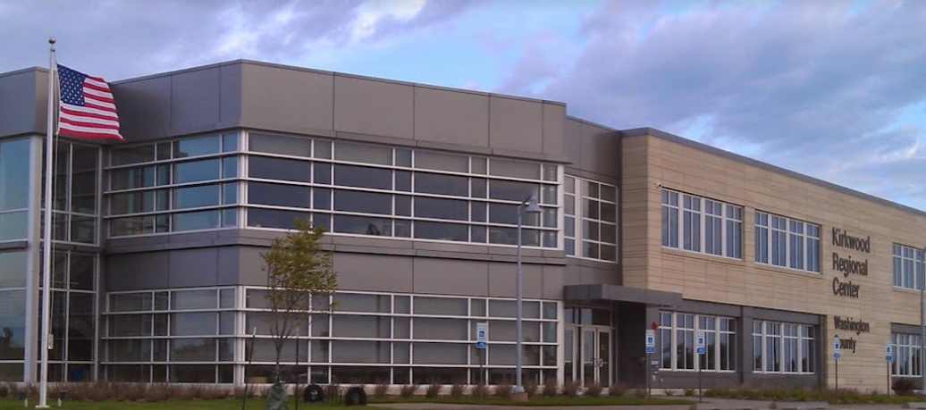
22 in operation Fall 22’ 5 will open in the next few years Served close to 22,500 high school students (2017-2022) 125 school districts served 170 Career Academies (AY21)
Regional Centers
A “facility” or “place” that primarily delivers high-quality CTE programming to high school students and these programs are commonly referred to as Career Academies.
Regional Centers are an effective means of delivering high-quality advanced Career Academy programs – and are making an impact on area high school students and their future career path!
Priority of Kirkwood Community College Regional Centers Embedding industry recognized credentials into CTE programs as part of the Career Academy experience 800 certifications and/or industry recognized credentials (AY22).
Student found his career path through the Automotive Technology Career Academy!
Place matters when delivering high-quality CTE Career Academies maximize impact of regional planning and collaboration through Regional Centers, schools can provide access to modern CTE programs.
STATEWIDE REGIONAL CENTERS
IOWA DEPARTMENT OF EDUCATION

Slide 11
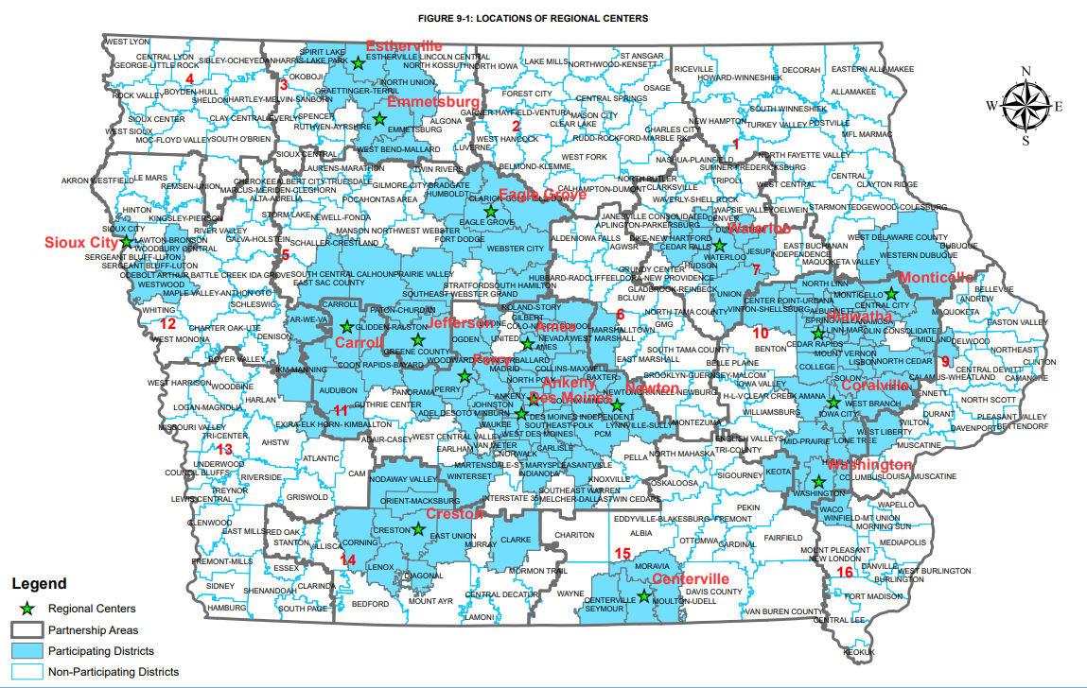
Cohesive CTE System RPPs plan for the strategic development of regional centers with the purpose of achieving equitable access to high-quality CTE and concurrent enrollment opportunities for all students.
Regional Center Site Location Study
Study conducted in an effort to support and show institutional partners – Community Colleges, School Districts, RPPs – What a strategically designed network of regional center facilities could look like within a given region as well as statewide.
IOWA DEPARTMENT OF EDUCATION

Slide 12
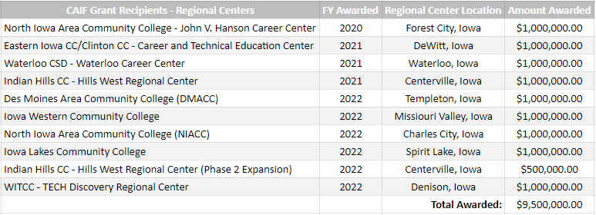
Cohesive CTE System ALL learners can flow seamlessly to the right program at the right time, with the necessary skills needed on their path to a care *Established in 2019 through the reauthorization of the Secure an Advanced Vision for Education (SAVE) fund that extends a statewide penny tax for school infrastructure through 2051.
Career Academy Incentive Fund (CAIF)
Effort to support the state priority of supporting high-quality CTE programming, expanding Career Academies, and the development of Regional Centers – the CAIF was established in 2019.
Provides competitive grants to Iowa School Districts and Community Colleges that team up together to expand Career Academies that meet the needs of local business and industry, communities and schools.
CAIF provides targeted grants of up to $1 million to support partnerships focus on Regional Centers, but open to other projects that plan for high-quality CTE Career Academy programming.
$9.5 million awarded (10 grants) Impacted 54 districts Expand access to 65 Career Academies
IOWA DEPARTMENT OF EDUCATION

Slide 13
Cohesive CTE System ALL learners can flow seamlessly to the right program at the right time, with the necessary skills needed on their path to a career.
IOWA DEPARTMENT OF EDUCATION

Slide 14
DIVISION OF COMMUNITY COLLEGES & WORKFORCE PREPARATION Jen Rathje, Consultant jennifer.rathje@iowa.gov 515.326.5389
Statewide Impact with a Future Focus

